Slide 1
Thinking sideways
Exercises in Divergent Thinking
Ronanda Liberty
July 2024

Slide 2
Who’s got the best life?

Slide 3
About the presenter
Ronanda Liberty, 20 Year Educator
B.A. Elementary Ed
EdM Literacy Development
Principal-North Franklin School District; Junior High (Refreshed)
Instructor-Walla Walla Community College/Coyote Ridge Corrections & Washington State University College of Education
Speaker- Sharing cool stuff and providing tools and support to engage learners and calm classrooms
Mom-Amazing Adultlets and an animal Menagerie

Slide 4
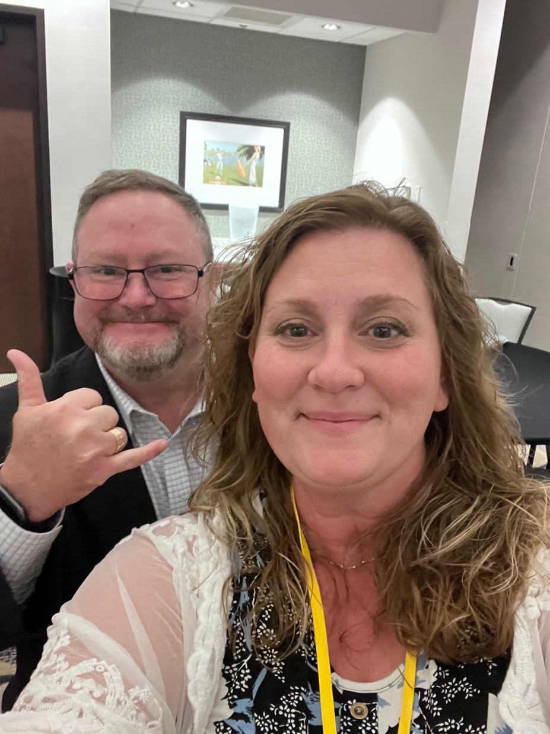
Learning Tools

Slide 5
Session Goals
Have fun and experience first hand
General examples
Process
Content specific examples
Apply to your practice
Share
Facilitate the experience for others

Slide 6

What just happened?
Let’s take a deeper look…

Slide 7
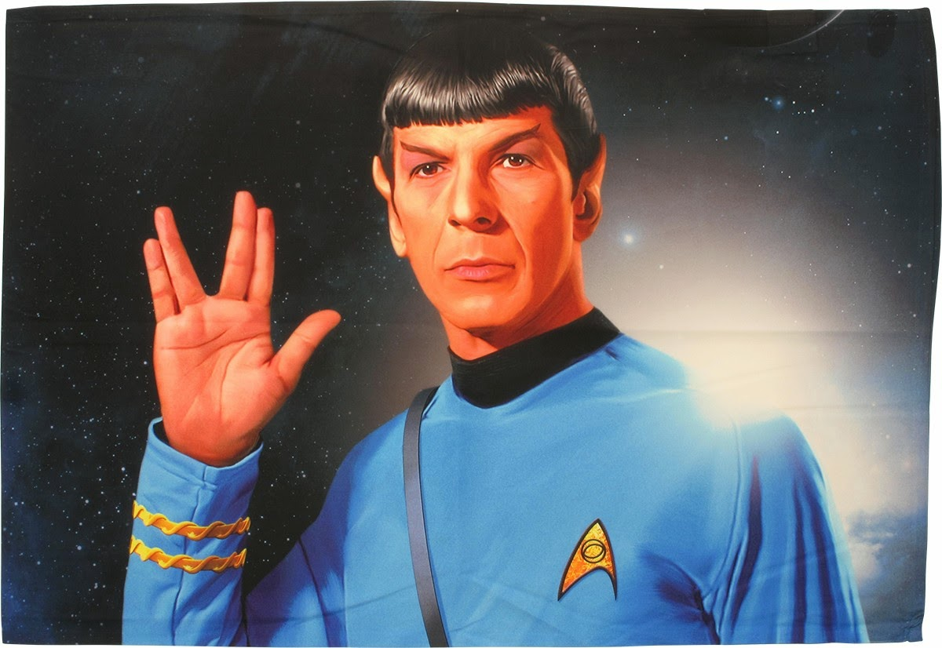
Scenario
Aliens have made contact with Earth and a meeting has been arranged. You have been charged to decide WHO is going to meet with the aliens, and ONE GIFT you will send.
WHO and WHAT are you sending?
Explain the reasoning for your choices.
This Photo by Unknown Author is licensed under CC BY-NC-ND

Slide 8
Embrace the power of relevancy
Foster engagement of personal reference and relevancy…
Childhood Culture
Job experience Pop culture/canon
Travel Family dynamics
Personality Talent
Hardships Expertise
...

Slide 9
Level it up with context
Put the scenario in a specific frame of reference…
Psychology Engineering
History Sociology
Economics Mathematics
Culinary Arts …

Slide 10
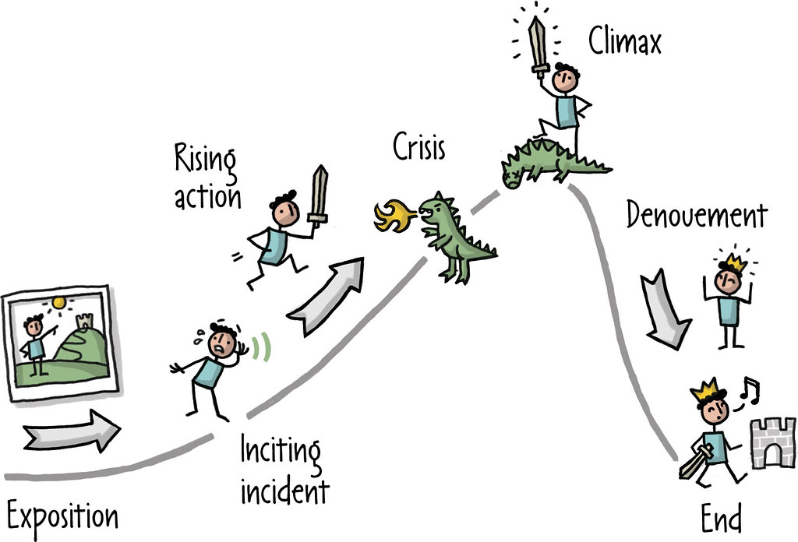
English Language arts
https://www.flickr.com/photos/rosenfeldmedia/25698275295
This Photo by Unknown Author is licensed under CC BY

Slide 11
1-Minute Story
__________
Character
__________
Character
Climax
__________
Situation
Rising Action
Falling Action
Exposition
Resolution
Tell the whole 1 minute story

Slide 12
pick an element
Exposition (setting (time/place/mood)
Rising action (events that move story)
Climax (the moment you can’t come back from)
Falling action (events that wrap up loose ends)
Resolution (how it ends)
Climax
Rising Action
Falling Action
Exposition
Resolution

Slide 13
Assessment
Practice
Creative thinking
Group bonding/dynamic strengthening
Brain breaks
Variations of Use

Slide 14
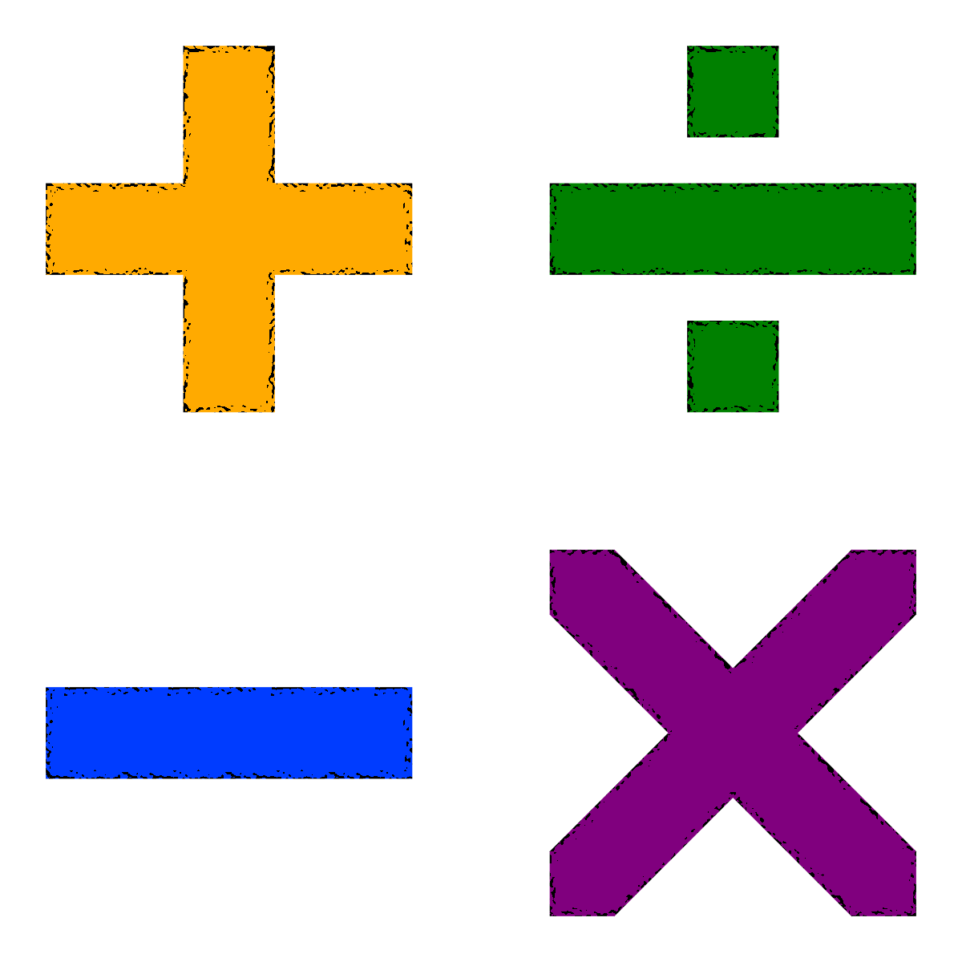
Math The missing operation
This Photo by Unknown Author is licensed under CC BY-SA

Slide 15
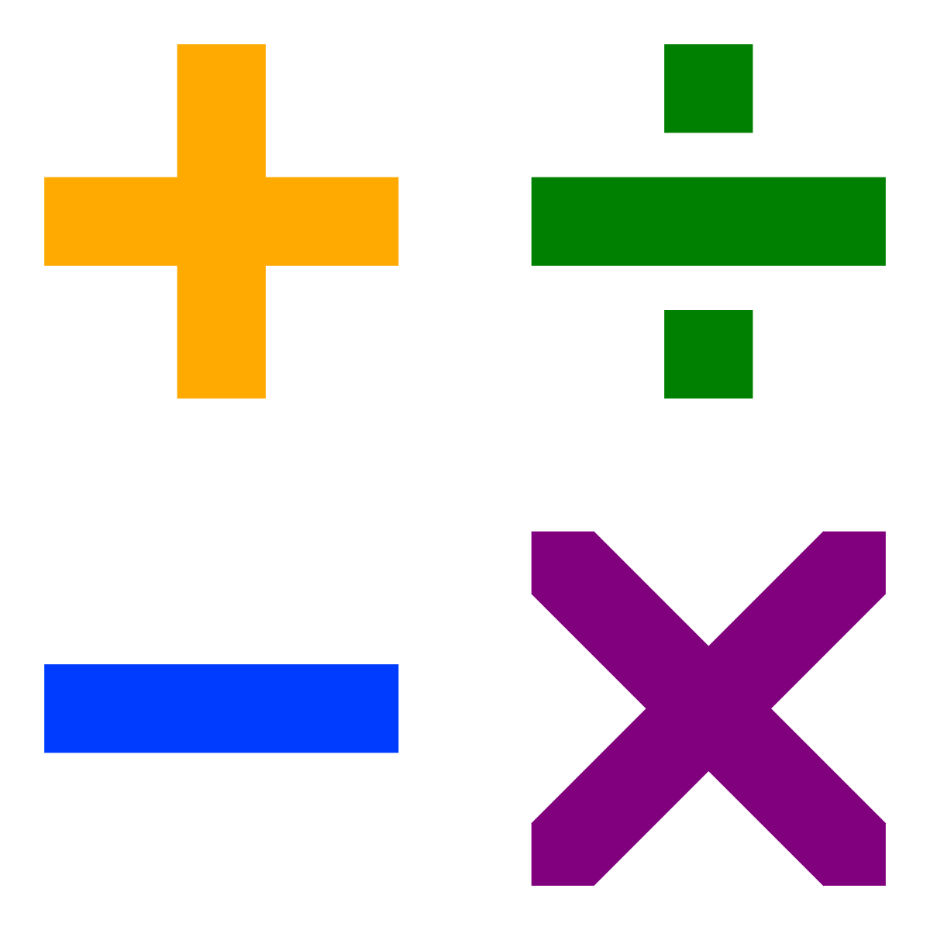
Imagine a world where only three of the four basic math operations could exist.
Which one should go?
Math The missing operation
This Photo by Unknown Author is licensed under CC BY-SA

Slide 16

Applied From your perspective…

Slide 17

Collaborative image

Slide 18

A little help from
This Photo by Unknown Author is licensed under CC BY-NC-ND

Slide 19
Please keep in touch
Ronanda Liberty
509-280-1212
ronanda@libertytolearn.education

