Slide 1

Trauma-Informed Teaching Approaches
Empathetic Andragogy
Laura Shi
Educator Support Specialist
Notes:
TIPS TItle Slide Option 3

Slide 2
Trauma & Adult Learners: defining the terms
Trauma: a deeply distressing or disturbing experience; can be physical, mental, and/or emotional.
Notes:
TIPS Intro Slide Option 1

Slide 3
Jane Leavy
“Trauma fractures comprehension as a pebble shatters a windshield. The wound at the site of impact spreads across the field of vision, obscuring reality and challenging belief.”
Notes:
TIPS Quote Slide Option 1

Slide 4
Key themes
Violence
(Former) Incarceration
Oppression & discrimination
Poverty
Refugee experiences
Veteran experiences
Foster care/child welfare experiences
Learning differences
Notes:
TWEED/TIPS Body Slide Option 1

Slide 5
Trauma & Adult Learners: defining the terms
Trauma Informed Instruction: an understanding of how trauma can impact learning and behavior; reflecting on and implementing teaching practices to better support students who have experienced trauma.
Notes:
TIPS Intro Slide Option 1

Slide 6

TRAUMA AND ADULT LEARNERS: What do we know?
Trauma can impact body and brain.
Trauma limits the capacity to learn.
Trauma is invisible.
Trauma does not “go away”.
Trauma is universal.
Notes:
TWEED/TIPS Body Slide Option 2

Slide 7

TRAUMA AND ADULT LEARNERS: what else?
Trauma cannot be erased, but it can be addressed.
Trauma informed instruction requires SEL (social and emotional learning) strategies.
Notes:
TWEED/TIPS Body Slide Option 2

Slide 8
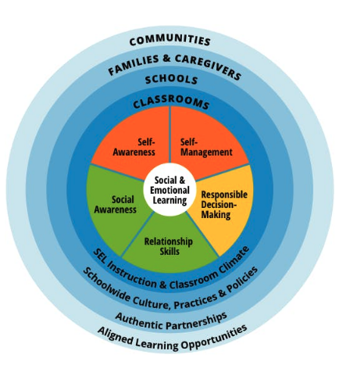
Social and emotional learning strategies
SEQUENCED: connected and coordinated activities
ACTIVE: employ active forms of learning
FOCUSED: dedicated time and attention
EXPLICIT: target specific social & emotional skills
Notes:
TWEED/TIPS Body Slide Option 2

Slide 9
Peter A. Levine
“Trauma is a fact of life. It does not, however, have to be a life sentence.”
Notes:
TIPS Quote Slide Option 1

Slide 10
Trauma-Informed Instruction should…
Be proactive, not reactivate
Focus on strengths
Intentionally target new skills
Have an awareness of triggers and alternative approaches
Provide resources
Notes:
TIPS Intro Slide Option 1

Slide 11
Trauma-Informed Instruction should not…
Be ignored
Require instructors to be counselors
Sacrifice accountability
Focus exclusively on student trauma
Notes:
TIPS Intro Slide Option 1

Slide 12
What can we do?
Better understand trauma
Learn more about and from students
Build relationships
Prioritize brain primers
Cultivate a safe environment
Pursue full team buy-in
Expand onboarding and intake
Notes:
TIPS Body Slide Option 1

Slide 13
Summary
Trauma is invisible, misunderstood, and ever present.
Trauma cannot be erased, but it can be addressed.
Trauma is universal. Reflect and support.
Trauma thrives in assumption. Learn, acknowledge, and act.
Trauma-informed instruction is vital to supporting adult learners.
Notes:
TIPS Closing Slide Option 1

Slide 14



Support from essential Education
3D Differentiation Guide
6 Anchors of Student Retention
Mastery Learning
Notes:
TWEED/TIPS Resources Slide Option 2

Slide 15
Thank You
Notes:
TWEED/TIPS Thank You Slide Option 1

