Slide 1
Guidance webinar
Reporting requirements for BEdA
September 22nd, 2023
9:00 – 10:00am

Slide 2
Welcome & introductions
Troy Goracke
Scott Toscano
Denise Costello
William Durden

Slide 3
Webinar overview
Purpose
Reporting Career & Training Services
Completing the Federal Financial Report (FFR)

Slide 4
Purpose for the webinar
Clarify definitions of required reporting components
Review and explain FFR requirements
Answer and collect questions on federal reporting
Fulfill portions of SBCTC/BEdA Federal CAP

Slide 5
Career & Training Services
An overview of reporting requirements
Scott Toscano, BEdA Program Administrator
Notes:
Slide 5
Welcome! This section will provide you an overview of federally required data collection and reporting requirements for Career Services and Training Services for Title II providers or our state’s Basic Education for Adults (BEdA) programs. I’m Scott Toscano, a BEdA Program Administrator. Together, we will review these new rules and give examples to help illustrate how to apply them. These requirements are described in the BEdA Reporting Requirements for Career and Training Services portion of the BEdA Handbook Local BEdA Reporting and Compliance page. Lastly, I want to mention that we are available for questions by phone or email and you can find our contact information on the last slide of this presentation. Ok, let’s get started!

Slide 6
Beda handbook
Notes:
https://www.sbctc.edu/colleges-staff/programs-services/basic-education-for-adults/beda-handbook/local-reporting

Slide 7
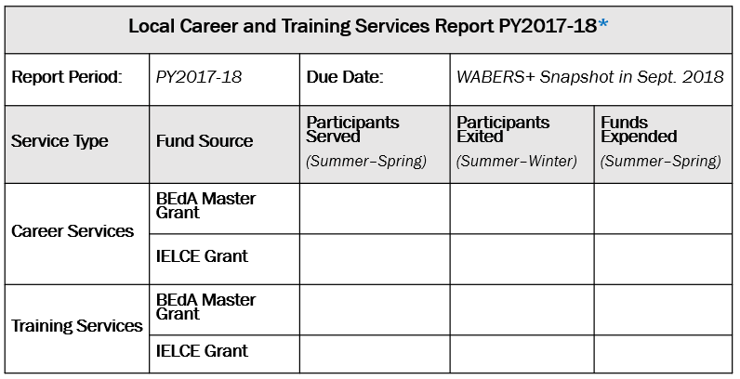
Reporting Template
If no federal dollars were spent on these services, report zero in every category.
*Report will be available in WABERS+ beginning in July 2018.
Notes:
Slide 2 – Reporting Template
This slide shows the reporting template for Career and Training Services. By looking at this template, we can see the various reporting categories. The first row is the title. The second row from the top shows the Report Period and Due Date. The next row down with the grey shading contains column headings for the cells below. Service Type includes Career Services and Training Services. Fund Source includes BEdA Master Grant and IELCE Grant (English Literacy and Civics Education) for each of the Service Types. Participants Served, Participants Exited, and Funds Expended includes each Service Type and Fund Source. Participants Served are counted for the entire program year. Participants Exited are counted between summer and winter. Funds Expended are counted for the entire program year.
We’ll go into the specific requirements on the next slide so let’s take this time to talk about the report timing will work.
It is currently being programmed and tested in the WABERS+ (Washington Adult Basic Education Reporting System Plus) Development Site. The report worksheet will go live in the WABERS+ application with the launch of the new WABERS+ programming for program year 2018-19 on or about July 16. It will remain open for editing until the reporting deadline which is currently estimated to be September 6. This is the WABERS+ summer snapshot date that has yet to be finalized by Data Services. So, basically, this means the report will be available for most of the summer quarter.
The time period this report covers is the previous program year, so program year 2017-18, in which we are currently operating. That means it is important to act on this information immediately and determine if your federal dollars are being spent on these services. Once you know that, you will be able to figure out your data collection and tracking needs. It is essential for you to understand that if no federal dollars were spent on these services, you will report zero in every category. Once the reporting period closes and the snapshot is taken, the report will be available as a view only document in WABERS+.
Now, let’s get into the specifics about Career and Training Services requirements.

Slide 8
BEdA Reporting Requirements for Career and Training Services
If no federal dollars were spent on these services, report zero in every category.
BEdA programs will report Participant counts and AEFLA funds expended on career and training services
Applies to federal AEFLA funds only
Expended from BEdA Master Grant
Expended from IELCE Grant
Applies to program costs only, do not include administrative costs
Notes:
Slide 3 - BEdA Reporting Requirements for Career and Training Services
The Workforce Innovation and Opportunity Act (WIOA) section 116(d)(2) requires Title II providers to report “the average cost per participant of those participants who received career and training services” paid for with federal AEFLA (Adult Education and Family Literacy Act)
funds. That means dollars from your BEdA Master Grant and the IELCE Grant that are spent on these services. It’s important to note here that this does NOT include administrative costs, only program costs.
Let me also repeat what I said on the last slide so we all are clear – It is essential for you to understand that if no federal dollars were spent on these services, you will report zero in every category.
Now, let’s review the activities that count as Career Services activities and Training Services and how they are defined by the Office of Career, Technical, and Adult Education (OCTAE). This is the federal agency that issues guidance to Title II programs.

Slide 9
Career & training Services activities
If no federal dollars were spent on these services, report zero in every category.
Career Services Activities
Training Services Activities
Outreach, intake, and orientation
Initial assessment (pretest)
Referrals and coordination with other programs and services
Provision of performance information and program cost information
Provision of information on availability of supportive services or assistance and appropriate referrals
Training component (the workforce content elements: e.g., welding, NAC, etc.) of Integrated Education and Training (IET) programs (stand-alone IET or part of I-BEST and IELCE programs)
Notes:
Slide 4 – Career & Training Services Activities
OCTAE Program Memo 17-2 classifies career and training services as including the following activities:
Career Services Applicable to AEFLA
Outreach, intake, and orientation to Title II programs
Initial assessment (pre-test) [not post-tests]
Referrals and coordination with other programs and services
Provision of performance information and program cost information on eligible providers of education, training, and workforce services by program and type of provider
Provision of information on availability of supportive services or assistance and appropriate referrals (including child care; child support; medical or child health assistance available through the State’s Medicaid program and Children's Health Insurance Program (CHIP); Supplemental Nutrition Assistance Program (SNAP) benefits; Earned Income Tax Credit (EITC); assistance under Temporary Assistance for Needy Families (TANF), and other supportive services and transportation)
Training Services Applicable to AEFLA
Training component (the workforce content elements: e.g., welding, Nursing Assistant Certified (NAC), etc.) of Integrated Education and Training (IET) programs (stand-alone IET or part of I-BEST [Integrated Basic Education and Skills Training] and IELCE programs)
Let me also repeat what I said on the previous two slides so we all are clear – It is essential for you to understand that if no federal dollars were spent on these services, you will report zero in every category. This is something you’ll need to work with your business office to figure out.
Now, let’s talk about Career Services costs and Training Services costs and what kind of tracking is necessary if you are spending your federal dollars on them.

Slide 10
Career Services costs
If no federal dollars were spent on these services, report zero in every category.
Funds Expended – Report any and only federal dollars spent on the career services.
Participants Served – Report the total number of Participants with complete data during the program year (Exclude Reportable Individuals).
Participants Exited – Report the number of Participants who Exited the program by the end of winter quarter.
Notes:
Slide 5 - Career Services Costs
First we’ll talk about Career Services costs. These are program costs, not administrative costs, where federal dollars from your BEdA Master Grant or IELCE Grant were used on the activities previously identified as Career Services, such as intake and orientation, pre-tests, etc.
As we discuss these reporting requirements, refer back to the Career and Training Services Report Template. If you used federal dollars from one of those grants on any of those Career Services, you will need to track the number of Participants served. Recall that a Participant refers to individuals who earn at least twelve (12) attendance hours in a Period of Participation. You will not count anyone with less than twelve hours. All counts of ‘Participants Served’ represent a program year and will be reported based on the grant funds that were used to serve them. This means you can have Participants Served under the BEdA Master Grant and a separate unduplicated count of Participants Served under the IELCE Grant. This is the center column of the Career and Training Services Report Template.
The next column over is ‘Participants Exited’. From the people counted under Participants Served, you’ll need to determine if any of them have Exited by the end of winter quarter. A count of Participants Exited between summer quarter and the end of winter quarter will be reported based on the grant funds that were used to serve them. Recall that there are separate rows for each Fund Source. This means you can have Participants Exited under the BEdA Master Grant and a separate unduplicated count of Participants Exited under the IELCE Grant. Participants Exited for spring quarter are not included in this report because the timing of this report limits our ability to determine all Participants Exited for spring quarter.
The last column is ‘Funds Expended’. You will report any and only federal Funds Expended on Career Services based on the grant funds that were used to serve them. This means you can have an amount of Funds Expended under the BEdA Master Grant and a separate amount of Funds Expended under the IELCE Grant. If no federal dollars were spent on these services, you will report zero in every category.
Next, we’ll discuss Training Services costs and what kind of tracking is necessary if you are spending your federal dollars on them.

Slide 11
training Services costs
If no federal dollars were spent on these services, report zero in every category.
Funds Expended - Report any and only federal dollars spent on the training component (workforce content elements) of an IET program.
Participants Served – Report the total number of Participants receiving the training component (workforce content elements) of IET programs that are funded by federal dollars during the program year (Include all students in IET/IELCE/I-BEST programs that are funded by federal dollars. Exclude Reportable Individuals).
Participants Exited – Report the number of Participants receiving the training component (workforce content elements) of IET programs that are funded by federal dollars who Exited the program by the end of winter quarter (Include all students in IET/IELCE/I-BEST programs that are funded by federal dollars. Exclude Reportable Individuals).
Notes:
Slide 6 - Training Services Costs
Again, as we discuss these reporting requirements, refer back to the Career and Training Services Report Template. Training Services costs are reported when federal dollars are spent on the training component of Integrated Education and Training (IET) program. This includes a stand-alone IET program or parts of I-BEST and IELCE programs. Costs can be for instruction or tools and materials. This includes the workforce content elements of workforce programs such as welding, nursing assistant, business management, early childhood education, manufacturing and machining, etc. Do not count federal dollars spent on literacy activities in support of a training component. If no federal dollars were spent on these services, you will report zero in every category.
The same Participant counting rules apply to Career Services and Training Services. To recap, that means Participants only, no one with less than twelve hours counts. Participants Exited between summer and winter quarter. And finally, you will report any and only federal Funds Expended on Training Services based on the grant funds that were used to serve them. This means you can have an amount of Funds Expended under the BEdA Master Grant and a separate amount of Funds Expended under the IELCE Grant. If no federal dollars were spent on these services, you will report zero in every category.
Let’s take one final look at the Reporting Template and then we will review any questions you entered in the chat window and solicit people to ask questions by turning on their microphones.

Slide 12
Reporting Worksheet in wabers+
If no federal dollars were spent on these services, report zero in every category.
Notes:
Slide 7 – Reporting Template
This slide shows the reporting template for Career and Training Services. By looking at this template, we can see the various reporting categories.
It shows that we will be reporting program year 2017-18 data and it will be due by the WABERS+ September snapshot. You will report Participants Served, Participants Exited, and Funds Expended on Career Services and Training Services, both broken down by the fund sources BEdA Master Grant and IELCE Grant. The report template will be available as an editable worksheet during the summer quarter and then turn into a view only document after the reporting deadline passes.

Slide 13
Completing the federal financial report (FFR)
Denise Costello, Associate Director
Notes:
Hello again, in this section we will be reviewing the Federal Financial Reports (FFR) and the Recipient Share Detail report.

Slide 14
Completing the ffr
Three forms are emailed out each year –
ABE FFR
IEL Civics FFR
Recipient Share Detail
Notes:
Three forms are emailed out each year in August. The ABE FFR is completed by every college or organization that has a BEdA Master grant. The Recipient Share Detail is also completed by each college or organization. The FFR for IEL Civics, is only completed by those institutions with an IELCE grant from SBCTC. In the next slides, we will review the forms and the directions for each set of boxes. Please note, both the FFR forms have the exact same set of boxes to be fill in.

Slide 15
Completing the ffr
Step 1 – Name and Category
Notes:
Please be sure to fill in the name of your institution and check the most appropriate category out of the list provided. If this section is not filled in, the form(s) will be returned for revision.

Slide 16
Completing the ffr
Step 2 – Non-federal Expenditures
Notes:
There is only one box to fill out for section A. This is the spot to report all non-federal spending that took place FY23 to support administrative and program costs for adult education activities (as defined in the Adult Education and Family Literacy Act). In later sections you will give more detail about this total, but in Section A you just enter the overall total for the year.

Slide 17
Completing the ffr
Step 3 – Program Income
Notes:
In section B, you will report the total amount of Program Income for the year. Program income is revenue generated from tuition and fees charged to students for the program. There is more information about Program Income on pages 14 and 15 in the Fiscal Guidelines for the BEdA Master and IELCE grants.
Please note, the box titled “Institutionalized Program Income” is NOT referring to your “institution” i.e., your college or organization, but is referring to programs serving justice-involved individuals.

Slide 18
Completing the ffr
Step 4
Notes:
As in section B, this section is referring specifically to expenditures for programs serving justice-involved individuals. Due to our state interagency agreement with the Department of Corrections and the reintroduction of Pell for corrections, we advise against the use of title ii funds for justice-involved individuals.

Slide 19
Completing the ffr
Step 5 – One-Stop Activities
Notes:
Sections D and E are for reporting expenditures for One-Stop Program Activities. In section D, please report only FEDERAL expenditures. In section E, report non-federal expenditures broken into Admin and Program specific expenditures.
*State Funding Mechanism (SFM) If the local One-Stop system cannot come to consensus on partner contributions then the Governor's office will intervene and determine the contribution
*Infrastructure Funding Agreement (IFA) is part of the local MOU and determines the contribution of each partner to the One-Stop System

Slide 20
Completing the ffr
Step 6 – Training
Notes:
Section F is new this year. Training refers to the “T” in an IET, this includes all I-BEST programs and any other IET programs. Typically, "T" would refer to the cost for the college instructor (prof/tech or academic) in an I-BEST program, or the cost for the workforce content instructor in any IET. If you do not have any training federal expenditures reported in WABERS, then you should not have any reported on the FFR.
We do not recommend spending Title II funds on the Training "T" portion of an I-BEST or IET program.

Slide 21
Completing the ffr
Step 7 – Certification
Notes:
As with the top section of the form, please make sure to fill out the certification section completely before submitting in OGMS. The form will be returned, if not filled out and signed. As a reminder, these forms are due 10/19/23

Slide 22
Completing the Recipient Share Detail
This form is intended to give more detail about the amounts you filled in on Section A of the FFR(s)
Notes:
The Recipient Share Detail is detailed break out of state matching funds - giving more information on your non-federal expenditures reported in Section A on the FFRs. On the FFRs you reported totals of non-federal spending, on the Recipient Share Detail form you will show a breakout of where the funds came from that make the total amount reported on the FFRs.

Slide 23
Completing the Recipient Share Detail
Sections highlighted in green have been pre-filled
Sections 1, 2, 4, 5 and 6
Section 3 and 10 – these sections must be filled out completely or the form will be returned for follow-up
Notes:
In the top section of the Recipient Share Detail, you will only need to fill in Box 3. If Box 3 is not filled out fully and signed, it will be returned for follow up.

Slide 24
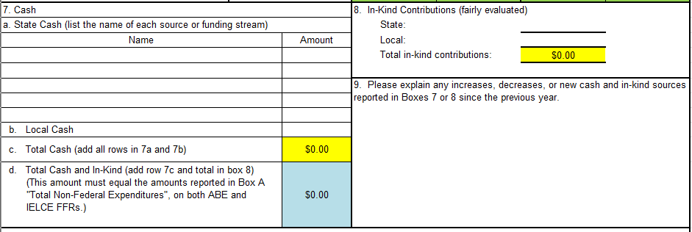
Completing the Recipient Share Detail
Box 7 – Cash
Notes:
In box 7, A -give information on the type of state cash used to support administrative and program costs for adult education activities (as defined in the Adult Education and Family Literacy Act). In part B, list the total amount of local cash used. Section C – in yellow -will auto-populate.

Slide 25
Completing the Recipient Share Detail
Box 8 – In-Kind Contributions
Notes:
In box 8 – enter any state or local in-kind contributions used to support administrative and program costs for adult education activities (as defined in the Adult Education and Family Literacy Act). The “total” line – in yellow -will auto-populate.
The two boxes in yellow will auto-populate 7d, in blue. Please note the amount in section D of box 7 must equal the amounts reported in Section A from both the ABE and IEL Civics FFRs.

Slide 26
Completing the Recipient Share Detail
Box 10 – Certifications
Notes:
Please fill out each part of the certification section. If the form is not filled out fully and signed, it will be returned for follow up.
As a reminder, these forms have already been sent out. They are submitted via upload in OGMS to your FY23 grants. They are due October 19, 2023.

Slide 27
WRAP UP
Q and A Doc, will be posted to the Federal Reports page
Career & Training Services reporting questions–
Scott Toscano, BEdA Program Administrator, stoscano@sbctc.edu
Federal Financial Reports (FFR) reporting questions–
Denise Costello, Associate Director, Fiscal Management, dcostello@sbctc.edu
Notes:
Slide 8 – Wrap Up
This is the final slide with our contact information. Now it’s time for your questions. We will start by reviewing any questions entered in the chat window and then solicit people to ask questions by turning on their microphones.
Q&A from the chat will be sent in a separate document.

