Slide 1
Building Inclusive
Advisory Committees
Lauren Hadley, Director of Workforce
lhadley@shoreline.edu
Workforce Education Council
February 29, 2024
Notes:
22 years working with Advisory Committees
7 in K-12
15 in community college
Prior to that I worked in fundraising and with volunteer boards
Like the connection with someone volunteers with the mission of an organization
Grad student at Antioch Masters in Education
Thesis – Moving from Compliance to Meaningful Engagement: Authentic Employer Partnership Through Technical Advisory Committees

Slide 2
Presentation Overview
Goals for the presentation
Brief history of industry involvement in education
Philosophy and best practices
Advisory committee best practices (handout)
Activity
Sample discussion questions from the CLNA
Review of goals
Questions
Notes:
Note: This is not rocket science, you will spend a lot of time thinking to yourself, that makes sense or that’s a good reminder and I can guarantee you will leave with at least one simple idea you can implement at your next meeting.
By implementing or reinforcing some of these best practices, you are creating that sense of belonging that welcomes all members to the table.

Slide 3
What are you hoping to get out of today’s conversation?
Notes:
Check in on goals the audience has.
(Take notes on what participants want to get out of session)

Slide 4
Benchmarks in prof-tech education
Late 1800s
The industrial revolution
1917
Smith Hughes Act
1917-1919 Charles Prosser, Commissioner for vocational education
1984
Carl D. Perkins Vocational and Applied Technology Act
Notes:
Industrial Revolution
Late 1800s manufacturing products were not matching the quality of European
Needed to develop a structure from training skilled workers
National Society for the Promotion of Industrial Education was formed, a group made up of manufacturers, educators, labor and social workers to develop industrial education and lobby for federal funding for vocational education
Smith Hughes Act
February 23, 1917 the Smith Hughes Act was signed to allow for workforce education
Charles A Prosser was the first Commissioner for Vocational Education
16 theories that provided the foundation for workforce education
Recognize and serve market demand
The only reliable source of for what training should be are those that are masters in their field
Education needs to adjust quickly to the needs of employers
Today we have the Carl D. Perkins Vocational and Applied Technology Act, originally passed in 1984 and was just reauthorized
Locally
Washington legislation – 1991
State offers guidelines on how to work with these groups
The challenge that I’ve observed because our advisory committees have these requirements, is we fall into treating these groups as compliance based bodies, and forget that these volunteers are our partners

Slide 5
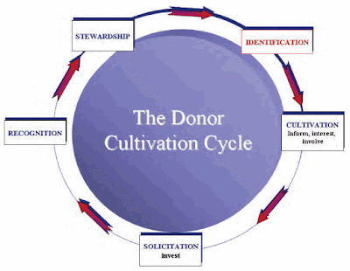
1. Identify your employer partner
2. Cultivate them – involve them in your programs
3. Solicit – ask them to give to your program
4. Recognize – don’t underestimate a certificate they can hang in their office
5. Stewardship – honor their contribution
BEGIN AGAIN! Each trip around the circle the investment grows.
Notes:
My first career was fundraising. The classic donor cycle drives my own philosophy of working with advisory committee members. As a development director, I would have killed to have such an easy way to engage my donors with my mission. Put a donor on your advisory committee and they see their impact first hand.

Slide 6
Indispensable traits of high-performance advisory committees by Scott Newman
Formal leadership structure
Careful management of members
Diversity of membership
Effective use of face-to-face time (10% rule)
Accomplish real work between meetings
Acknowledge advisors for their contributions
Extensive participation
Source: Newman, S. (2010). Indispensable Traits of High-Performance Advisory Committees. Industry and Higher Education, 24(1), 11-15.
Notes:
In my research I’ve read a lot on ways to manage advisory committees, I’ll share with you my two favorites, and some highlights on what they focused on.
Leadership structure – specifically having an industry chair that runs the meeting
Also could have a chair-elect, to allow for learning the ropes
Review agenda with the chair along with goals of the meeting/discussion
Debrief is also good for feedback loop –
Membership management
Identifying members – ask who needs to be at the table
Set expectations – let them know what they are committing to
Terms of service – sets the expectation, also allows for new perspectives and a way to rotate members off the committee, I use this for expectations, we’d like you to consider a two-year commitment.
Diversity of members – diversity of industries and size of companies
Use face-to-face time for discussion
10% rule – college only talks for 10% of the time, I myself use 20% our job is to listen
Think too about using surveys to gather information instead of taking up discussion time
Set standard meeting times, or set schedule for the year – many members like an Outlook Meeting Request so it is on their calendar
Send agendas ahead of time, consider an annotated agenda that provides context for discussion items

Slide 7
Indispensable traits of high-performance advisory committees by Scott Newman
Formal leadership structure
Careful management of members
Diversity of membership
Effective use of face-to-face time (10% rule)
Accomplish real work between meetings
Acknowledge advisors for their contributions
Extensive participation
Source: Newman, S. (2010). Indispensable Traits of High-Performance Advisory Committees. Industry and Higher Education, 24(1), 11-15.
Notes:
Real work between meetings
This could be a subcommittee work or a special program request
SBST example of internship learning outcomes
If not actual work, touch base and check in
Manufacturing article mailed with thank you post-it, I received thank you emails and one from an employer that had job openings, would they have thought of us if they had not gotten communication from the college
Acknowledge contributions
Thank you to them or letter to their boss
Sometimes this can come from the college president
Some colleges do an appreciation event/dinner
Extensive participation
Professional development for students and staff (job shadow)
Presentations or tours
Help with outreach
Job fairs
Program assessment
Internship
Donations (equipment/funding/letters of support for grants)

Slide 8
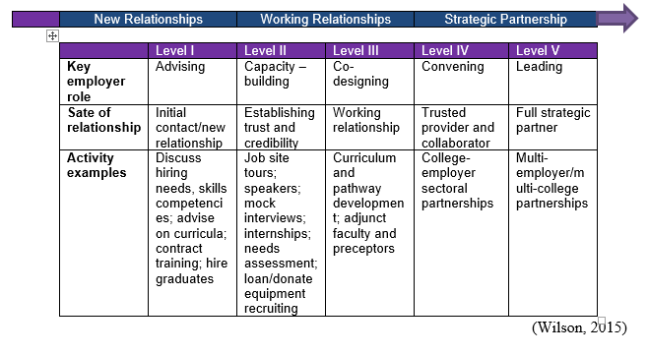
A resource guide to engaging employers by Randall Wilson
Ladder of Employer Engagement
Source: Wilson, R. (2015). A Resource Guide to Engaging Employers. Retrieved from Jobs for the Future website: http://www.jff.org/publications/resource-guide-engaging-employers
Notes:
I love the idea or growth of this model. We are all somewhere on this continuum, this gives us all validation that we are on the right track, but we have a next step and what that looks like. It’s a growth-mindset map.

Slide 9
What do advisors say?
I got involved because I was invited
Networking with colleagues
Involved because they feel they make a difference
Listen to industry
Engagement strategies
Meeting mechanics
Notes:
Because in my reading most content was provided from the education side, I decided I wanted to hear more from the volunteer side. What struck me is that my findings are very simple.
Invite them, be clear and say thank you.
I was invited - In my experience if someone likes their job, and is invited to help, they will say yes.
By staff, faculty or another industry advisory member
An invitation to everyone is an invitation to no one
Networking with colleagues – the networking that happens at our advisory meetings is better and different than with professional associations.
“Because I’m trying to improve a training program I am more open with what I share”
I can also get other business done in a side-bar with a colleague
Because they make a difference –
Provide value with a small commitment
Received Prof-tech education and it impacted their lives/careers
Contribute to the growth of students
Listen – In response to questions about what could colleges do better
When industry defines the goals, the program is stronger
Engagement strategies –
Getting to know the program – open house, tours, presentations
Engaging with students – student poster sessions, speed-dating, mock interviews
Specific impact – articulation agreements, industry overview, program review, industry certifications
Meeting mechanics –
Logistics – meeting location, times, expectations of members (role of a member and work of the committee) “I just want to know what you need”
Facilitation – Chair meets with college ahead of time, make the work or question easy to answer, too many college presentations
Communication – No Jargon, use of education language, one point of contact, check in outside of meetings

Slide 10
Creating Belongingness
Provide an orientation (1:1 is best).
Make introductions
Remember the details (i.e. nametags)
Invite participation
Intentional recruitment of members and committee chairs
Notes:
Provide and orientation –
Pre-pandemic I did these face-to-face at a location convenient to the advisor
Now more often, it is on Zoom
Provide an introductory letter, handbook, and roster of the committee
Almost all the time, they bring their packet with them, and sometimes read the entire handbook
Introductions – or even a buddy or host so the person has a connection
Details – nothing makes you feel less welcome than not feeling like you’re supposed to be there – make sure that everyone has a nametag (example: Shoreline Chamber Board – after three years, I don’t have a nametag, but other do that have been on the board a while)
Participation – Make sure that the facilitator invites everyone to give input.
Intentional Recruitment – i.e. making sure that I ask the underrepresented person to be the next chair person. I work to make a personal ask prior to the election of a chair person – again asking a group who wants to be chair is awkward, being invited to serve is an honor

Slide 11
Paired Discussion & Handout
What one thing did you hear today are you going to implement with your advisory committee work?

Slide 12
Straight from the CLNA – Element 2 – Evaluation of Student Performance
Advisory Committee Discussion Topics
2.B Where are the biggest gaps in Perkins Performance Indicators among student demographic subgroups? What strategies might narrow this gap?
2.C Where are the biggest gaps in Perkins Performance Indicators among Perkins special populations? What strategies might narrow this gap?
2.D In which CTE programs is the enrollment of one gender over 75% of the total program enrollment? Where there are program disparities in performance in 3P1, what is being done to address them?

Slide 13
Straight from the CLNA – Element 3 – Evaluation of CTE Programs
Advisory Committee Discussion Topics
3.B Which programs do not yet incorporate current industry standard equipment, appropriate classroom, and laboratory space, and/or quality instructional materials?
3.C How does the institution or district partner with stakeholders to ensure program alignment to workforce needs?
3.D What strategies are in place to recruit and retain employers participating in work-based learning? What should be added?
3.E How is the institution or district evaluating employer satisfaction with the learners they supervise and the quality of the work-based learning experiences? How are program outcomes met and/or reinforced by work-based learning activities?
3.F Does the institution have adequate CTE program design? Indicators include growing and sustainable enrollment, meaningful programs of study, articulation agreements, sequenced progression of courses within program area, meaningful credentials, and program evaluation.

Slide 14
Straight from the CLNA – Element 5
Advisory Committee Discussion Topics
5.B What processes are in place to recruit new CTE educators who reflect your student population?
5.C What strategies are used to support the retention of high-quality CTE educators?

Slide 15
Further questions or thoughts?

Slide 16
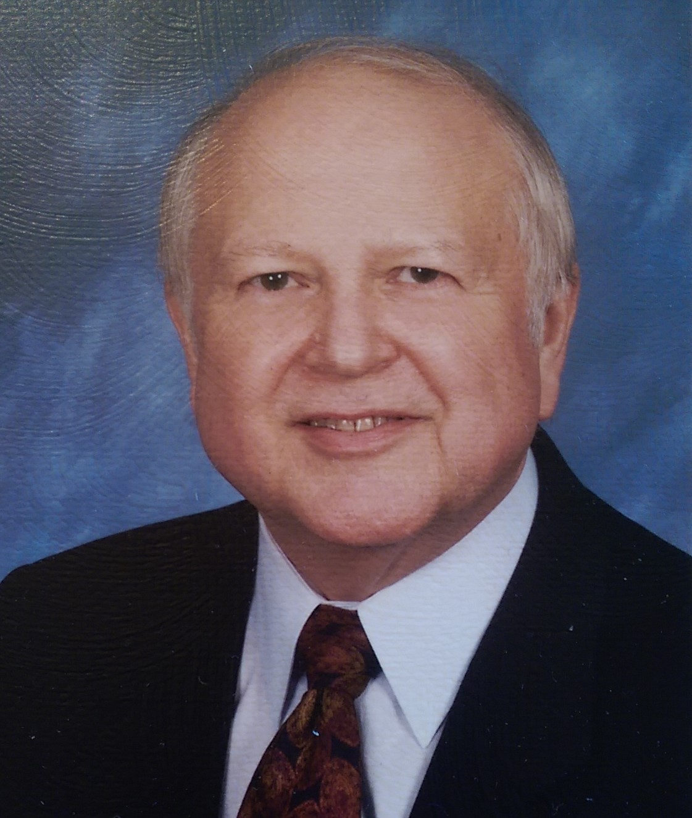
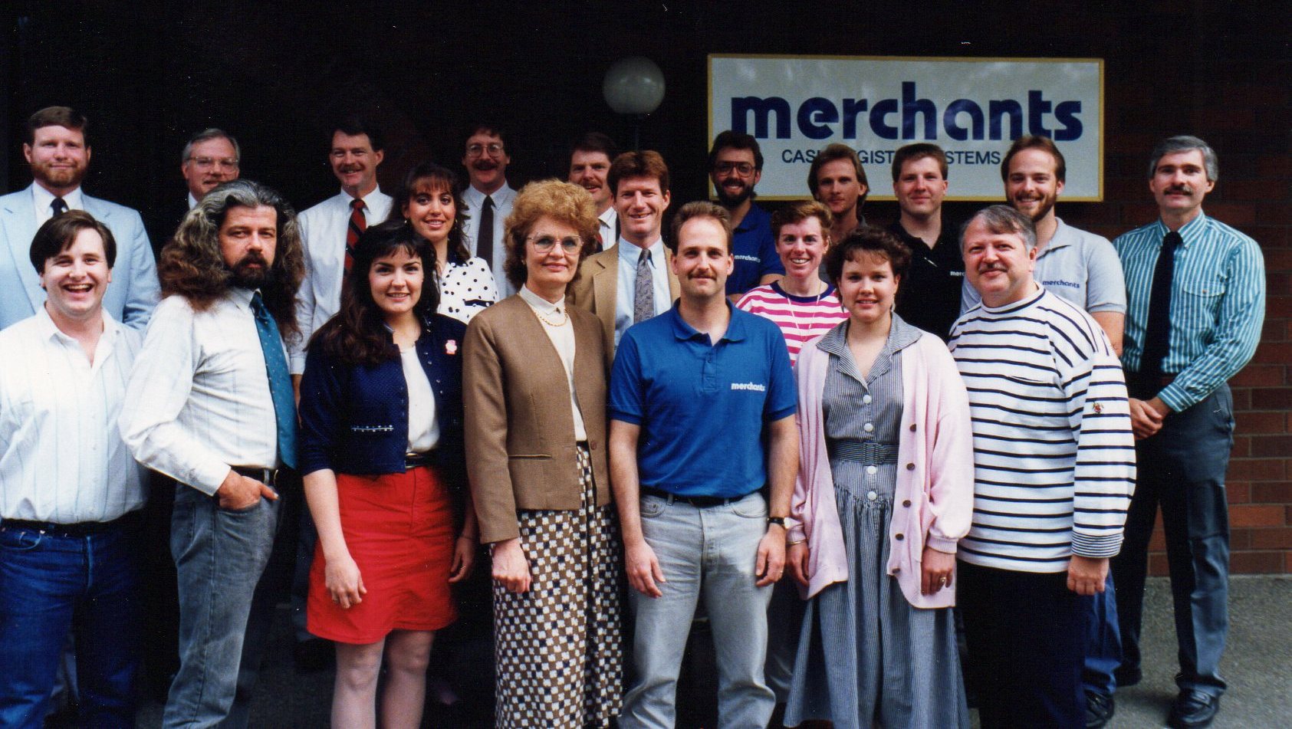
They could be talking about us in 25 years.

