Slide 1
Guided Pathways Planning Webinar
Monica Wilson, Director, Student Success Center
November 2025

Slide 2
WELCOME!
Our purpose:
What we’ll do:
Help college teams across Washington’s community and technical college system prepare to develop and implement their 2026–2028 Guided Pathways Plans.
Share updated Guided Pathways reporting timeline for 2026-2028
Explore the updated Guided Pathways Planning Guide and Planning tool

Slide 3
Vision for Student success
SBCTC System Vision
Guided Pathways Vision
Create an equitable system that prepares all learners to engage in a diverse society and workforce, achieve economic mobility through educational attainment and contribute to a socially just society.
Guided Pathways Mission
Leading with racial equity, our colleges maximize student potential and transform live within a culture of belonging that advances racial, social, and economic justice in service to our diverse communities.
A system that advances racial, social, and economic justice by achieving equitable student aspiration, access, economic progress, and educational and career attainment.

Slide 4
Guiding Principles
Transformation
Equity-minded, transformative organizational change.
Racial & Social Equity
Culturally responsive commitment to racial and social equity by dismantling systemic policies and practices that perpetuate inequities.
Community
Collaboration
Alignment
The voices of students, faculty, staff and community members are essential to fully engage in adaptive problem focused inquiry processes leading to meaningful action and sustained systemic change.
Intentional collaborative learning through partnerships,
professional and resource development
Focus on learning and outcomes aligned with community
values and industry needs.

Slide 5
Guided pathways planning and reporting timeline 2026-2028
OCTOBER 2025
Guided Pathways Planning Summit
Guidebook released
March 20, 2026
Work Plan due
Online webinars to support work planning with Q&A offered between October and March
June 26, 2026
Feedback provided to colleges on work plan
Fall 2026
Guided Pathways Retreat
Opportunity for commissions to embed guided pathways and student success efforts into workplans, aligned with WACTC.
Professional Development
Cross commission conversations, data review, and action planning
March 2027 —
August 2028
Annual Progress reporting cycle begins
Biannual data reflection labs
Cross institutional support for problems of practice

Slide 6
Guidebook and Action Plan Overview and Orientation
Notes:
Thank you! We are so excited to be here today to share about the work we have been doing with Monica and her team and many stakeholders throughout the system Before we do that wanted to do some quick introductions to tell you more about ourselves and JFF as an organization

Slide 7

Jobs for the Future's
North Star
By 2033, 75 million Americans facing barriers to economic advancement will have quality jobs.

Slide 8
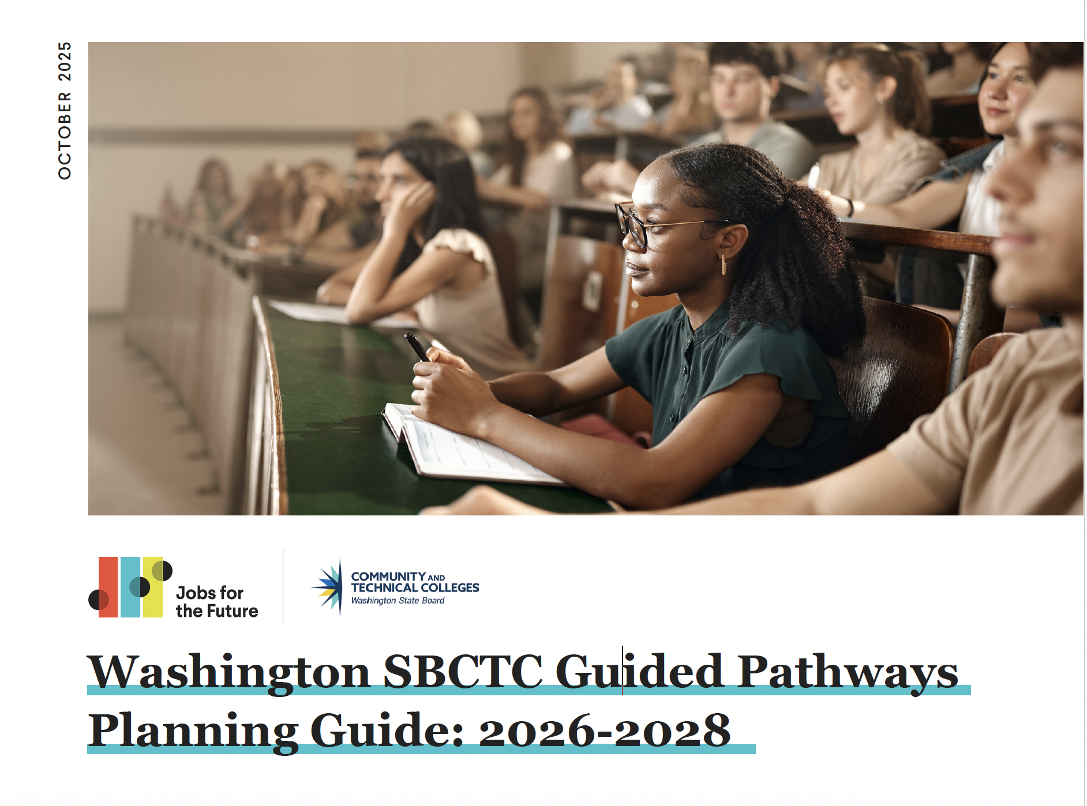
Key Planning Resources
Interactive Planning Guide
2026-2028 Action Plan

Slide 9
Planning with the guidebook
Plan for Progress and Impact
Institutional Self Assessments
Reflect and Prioritize for Action
Set Data-informed Goals and Evidence Based Structures
Plan for action
Non-prescriptive
The recommendations in the guide are intended to be additive to each college’s efforts and allow flexibility within a set of guidance.
Continuous Improvement Approach
The guide acknowledges the tremendous effort and progress over the past several years as the basis of how each institution moves forward while centering the needs and success of students.
Customizable
The guide supports each college’s ability to lean into what is most important for its implementation efforts and align their planning accordingly.
Stakeholder collaboration
The guide relied on stakeholder collaboration to develop key content.

Slide 10
Institutional self assessments
Planning guide provides rubrics that are meant to establish a benchmark for your planning by helping you determine your institution's current status:
Emerging
Accelerating
Sustaining
Leading
Leading Large-Scale Change
Pathway and Program Design
Pathway Entry and Navigation
Teaching and Learning
Academic, Career, and Financial Planning

Slide 11
Reflect and prioritize for action
What do you want to keep doing? What practices, structures, or mindsets are working well and should continue?
What do you want to stop doing?
What do you want to start doing? Are there new approaches you want to pilot?
What do you want to lean into in this next planning cycle? Where do you see momentum or opportunity for growth? What new or emerging ideas feel exciting, urgent, or essential?
What is the evidence? What data and rationale do you have to support these decisions?
What are the strengths of your Guided Pathways implementation that you can leverage in your planning?
Where have you had the greatest challenges in driving student outcomes through Guided Pathways?
What are your current needs? What’s missing?
What kind of training or professional development would support the implementation of your institution’s action plan?

Slide 12
Guided pathways legislative metrics
Student retention and persistence
College level math & English
Graduation and transfer rates
Completion (certs, degree, apprentice)
Time to completion and transfer
Employment and earnings

Slide 13
Prioritizing your planning
Start
New actions/interventions suggested by data.
Stop
Actions not showing impact or misaligned with equity goals.
Lean Into
Actions already showing promise that could be scaled.

Slide 14
Goals to action plan
SMARTIE FRAMEWORK
S | Specific
M | Measurable
A | Achievable
R | Relevant
T | Time-Bound
I | Inclusive
E | Equitable
Strategies
Action Steps
Responsibilities
Measurement
Progress tracking

Slide 15

Questions? Comments? Discussion? Collaboration!
Reach out anytime!
Monica Wilson
Student Success Center & Strategic Initiatives
Director
mwilson@sbctc.edu
503-307-1555

Slide 16
2024-2026
Guided pathways report due may 29
Scale of Adoption & Progress
Review 2024-2026 SOA data, confirm changes, and describe progress toward full scale and impacts on equity, learning, and completion.
Equity & Impact
Document how reforms are closing equity gaps, improving access and completion, and building equity-minded capacity.
Financial Investments & Outcomes
Summarize how Guided Pathways funds (2024–2026) were used and the resulting impacts.
Legislative Spotlight
Share local stories, data, and innovations showing institutional and statewide transformation.

