Slide 1
Guided Pathways Advisory Council
Winter 2024
Monica Wilson
Director, Student Success Center & Strategic Initiatives

Slide 2
Our Time Together
Welcome and Introductions
Data Spotlight and Discussion: Guided Pathways Metrics
SBCTC Updates and Commission Sharing
  Student Success Tool RFP Process Update
  Student Success Center Peer and Professional Development
  Executive Retreat Debrief
Guided Pathways Work Plan
Guided Pathways Legislative Report

Slide 3
Guided Pathways Retreat Reflection
What was supposed to happen?
Communicate within and across institutions and roles/commissions to identify opportunities for deeper collaboration for institutional and systemic transformative change that advances student success and equity
Identify and apply local and national data to set priorities for local and system leadership strategies for scaling Guided Pathways and Student Success practices
What actually happened?
Institutional, commission, and inter-commission conversations and planning
Hard conversations and honesty
New and renewed commitments and curiosity around Guided Pathways
What was the difference?
Lessons learned?
More collaboration on future events
Increased scaffolding and customizable agendas
Improved communication planning
Different starting places and needs
Agenda and timing challenges
Lack of clarity on goals and outcomes

Slide 4
Commission Conversation Themes
WACTC
Capacity
Student Services Commission
Student Success RFP
Financial aid simplification
Instruction Commission
Clarity on metrics and accountability
Diversity Equity Officer Commission
Research and Planning Commission
Promising practices in GP
Faculty ownership and engagement
Going all in on transformation
Mapping to the Student
Assessment, Teaching and Learning,
Leading with racial equity
Alignment and putting it all together
Strengths and opportunities for role in guided pathways
Deeper system engagement
Ideation on WACTC support for DEOC work institutionally and systemically
Introductions and Connection opportunities
Role for integration around data needs
Professional development—internal to commission and external for councils and colleges

Slide 5
Student Success Center Team Support
Monica Wilson
Director
Brook Bane
Policy Associate
Pathway Navigation
Guava Jordan
Policy Associate
Faculty Development
Ensured Learning
Dawn Draus
Policy Associate
Math Pathways
Placement
Student Services Liaison
System Engagement
Strategic Initiatives
Program Specialist
Professional Development
Coaching
Vacant
Administrative Assistant
Professional Development
IDEAL Fellowship
Amunoo Tembo

Slide 6
Faculty Development and Ensured Learning
Assessment Teaching and Learning Conference
Setting structural foundation for faculty development
Key focus areas for faculty success and ensured student learning:
Engagement: intentional and sustained student engagement
Effectiveness: employing high-impact practices in the classroom
Improvement: data-informed assessment and revision
Inclusion: equity-minded and asset-based teaching
Alignment: pathway-aligned and applied learning experiences

Slide 7
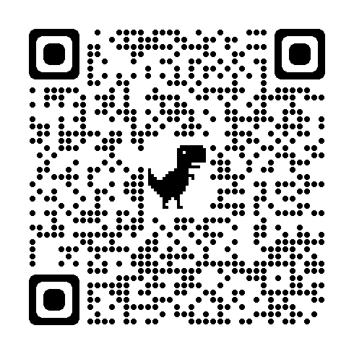
Assessment Teaching and Learning Conference
Connect and Build: Nurturing growth of community and excellence in teaching and learning
Thursday and Friday, May 2-3, 2024 @ Yakima Convention and Event Center
$75.00
Support your faculty to attend
Registration is open now

Slide 8
Current Student Success Center Engagements
Guided Pathways Career Convenings
Rural and Technical College Convenings
Quarterly Math Faculty Retreats
Student Affairs Assessment Cycle series
Project Management series
Assessment, Teaching, and Learning Conference
Multi-college Placement Initiative
In Development:
  First Year Experience Repository and Learning Community
  On-Demand New Faculty Institute
  On-Demand Guided Pathways Orientation
  Professional Development badging
  Cohort Convenings
  Retreats and Institutes
Communities of Practice:
Faculty Development
Building a Thinking Classroom
Data Science
Social Justice in MATH& 107
Corequisites with Kathleen Almy
Antiracist Curriculum and Assessment Practices

Slide 9
Work plan Overview
Large Scale Change
Pathway Entry
& Navigation
Data Analytics
Pathway and Program Design
Equity informed project and change management infrastructure
Comprehensive mapping of student educational pathways with student end goals in mind
Students make informed program choices and develop completion plans
Data analysis of student learning as well as program and service outcomes
Success Support
Infrastructure
High impact practices in teaching and learning
Auto populated with data
Aligned with legislative requirements from the Workforce Education and Investment Act
Redesign cohorts
Inform statewide PD, coaching, and technical assistance.
Released March 11, 2024
Due June 28, 2024

Slide 10
Legislative Report
Advance copy of report to WACTC March 15, Leg March 25
Guided Pathways implementation, including timeline, alignment with legislative requirements, challenges, and ongoing needs
Trends in outcomes between 2012-2019
Compares retention, course completion, credit accumulation, and Grade Point Average
No statistical analysis to evaluate the impact of Guided Pathways

Slide 11
Guided Pathways Metrics
Preliminary Report
Final Report
Student retention and persistence
College level English and math within the first year
Graduation and transfer rates
Degree completion
Time to degree, transfer to four-year institutions
Employment and earnings

Slide 12
Data Analysis Example
“Our college has used Guided Pathways funding to support data infrastructure including personnel, software, and data dashboards to inform strategic planning. Data analysis has been used to identify equity gaps too. Data is presented in meetings and workgroups to measure outcomes and prioritize areas of focus.”

Slide 13
Challenges and Ongoing Needs
Challenges
Ongoing Needs
Impact of COVID-19
Staff Capacity and Turnover
ctcLink Transition
Buy-In
Staffing
Student Success Software
Continued Support from SBCTC
Learning from Others
Reducing Reporting Burdens

Slide 14
Guided Pathways Success: Culture
“Our college has transformed the culture of the institution from one that expected students to be 100% college ready and “had a right to fail” to an institution committed to meeting students where they are and ensuring that all students have a right to succeed.
Lack of student success is now seen as an indication of need for institutional change, rather than student change.”

Slide 15
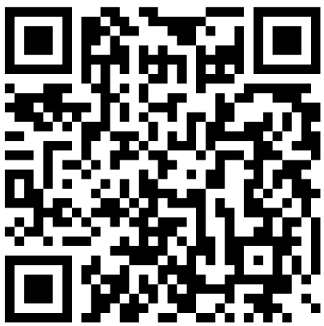
Thank You
Questions? Comments? Feedback? Collaboration?
Monica Wilson
mwilson@sbctc.edu
Schedule a meeting
360-704-1022

