Slide 1
Guided pathways advisory council
Winter 2026
Monica Wilson
February 26, 2026

Slide 2


Welcome & Introductions
How are your campuses highlighting and/or celebrating Black History Month and/or Ramadan?

Slide 3
Gpac 2025-2026 focus
Student Achievement Initiative Review
Contribute to the revision of the SAI model to align student achievement with financial incentives, using equitable, Guided Pathways–based metrics.
Policy Recommendations
In 2025–2026, GPAC will develop recommendations for the State Board’s consideration to ensure that the legislative intent of House Bill 2158 on Guided Pathways Implementation remains central to our system’s continued focus on equity and student success.
Middle Leadership Academy Advisory Role
With the launch of this professional development initiative for mid-level practitioners, GPAC will provide critical guidance to ensure leadership development is aligned with statewide Guided Pathways strategies and accountability measures.

Slide 4
Fall gpac agenda
Time | Activity
10:00-10:05a | Welcome and Introductions
10:05-10:30a | Student Success Center and Guided Pathways Updates ConexEd Implementation Update Guided Pathways Planning and Reporting Pathway Navigation Pathways Leadership Faculty Development & Ensured Learning Math Pathways and Placement
10:30-11:00a | Student Achievement Initiative
11:00-11:25a | Guided Pathways in the Legislature
11:25-11:30a | Q&A, Farewell

Slide 5
Work plan: Conexed IMPLEMENTATION update
Established a ConexED/SBCTC Workgroup to evaluate and recommend one-way and two-way integration models that improve data accuracy, reduce manual processes, strengthen compliance (FERPA, state privacy, SBCTC security), and support equitable student outcomes systemwide.
Membership includes cross-functional representation, commission representatives, and participants from multiple colleges to ensure broad system input and alignment.
Integration work is complete on the initial set of data elements between ConexED and ctcLink. The ctcLink Support team is now partnering with ConexED to review system functionality and validate how data displays to students and staff, ensuring accurate table sourcing, appropriate security controls, and correct information presentation.
Internal efforts remain focused on validating end-to-end data flow, confirming role-based access, and ensuring alignment with existing ctcLink business processes and governance expectations.
A “What Can ctcLink Do?” presentation was delivered to the EmpowerED Community of Practice earlier this week. The session provided a high-level, advisor-focused overview of advising functionality currently available in ctcLink, clarifying what tools exist today, what students can view and access, and where colleges have flexibility to more intentionally leverage ctcLink to support advising practices.

Slide 6
Guided Pathways Action plan
Action plan for 26-28 is due March 20
Planning Guide and Action Plan released in October
Only Action Plan is required for submission
Submit in format that works best for college

Slide 7
2024-2026 Guided pathways report due june 26
Scale of Adoption & Progress
Review 2024-2026 SOA data, confirm changes, and describe progress toward full scale and impacts on equity, learning, and completion.
Equity & Impact
Document how reforms are closing equity gaps, improving access and completion, and building equity-minded capacity.
Financial Investments & Outcomes
Summarize how Guided Pathways funds (2024–2026) were used and the resulting impacts.
Legislative Spotlight
Share local stories, data, and innovations showing institutional and statewide transformation.

Slide 8
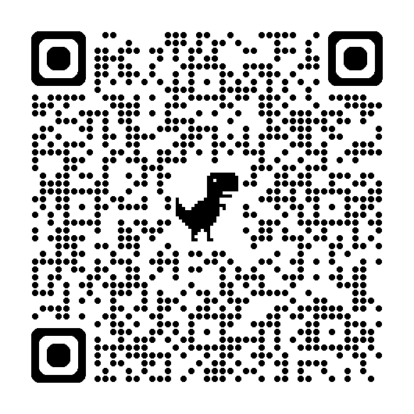
Pathway navigation
Advising Forward: From Many Roles, One Purpose
October 26–27, 2026 Wenatchee Convention Center
Registration details, agenda highlights, and call for proposals coming soon.
Holistic Advising for Student Success learning community
EmpowerED Community of Practice
College implementation progress
ConexED accessibility and ctcLink utilization
Two-year learning community to strengthen advising ecosystems.
Assess advising, leverage policy, and advance durable, student-centered models.
Check out our EmpowerED Community of Practice (CoP) Project page for more updates
Amunoo Tembo
Policy Associate
Student Succes
& Pathway Navigation

Slide 9
Pathway Leadership
Middle Leadership Academy
Evolve
Student Success Center Internship
Session 3 at Everett
Planning for next year
Next Advisory meeting 3/13
Moving grantmaking forward
Welcome Isaiah
Business Transfer student SPSCC
Dr. MarcusAntonio Gunn
Policy Associate
Pathway Leadership

Slide 10
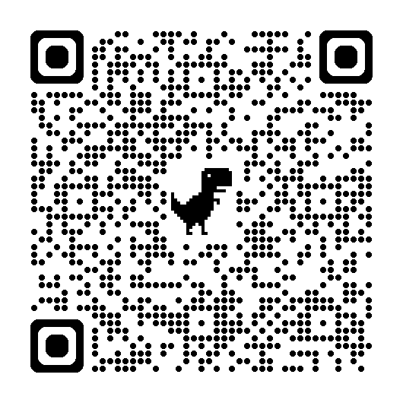
Math pathways & placement
2026 Math Conference
Communities of Practice
Launch Years
May 14-16, 2026 at Great Wolf Lodge
Presentation Proposals still being accepted
Accessible STEM
Joint Transfer Council Biology & Calculus
Scaling of math pathways from high school through postsecondary and employment
Building Thinking Classrooms
Dawn Draus
Policy Associate
Math Pathways and Placement

Slide 11
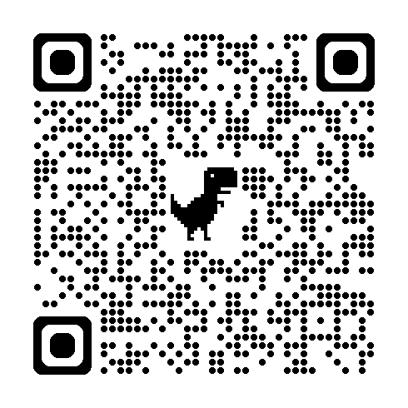
Faculty Development
WACC/ATL Conference
New Faculty Institute
Faculty AI Learning Series
April 29–May 1, 2026
20 colleges have registered
September 3–4, 2024 @ Clover Park Tech College
Registration opens April 2026
Support instructors in developing critical AI skills
Short, focused sessions emphasize curiosity over platform endorsement.
Institutional registration deadline March 11
Designed for pre-tenure faculty new to our system
Guava Jordan
Policy Associate
Faculty Development & Ensured Learning

Slide 12
Student achievement initiative (sai) review
Dr. Joyce Hammer Deputy Executive Director, Education SBCTC

Slide 13
Tentative timeline
2 Oct. 2025
SAI Review introduced to GPAC at October 2, 2025 meeting.
Oct.–Nov. 2025
Committee membership finalized and meetings scheduled October-November, 2025.
Nov.–Apr. 2026
Regular meetings scheduled November-April 2026 including regular updates and discussions at GPAC meetings (1/29/2026 and 3/26/2026).
Mar. 2026
Draft recommendations completed March 2026 and presented to system commissions and councils for feedback.
Apr. 2026
Draft recommendations finalized April 2026 and presented to WACTC at meeting April 23, 2026.
28 May 2026
WACTC Action: May 28, 2026 meeting.
June 2026
Final recommendations presented to State Board
Aug.–Sep. 2026
State Board action

Slide 14
SAI metrics for finalization
Retention
Completion
Basic Education for Adults
Transfer
Equity Considerations
Further Considerations:
Overall weighting
Communication
Next Meetings:
3/11 - 10:00-12:00
4/21 2:30 – 4:30 (Bates)
5/19 2:00 – 4:00

Slide 15
Guided pathways in the legislature
Senate Proposal:
Section 601(19) page 455: Adds back the proviso language for implementation of guided pathways (this is not new funding, just the proviso language was removed in the enacted 2025-27 biennial budget).

Slide 16

Thank you
Next Steps...
Questions...
Farewell...
Spring 2026: May 28 10:00–11:30 AM Hybrid at Columbia Basin College
ThePhoto by PhotoAuthor is licensed under CCYYSA.

