Slide 1
Sbctc data dashboards
Exploring Statewide Data
Monica Wilson | Director | Student Success Center
November 2024

Slide 2
Our Time Together
Purpose: provide time and support for exploration of the first time enrolled in college dashboard
Topics
  Guided Pathways in Washington
  Student Achievement Initiative
  Data Dashboards
    General Overview
    Disaggregation
  Q and A, farewell

Slide 3
SBCTC System Vision
Leading with racial equity, our colleges maximize student potential and transform live within a culture of belonging that advances racial, social, and economic justice in service to our diverse communities.

Slide 4
Guided Pathways Vision & Mission
A system that advances racial, social, and economic justice by achieving equitable student aspiration, access, economic progress, and educational and career attainment.
Create an equitable system that prepares all learners to engage in a diverse society and workforce, achieve economic mobility through educational attainment and contribute to a socially just society.

Slide 5
Guiding Principles
Transformation
Equity-minded, transformative organizational change.
Racial & Social Equity
Culturally responsive commitment to racial and social equity by dismantling systemic policies and practices that perpetuate inequities.
Community
Collaboration
Alignment
The voices of students, faculty, staff and community members are essential to fully engage in adaptive problem focused inquiry processes leading to meaningful action and sustained systemic change.
Intentional collaborative learning through partnerships,
professional and resource development
Focus on learning and outcomes aligned with community
values and industry needs.

Slide 6
Washington State Scaling Investments
American Association of Community Colleges
  2015: Three colleges selected to receive technical assistance and professional development
College Spark Washington
  2016: First cohort of five colleges received 100,000 per year for five years
  2018: Second cohort of five colleges received 100,000 per year for five years
Washington State Legislature
  2019: Workforce Education Investment Act, HB 2158
Notes:
Washington is at the forefront of leading with racial equity in guided pathways, and we have a lot of work still to do. But we are fortunate to have generous support from philanthropic partners like College Spark Washington as well as a historic investment from the Washington State legislature to do this work.

Slide 7
HB 2158 Guided Pathways
Guided pathways is a research-based approach that provides clear, structured, educational experiences for students with four elements: Clarify paths to students' end goals, help students choose and enter a pathway, help students stay on path, and ensure that students are learning.
Guided pathways implementation includes:
  Comprehensive mapping of student educational pathways with student end goals in mind;
  Dedicated advising and career counseling that helps students make informed program choices and develop completion plans;
  Data analysis of student learning as well as program and service outcomes;
  Inclusive curriculum and teaching practices

Slide 8
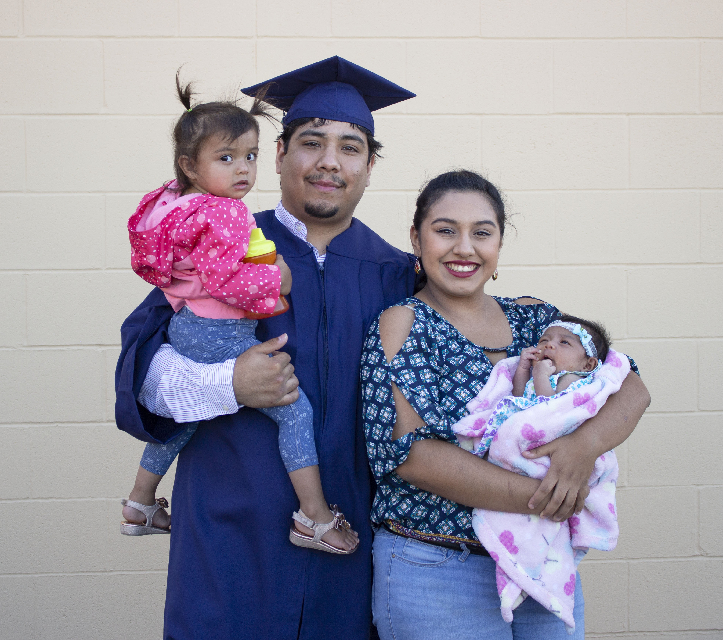
Design
Pathway Development
Program Maps
Welcome
Intake
Entry Advising
Guidance
Progress Monitoring
Teaching & Learning
Engagement
Scheduling
Completion Support
Degree Math and English in One Year
Effectiveness
Improvement
Inclusion
Alignment
Educational Planning
Financial Planning
Math Pathways
Advancing Student Success:
  Simplifying choices and restructuring student experiences
Equity Minded Leadership
and Management

Slide 9
Guided pathways metrics
Student retention and persistence
College level math & English
Graduation and transfer rates
Completion (certs, degree, apprentice)
Time to completion and transfer
Employment and earnings

Slide 10
Student achievement initiative
Purpose
Achievement Measures
Accountability
Incentive
Equity points
  BEdA students*
  Low-income (zip code) ±
  Students of Color ±
Basic skills
15 college credits*±
30 college credits*
Program English
Program math*
45 college credits*
Completions*±
*If the student reaching this momentum point started in basic skills, an additional point is awarded
± If the student reaching this momentum point is low-income and/or historically underserved students of color.

