Slide 1


Perkins
An Opportunity to “ReThink CTE”
September 2018
Scott Stump
Assistant Secretary
Office of Career, Technical, and Adult Education
U.S. Department of Education
Notes:
On behalf of the Division of Academic and Technical Education, or DATE, in the U. S. Department of Education’s Office of Career, Technical, and Adult Education, welcome to this overview of the Perkins 101 modules.
We begin with a brief overview of career and technical education—or CTE—in the U.S.

Slide 2
Poll
Were you in your current role as
state director when Perkins IV
was enacted in 2006?
No Yes

Slide 3
Poll
On a sliding scale from
1 = nervous to 10 = excited,
are you more nervous or excited
to begin building your Perkins V State plan?
Nervous Excited

Slide 4
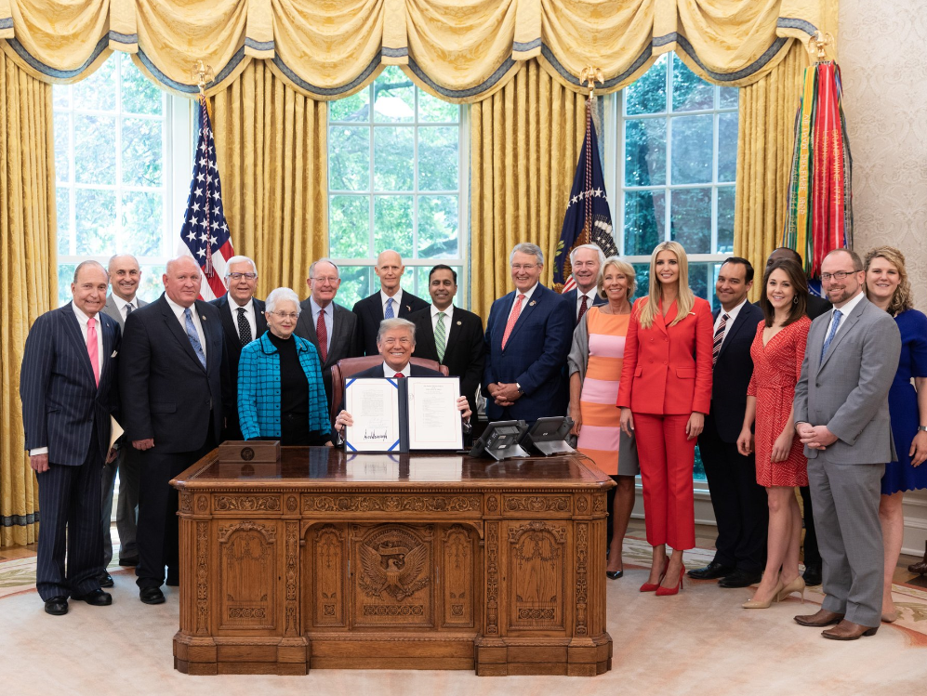
Statements on the Passage of Perkins V
“We will continue to prepare students for today’s constantly shifting job market, and we will help employers find the workers they need.”
President Donald J. Trump
“Congress came together to expand educational pathways and opportunities and give local communities greater flexibility in how best to prepare students for the jobs of today and tomorrow.”
Education Secretary Betsy DeVos

Slide 5
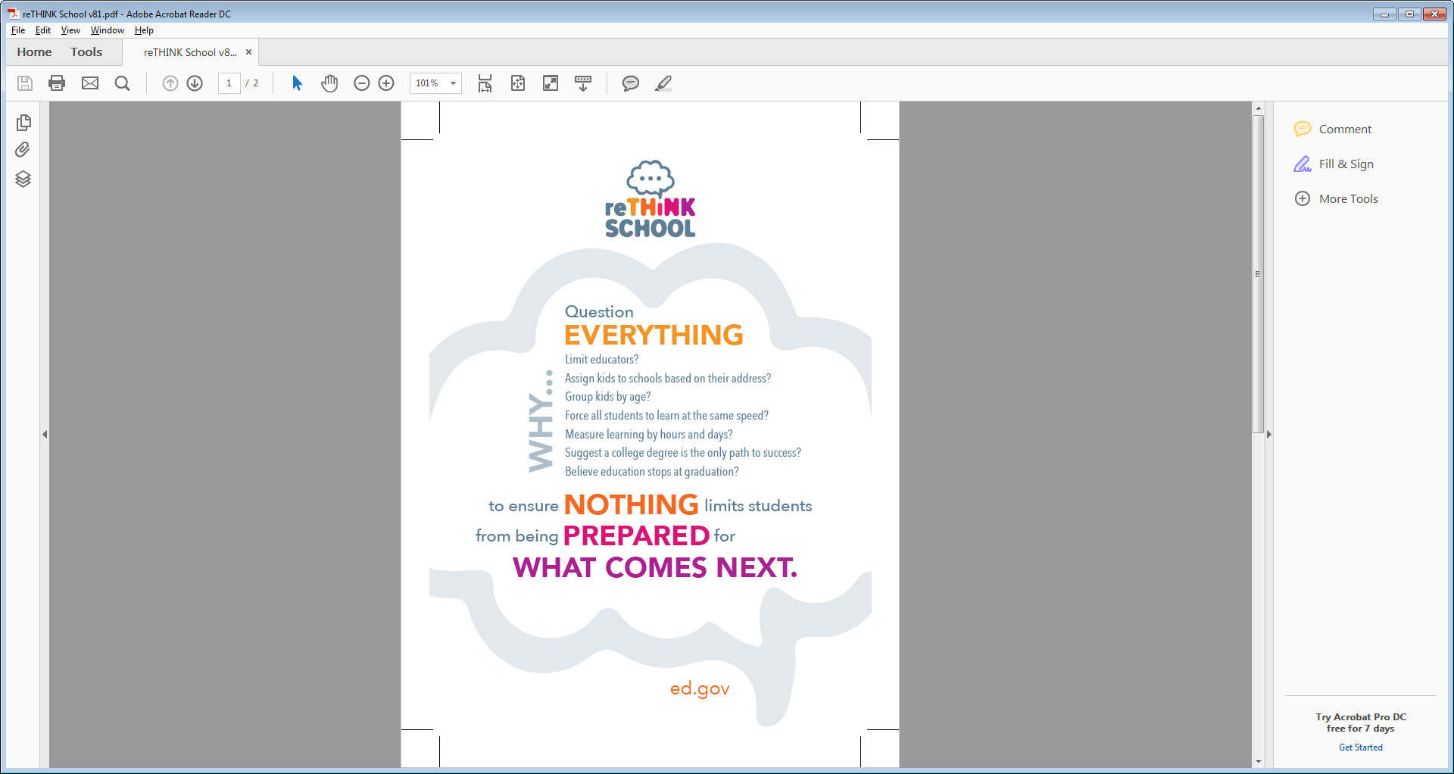
Time to reTHINK
2006
iPhone
Netflix
2018
Drones
Autonomous Vehicles
Great Recession
Unemployment - 3.9 %
Skilled occupations - 13% gap
Health care - 1.1 million unfilled
Manufacturing (2015-2025) - 2 million unfilled

Slide 6
Time to reTHINK
What is the right secondary/postsecondary “split of funds” given today’s environment?
How can “reserve” funds best be used to spark innovation and incentivize “high-quality?”
How do you define/approve high-quality CTE programs?
How can work-based learning, including “earn and learn programs” such as apprenticeships, be the rule and not the exception?
How do we build the pipeline of teachers necessary to deliver the critical pathways local communities need?
What is your state’s level of commitment to Career Pathways and Programs of Study?
What is the best role for employers in program development and delivery?

Slide 7

Perkins Vision
Expand opportunities
for every student
to explore, choose,
and follow
vertically-integrated career pathways to earn credentials of value.

Slide 8
Levers of Opportunity
Aligning CTE Programs
  State and local collaboration with workforce boards
  Opportunity to submit WIOA combined plans
  Comprehensive local needs assessment
  Use of the reserve
Fostering Collaboration
  Extensive collaboration in State plan development
  Involvement of the Governor’s office
  Timeframe for public hearings
  Consultation with adult education agency on split of funds
  Statewide industry or sector partnerships to develop and implement POS

Slide 9
Levers of Opportunity
Strengthening CTE Teacher and Faculty Pipeline
  One of four required State leadership activities
  Included as part of local needs assessment
Expanding the reach and scope of guidance and counseling
  Middle school
  Special populations recruitment
  Informing parents and students about programs
Promoting innovative practices
  Programs of study
  Work-based learning, including apprenticeships
  Dual and concurrent enrollment programs and early college high schools
  Pay for Success

Slide 10
Levers of Opportunity
State and local-driven continuous improvement
  Common student definitions and measurement approaches
  State-determined levels of performance
  Disaggregation of data
  Program quality indicators
  Public reporting of data
  Program improvement plans

Slide 11
Timeline
Fall 2018: Stakeholder Summit
Fall 2018: Non-regulatory Q&As
Mid–January 2019: Perkins V State Plan Guide
Mid–January 2019: Perkins V Consolidated Annual Report (CAR) Guide

Slide 12
Technical Assistance Plans
Topical Webinars
On-site Technical Assistance Visits
Next Steps Workgroup Calls
Perkins V Data Quality Institute
Perkins Regional Coordinators

Slide 13

Perkins
Q & A

