Slide 1
Welcome
Perkins V Training
October 16, 2019

Slide 2
Count-down
START

Slide 3
Welcome!
Perkins V Subcommittee Members:
  Cathy Alston, Green River
  Rachel Andre, Seattle Colleges
  Terry Cox, Edmonds
  Keeley Gant, Columbia Basin
  Loren Hadley, Shoreline
  Brian Kneidl, Peninsula
  Paulette Lopez, Yakima Valley
  Trish Newbold, Whatcom
  Susan Parker, Bellingham Tech.
  Tim McClain, SBCTC
  Kathy Goebel, SBCTC

Slide 4
What We’ll Cover Today
Overview of Perkins V
The New Performance Indicators
Student Performance Data
Root Cause Analysis and Developing Strategies
The Comprehensive Local Needs Assessment
Next Steps

Slide 5
Perkins 101
Test your knowledge – Amaze your friends
Brian Kneidl
Tim McClain

Slide 6
Practice Question
Choose your favorite music genre:
Rock
Hip-Hop
Pop
Country

Slide 7
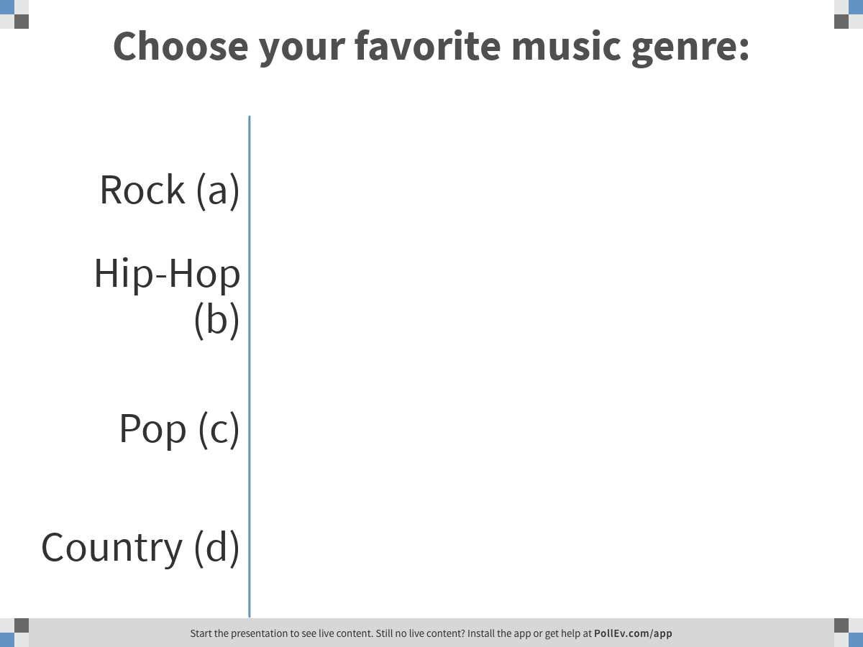
Notes:
Poll Title: Choose your favorite music genre:
https://www.polleverywhere.com/multiple_choice_polls/SngcNbt03NIzrUCUtXFST

Slide 8
Practice Question
Choose your favorite dessert:
Cake
Pie
Ice Cream

Slide 9
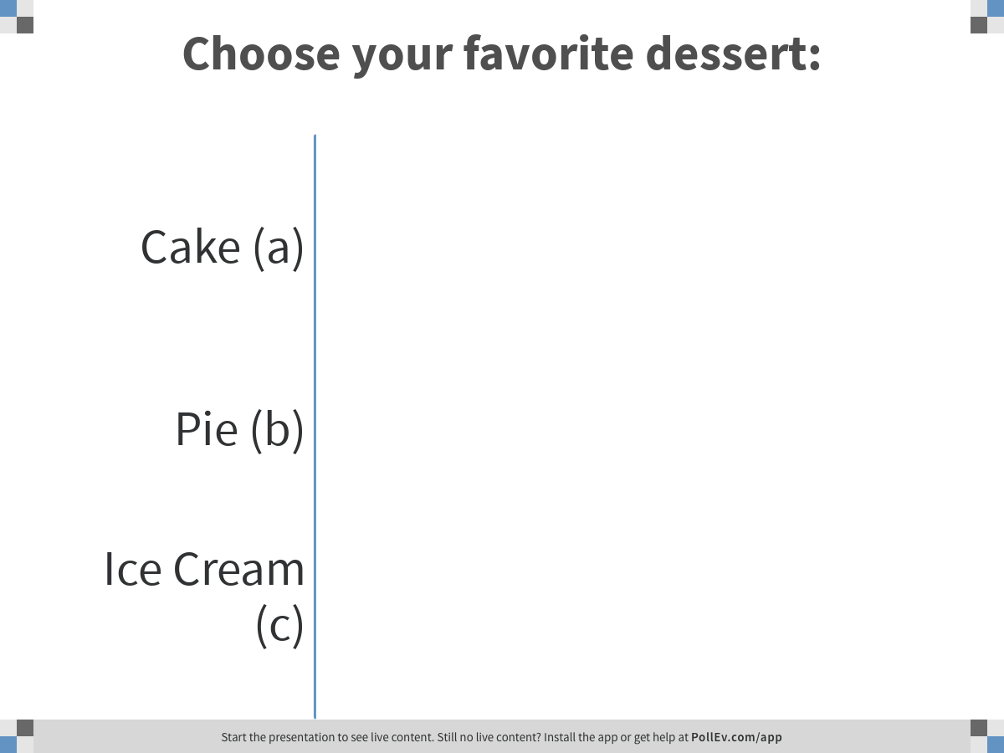
Notes:
Poll Title: Choose your favorite dessert:
https://www.polleverywhere.com/multiple_choice_polls/uDYXqfvOPyieQYaKADMSz

Slide 10
Which is NOT an accurate correlation between a requirement and a major theme of Perkins V?
  Disaggregated performance data = equity
  Accountability indicators = program improvement
  Programs of study = alignment w/ K-12 and industry sectors
  Flexibility in use of funds = innovation
  Defense Against the Dark Arts = preparing students for non-traditional occupations within the Ministry of Magic

Slide 11
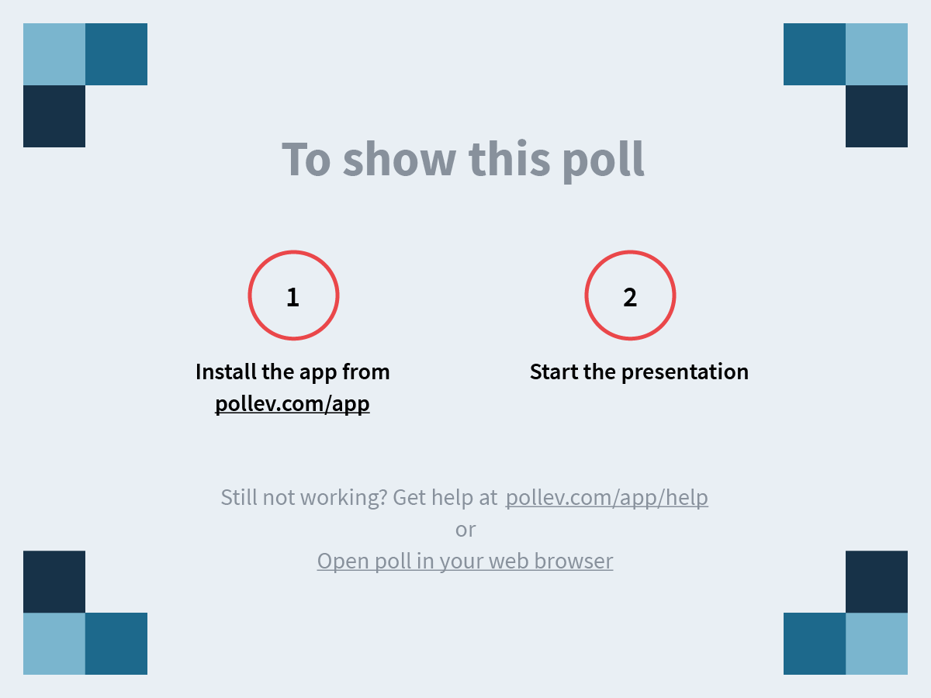
Notes:
Which is <strong>NOT</strong> an accurate correlation between a <strong>requirement<.strong> and a <strong>major theme</strong> of Perkins V?</strong>
https://www.polleverywhere.com/multiple_choice_polls/liMfy4YGu4ai5G3nzVrw1

Slide 12
The Answer Is “E” – Defense against the dark arts
Important Perkins V themes –
Equity and Access
Program Improvement
Stakeholder Engagement
Alignment
Innovation
Notes:
Equity: PV includes new special populations, requires disaggregated data, response to performance gaps, DEI-focused professional development, and support for special populations as a required use of funds.
Improvement: new indicators, identify and address performance gaps, CLNA, assessment and professional development as required uses of funds, catch-all “other activities to improve CTE programs”
Stakeholder Engagement: CLNA, 8 required stakeholders, State Plan development and public comment period, “continued consultation”
Alignment: Combined Perkins/WIOA State Plan, ESSA/WIOA alignment in definitions, timelines, student subgroups and populations, CLNA, dual-credit and programs of study
Innovation: Flexibility and autonomy, CLNA and application, disaggregated performance data, data-informed decision-making, federal Innovation and Modernization grant, reserve increase to 15%, addition of performance gaps to reserve options

Slide 13
Which of the following was NOT redefined in Perkins V?
  Program of Study
  Work-Based Learning
  Professional Development
  Size, Scope, and Quality
  CTE Concentrator
  Special Population

Slide 14
Notes:
Which of the following was <strong>NOT</strong> redefined in Perkins V?
https://www.polleverywhere.com/multiple_choice_polls/c3gsTZ4rPDyzDlSctl8WX

Slide 15
The Answer Is “D”- Size, Scope, & Quality
These definitions have changed –
Program of Study*
Work-Based Learning*
Professional Development
CTE Concentrator
Special Population*
*These definitions will be addressed in subsequent questions.
Notes:
Size, Scope, and Quality must be defined in the State Plan and addressed in local applications. The Perkins leadership team is drafting a definition, which will be vetted by the college subcommittee and subject to stakeholder feedback.
Professional Development: 9 examples under required use of funds, new definition: “sustained…intensive, collaborative, job-embedded, data-driven, classroom focused…and evidence-based” including 14 conditions
CTE Concentrator: student enrolled in an eligible college who has earned 12 credits w/in a CTE program or completed a program if it is less than 12 credits

Slide 16
Which of the following terms/phrases are used to define Program of Study?
Dual-credit
Nonduplicative
Academic and technical content
Middle grades
Some of the above
All of the above

Slide 17
Notes:
Which of the following terms/phrases <strong>are used</strong> to define Program of Study?
https://www.polleverywhere.com/multiple_choice_polls/QmAetOfQZ83PuPLrLPsZF

Slide 18
The Answer Is “E” - Some of the above
Program of Study –
“A coordinated, nonduplicative sequence of academic and technical content at the secondary and postsecondary level”.
Notes:
Perkins V provides the opportunity to offer CTE in the middle grades, but does not require it. Likewise, the law does not require Programs of Study to include dual-credit articulations, although they are the most effective means of meeting other requirements. On that note…

Slide 19
Which of the following is NOT a required component of Programs of Study?
State approval and cataloging
Challenging state academic standards
Academic and technical knowledge and skills
Alignment with employer needs
Multiple entry and exit points
All of the above

Slide 20
Notes:
Which of the following is <strong>NOT</strong> a required component of Programs of Study?
https://www.polleverywhere.com/multiple_choice_polls/r8zuGDAz2Eymp3i13YZxr

Slide 21
The Answer Is “A” – State approval
Programs of Study should include –
Challenging state academic standards
Academic and technical knowledge and skills (including employability skills)
Alignment with employer needs
Progression in specificity
Multiple entry and exit points
Opportunity to attain a postsecondary credential
Notes:
There is no requirement that Programs of Study receive state approval; however, most states have some standards in place and this is likely a practice we will be exploring. With SERS being used less and less since the expiration of Tech Prep funding, we have a lot of work to do in terms of validating our commitment to and implementation of Programs of Study.

Slide 22
Work-based learning is characterized by:
Real workplace settings
Simulated work environments
Sustained interactions with professionals
Alignment with curriculum and instruction
All of the above

Slide 23
Notes:
Work-based learning is characterized by:
https://www.polleverywhere.com/multiple_choice_polls/5moIv3UO92WHSrNw0TQ8j

Slide 24
The Answer Is “E” – All of the above
Work-Based Learning –
Sustained interactions with professionals
Real workplace setting or simulated environments
In-depth, firsthand experiences with required tasks in the field
Aligned to curriculum & instruction
Notes:
The options presented summarize the formal definition. If you were tripped up by simulated environments, know that they, too, are considered work-based learning provided they offer “in-depth, firsthand engagement with the tasks required in a given career field.” This, of course, is a priority not only in Perkins V, but with the launch of Career Connect Washington, which you will surely hear more about in the days to come. Work-based learning is infused throughout Perkins V as a secondary performance indicator, a component of the needs assessment and application, theme of stakeholder engagement and alignment activities, a permissible use of funds, and a feature of Innovation and Leadership grant funding.

Slide 25
Equity in meeting the needs of ALL students is a major theme in Perkins V, as evidenced by the frequent inclusion of the term “Special Populations”. Which of the following is NOT a revision to the list of Special Populations?
Out-of-workforce individuals
Individuals preparing for non-traditional fields
Homeless individuals
Foster youth
Youth with active-duty military parents

Slide 26
Notes:
Equity is a major theme in Perkins V, as evidenced by the frequent inclusion of the term "Special Populations". Which of the following is <strong>NOT</strong> a revision to the list of Special Populations?
https://www.polleverywhere.com/multiple_choice_polls/CFc3LTTsDFzs6tJpmRwZT

Slide 27
The Answer Is “B”
Individuals with disabilities
Individuals from economically disadvantaged families, including low-income youth and adults
Individuals preparing for non-traditional fields
Single parents, including single pregnant women
Out-of-workforce individuals
English learners
Homeless individuals
Youth who are in, or have aged out of, the foster care system
Youth with a parent who is a member of the armed forces on active duty
Notes:
b. is correct – it was there in Perkins IV – but this was trickier than it may have seemed. “Out-of-workforce individuals” is an expanded category. It was previously written as “displaced homemakers”, which had a much narrower definition. The “foster youth” was terminology was previously included with “economically disadvantaged families”, but is now its own bullet point. c. and e. are the really, really new categories – both of which we’ll have trouble reporting on. We’ve communicated this to both the Workforce Board and OCTAE and will likely explain in the State Plan that this is data we won’t have readily available in the immediate future. The other Special Population holdovers from Perkins IV are individuals with disabilities, individuals from economically disadvantaged families, single parents and single pregnant women, and English learners, for a total of 9.
“The term ‘non-traditional fields’ means occupations or fields of work, such as careers in computer science, technology, and other current and emerging high skill occupations, for which individuals from one gender comprise less than 25 percent of the individuals employed in each such occupation or field of work.”

Slide 28
The comprehensive local needs assessment (CLNA) should address which of the following Perkins V priorities?
Equity and access
Data-driven program improvement
Accountability for funding
Stakeholder engagement
Program alignment with employer needs
All of the above

Slide 29
Notes:
The comprehensive local needs assessment (CLNA) should address which of the following Perkins V priorities?
https://www.polleverywhere.com/multiple_choice_polls/ztXRcvMolqNFV2HlgWRFq

Slide 30
The Answer Is “F” – All of the above
CLNA Requirements
Evaluation of student performance, including special populations
Description of size, scope, and quality
Evaluation of program/program of study implementation
Recruitment, retention, and training of educators
Progress towards implementation of equal access to high-quality CTE
Notes:
Easy. These are the major points of emphasis in Perkins V, and the CLNA should address all of them. The CLNA is the most noteworthy change at the college level, and one that we will speak at length about later. In short, however, it was established to accomplish all of the aforementioned goals, but we will be taking an incremental approach to it that will be discussed later.

Slide 31
Your first Comprehensive Local Needs Assessment will be due:
Winter 2020
Fall 2020
Winter 2021
Due? I’m not due-ing it!

Slide 32
Notes:
Your first Comprehensive Local Needs Assessment will be due:
https://www.polleverywhere.com/multiple_choice_polls/7SjQhAu9etPMw9dxe4Z2X

Slide 33
The Answer Is “A”
“CLNA-Light” will be due Winter 2020
Internally Focused
Element 1: Improving Equity and Access
Element 2: Evaluation of Student Performance
Notes:
The answer is a., but DON’T PANIC! Again, in year 1 we’ll be expecting CLNA-light. We want a good-faith effort at stakeholder engagement and program alignment, but you will be primarily concerned with evaluating equity and access, analyzing the new and disaggregated performance data, and incorporating your findings in your Plan application. We will be working on developing labor market tools, stakeholder engagement resources, and regional strategies in the coming months, but anticipate that you will focus your attention on your internal strengths, limitations, and needs this year.

Slide 34
The comprehensive local needs assessment is:
A disgustingly egregious example of legislative overreach.
A ho-hum means of loosening Carl D. Perkins’ purse strings.
An invaluable opportunity to work with our partners to evaluate our programs’ efficacy in meeting employer needs and equitably preparing students for living-wage careers in in-demand occupations.
The greatest thing since sliced bread because I’m a data and accountability nerd.

Slide 35
Notes:
The comprehensive local needs assessment is:
https://www.polleverywhere.com/multiple_choice_polls/KfmA0kBQHrUEL9mKlHimA

Slide 36
The Answer Is “C”
“An invaluable opportunity to work with our partners to evaluate our programs’ efficacy in meeting employer needs and equitably preparing students for living-wage careers in in-demand occupations.”
Notes:
This is a trial year. Try new things and find out what works for you.
We want you to see this as an opportunity to build relationships and fine-tune your process for the future.
Keep the students in the forefront – always consider how you can better serve them and best prepare them for future education and careers.

Slide 37
Expenditures prohibited by Perkins V include:
Food purchases
Direct assistance to students
Support for students participating in CTE clubs and organizations
Marketing and recruitment materials
All of the above
None of the above

Slide 38
Notes:
Expenditures prohibited by Perkins V include:
https://www.polleverywhere.com/multiple_choice_polls/H4DkjYE9UWAzVGxivGqHY

Slide 39
The Answer Is “F” – None of the above
Required uses of Perkins funds:
Career exploration & development activities…
Professional development for teachers, faculty, school leaders, administrators, etc…
Skills necessary to pursue high-skill, high-wage, or in-demand careers…
Integration of academic skills into CTE programs…
Implementation of CTE programs/programs of study…
Evaluations of the activities carried out with funds…
Notes:
Perkins V does not explicitly restrict your use of funds. In fact, it is more permissive than Perkins IV. There are six required uses of funds and 37 examples of permissive uses, concluding with the ever-nebulous, “other activities to improve career and technical education programs.” The disclaimer here is the clause, “to meet the needs identified in the comprehensive needs assessment described in section 134(c).”

Slide 40
Perkins V requires no less than a 25%/75% split of the state’s funding between secondary and postsecondary or vice versa?
True
False

Slide 41
Notes:
Perkins V requires no less than a 25%/75% split of the state's funding between secondary and postsecondary or vice versa?
https://www.polleverywhere.com/multiple_choice_polls/sHzbxLJaj0SwILQVIg6Y1

Slide 42
The Answer Is “B” – False
Current Split: 56%/44%
$12,265,098 Postsecondary
$10,056,444 Secondary
50/50 Split
$11,160,770 to Each
$1,104,328 Loss to CTC System
Average Loss of $33,464 per College
The Moral: Spend Your Money!
Notes:
The law does not stipulate how much either system should receive. The current split is 56%/44% in favor of the postsecondary side, but that is up for discussion. No changes are anticipated in year one and OSPI does not appear to be lobbying for more, but there are no guarantees. We will advocate for the system to retain its cut (or more); however, we are in the minority nationwide. Consequently, it is important to note that even a modest change to a 50/50 split could result in thousands lost at each college. Plan accordingly and spend your funds so that we can justify our current split.

Slide 43

Questions?
Perkins V Brief in folders

Slide 44
Perkins Indicators & Big Data
What’s changed
Carmen McKenzie
Tim McClain

Slide 45
Perkins Indicators
Broad measures of performance –
  How well are schools and colleges preparing all students for work?
  Shows if state policies are improving positive outcomes for –
  Students
  Employers
  Each state determines its performance targets

Slide 46
Indicator Definitions (Blue handout)
Concentrator
Credit Threshold
Exiter
Program Completion
Cohort

Slide 47
Perkins V Indicators
1P1 | Students who complete their program and do something more.
2P1 | Students who complete their program.
3P1 | Students preparing for non-traditional fields.

Slide 48
Indicator 2P1
Percent of Concentrators who received a postsecondary credential in or within 1 year of program completions
Denominator = CTE Concentrator Cohort
Numerator = Cohort with Program Completion
Prog. Completion = Exit Codes 1 through Y
excluding codes U, 6 and 7.

Slide 49
Indicator 1P1
Percent of Concentrators who, during 2nd quarter after program completion do any of the following:
Remain enrolled in postsecondary education.
Participate in advanced training
Enter into military service
Participate in a national service program (AmeriCorps)
Serve in the Peace Corp
Placed or retained in employment

Slide 50
Indicator 3P1
Percentage of Concentrators in CTE programs and programs of study that lead to non-traditional fields.
Denominator = # of students in Concentrator cohort and enrolled in CTE programs leading to careers in non-traditional fields. (both genders)
Numerator = # of students in cohort who represent the non-dominant gender enrolled in CTE programs leading to careers in non-traditional fields.

Slide 51
Questions?

Slide 52
Perkins V Student Sub-Groups
Gender
Race and Ethnicity
Migrant Status

Slide 53
Perkins V Special Populations
      Individuals with disabilities
      Economically disadvantaged
      Preparing for nontraditional fields
      Single parents and single pregnant women
      Out-of-Work individuals
      English learners
      Homeless individuals
      Youth in or aged-out of foster care
      Youth with a parent in the military

Slide 54
Questions?

Slide 55
The Big Picture
What does state aggregated data tell us?
Kathy Goebel

Slide 56
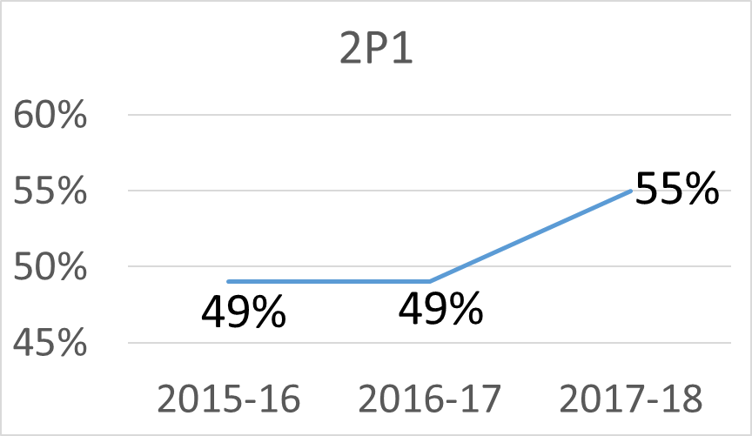
2P1 – State Trend

Slide 57
2P1 - State Data by Subgroup

Slide 58
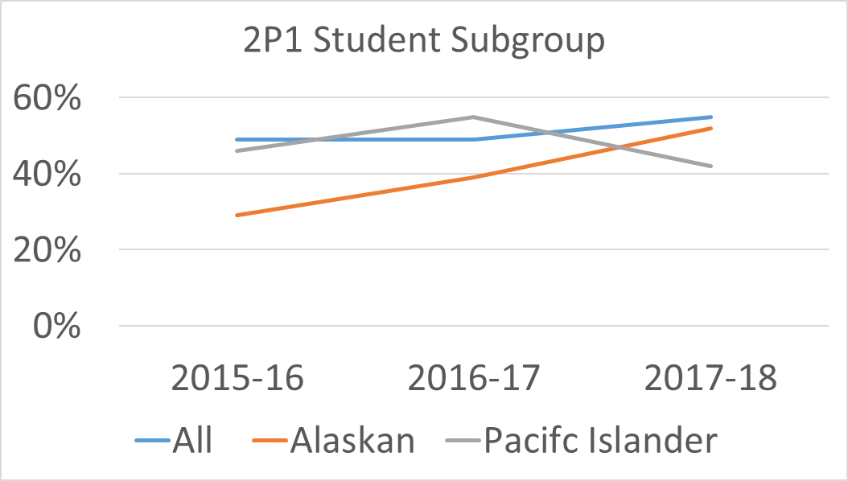
2P1 by State Student Subgroup
55%
49%
52%
46%
42%
29%

Slide 59
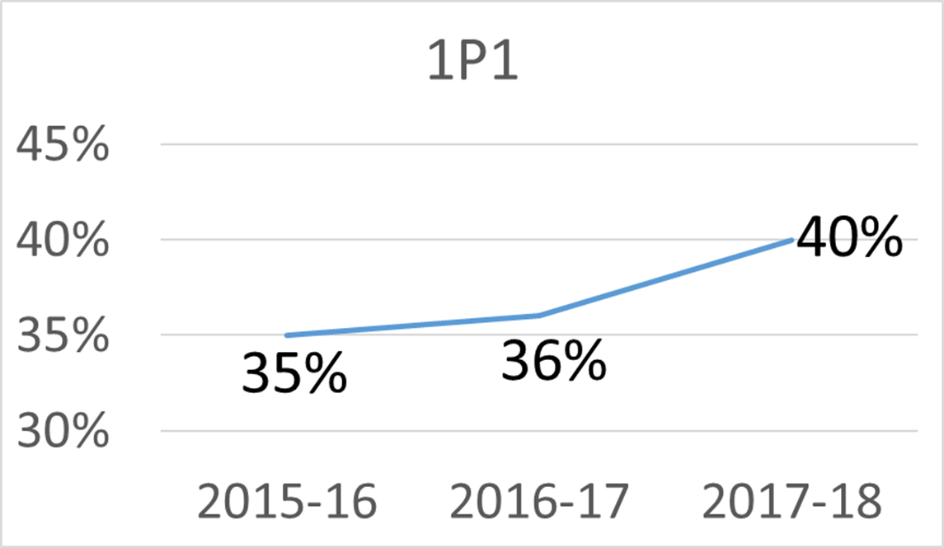
1P1 – State trend

Slide 60
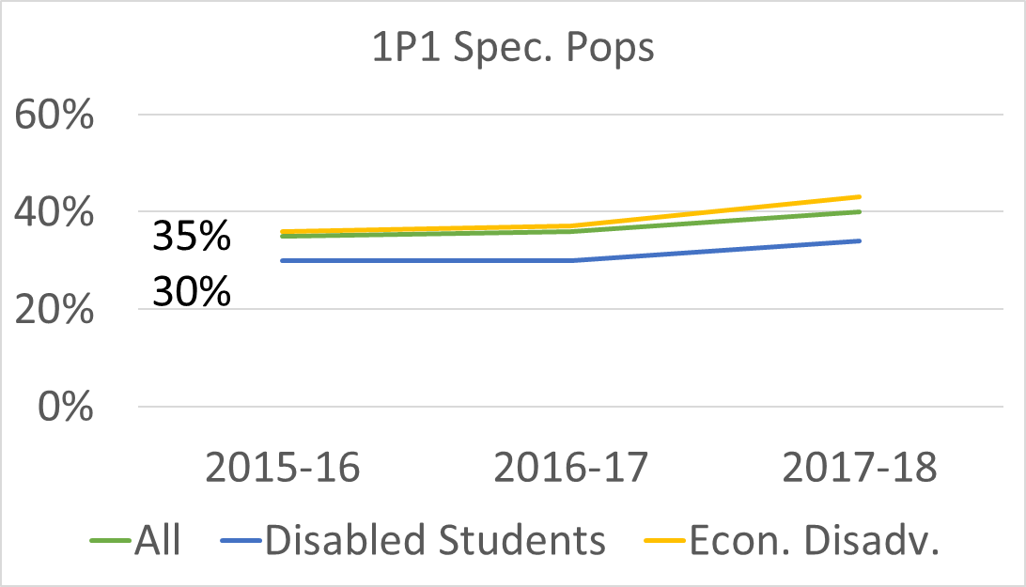
1P1 by State Spec. Pops
43%
40%
34%
36%

Slide 61
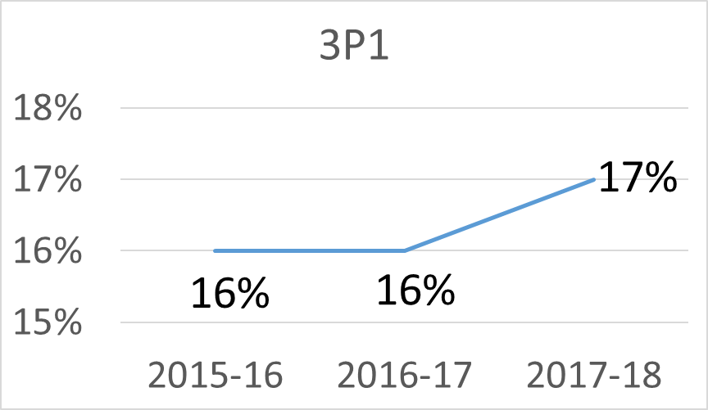
3P1 – State Trend

Slide 62
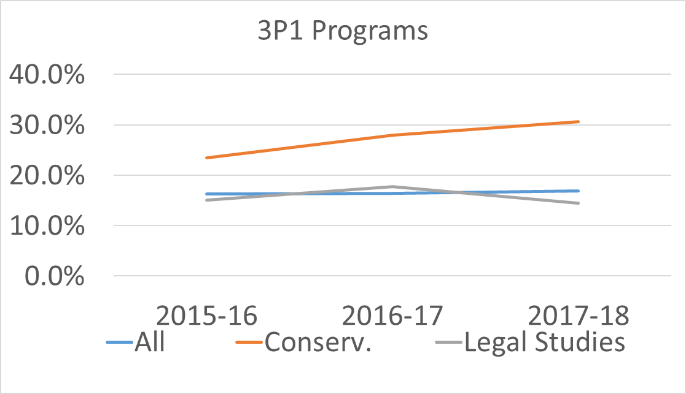
3P1 by State Programs (Non-trad Fields)
30.6%
23.5%
16.3%
16.9%
15.1%
14.5%

Slide 63
Questions?

Slide 64
Let’s Take a Peek…
Looking at College Specific Data
Trish Newbold

Slide 65
College Worksheet (College-specific data and yellow handout)
What student groups or special populations are being successful?
Where are some performance gaps?
Which programs are performing well?
Which have challenges?
What are your “Ah-ha” findings?

Slide 66

Let’s Eat!

Slide 67
Data Tells only Part of the Story
What Else to We Need to Know?
Cathy Alston
Paulette Lopez

Slide 68

Root Causes
Symptoms
Result or outcome of the problem
What you see as a problem (obvious)
The Problem
Gap from goal or standard
Causes
“The Roots” – system below the surface, bringing about the problem (Not obvious)
Symptoms
Problem
Causes

Slide 69
Strategy Development
Clarify the problem and your desired results – what is the gap?
  Analyze data
  Analyze root causes
Refine your strategy
  Discuss with college partners
Develop your action plan
  Major activities
  Timelines
Define how progress will be measured.
Evaluate the outcomes and modify strategy as needed.

Slide 70
Questions?

Slide 71
College Discussion Time
Using your college-specific data, what student groups or programs merit further investigation?
Using the back of the yellow handout, identify an issue/problem and develop a list of potential root causes.
Choose one likely root cause and list potential strategies to mitigate the issue/problem. Include how you will measure progress.

Slide 72
Comprehensive Local Needs Assessment
What does that even mean?
Lauren Hadley
Tim McClain

Slide 73
Purpose of CLNA
Data-informed evaluation
Collaboration
Equity
Accountability
Leading to continual improvement and innovation

Slide 74
State Expectations for Year 1
This year our system will concentrate on 2 of the 5 requirements of the CLNA.
“CLNA Lite”
1. Evaluation of performance data (Element 2)
2. Ensuring equity and access (Element 1)

Slide 75
Evaluation of performance data
New indicators
Analysis of data trends
Program-by-program review
Student support services
Engagement with existing stakeholders

Slide 76
Ensuring equity and access
Analysis of disaggregated data
Performance gaps
Root causes
Resources and strategies development
Engagement with diverse stakeholders

Slide 77
3 additional CLNA requirements
This year our system will put less emphasis on the remaining three CLNA requirements.
3. Program alignment and size, scope & quality.
4. Implementing programs & programs of study.
5. Recruitment, retention & training of CTE educators.

Slide 78
Did we mention…
DON’T PANIC!
Focus on two elements.
Start with existing stakeholder groups and data sources.
Know that expectations are tempered.
Know that the process and documents are a work in progress.
Utilize SBCTC resources and technical assistance.
Consider a continuous, cyclical approach.
Notes:
Most are already doing this work – don’t recreate the wheel, just be intentional and streamline/adjust/supplement current practices.
Take opportunities – such as this – to provide feedback. This is new to us, too, so we welcome constructive criticism and new ideas.
Planning to suspend monitoring to provide assistance.
Don’t try to pack everything into the year the CLNA is due. Track and take advantage of ongoing engagement opportunities and develop a reliable system of recordkeeping.

Slide 79
CLNA Template
Leadership Team
Stakeholders List
5 Elements
  4-6 Questions
  Current/Desired States
  Evidence/Data
  Rating
  Strategies/Priorities
Summary
Stakeholder Verification
Notes:
Required Stakeholders:
Faculty, Administrators, Counselors/Advisors, etc.
K-12 Partners
Employers, Business/Industry Leaders, WDCs, Labor, etc.
Students (and Parents)
Representatives of Special Populations
Agencies Serving Out-of-School or At-Risk Youth
Representatives of Indian Tribes/Organizations
Summary
Themes, Needs, Priorities
Funding Estimates
Foundation for Local Application

Slide 80
Strategies
Step 1: Determine Emphasis and Objectives
  Guide Pages 4-5
Step 2: Identify Leadership Team and Stakeholders
  Guide Page 5
Step 3: Gather and Develop Materials
  Guide Pages 5-6
Step 4: Solicit Feedback and Provide Analysis
  Guide Pages 6-7

Slide 81
Step 1: Emphasis and Objectives
Review CLNA Elements 1 & 2
Review Mission, Vision, and Guiding Principles
Determine Approach and “North Star”
Identify and Lead with the Essentials
Notes:
If you’re familiar with state priorities, you don’t need a deep-dive into data to identify preliminary themes and objectives.
Be deliberate about your approach and strategize how and when to invite others to the table.
Identify and lead with the essentials. Don’t coopt the process, but reverse engineer it so that you can account for and justify those things you need to sustain your programs.
Look for opportunities to be innovative, but don’t lose sight of what you’re already doing well.

Slide 82
Step 2: Identify Team and Stakeholders
Start Close to Home
Identify Missing Stakeholders
Identify Standing Groups/Meetings
Consider Other Methods of Engagement
Partner with Other Colleges, Schools, and Agencies
Notes:
Your leadership team should be your “circle of trust” wherein you can be critical and not worry about airing dirty laundry.
Make sure you have the expertise you need within arm’s reach.
Delegate when appropriate: scheduling, agendas, minutes, data collection, recordkeeping, writing
Other methods: surveys, webinars, conference calls, web forms, document-sharing
Everyone needs to write their own local needs assessment, but that doesn’t mean you can’t share resources or collaborate on the process.
Examples of stakeholders groups: General Advisory Committees, WRT Advisory Committees, Workforce Education Services Teams, student organizations/governments, chambers, WDCs, EDCs, unions, consortia, DEI Committees, Tribal Organizations, social services agencies, etc.

Slide 83
Step 3: Gather and Develop Materials
Collection of Readily Available Data/Information
Leadership Team Review and Prioritization
Missing Data/Information
Stakeholder Review/Feedback Strategy
Notes:
Start with observations/themes noted in Step 1 and determine if you have the data available to support them.
Look for areas where you’re missing information or need more to triangulate findings.
Determine your priorities and who needs to inform them.
Organize, organize, organize: Who needs to see and respond to what?
Determine how you are going to present information and document feedback.
Examples of materials: disaggregated performance data, advisory committee recommendations, student evaluations, demographic data, labor market information, accreditation reports and findings, focus groups, survey results, demand/decline list, salary/wage reports, program review summaries, budgets, student learning outcomes

Slide 84
Step 4: Feedback and Analysis
Purpose, Vision, and Objectives
Questions and Facilitation
Recording and Recordkeeping
Recognition and Continual Engagement
Notes:
Questions to Consider:
Who is the most appropriate person to facilitate the conversation?
How will you convey the overarching purpose, strategy, vision, values, or goals?
How will you share pertinent information with groups?
How will you document recommendations and findings?
How can you acknowledge their contributions and keep them engaged in a continual improvement process?
Recommendations:
Document attendance and participation
Limit scope by preparing questions/topics in advanced based upon materials/data sources
Create worksheets modeled after the CLNA template
Look forward and focus on the “desired state” and what strategies are going to get you there.
Debrief stakeholder engagement activities with leadership team to prioritize findings.

Slide 85
Goals of Stakeholder Engagement
Validate strengths and areas of concern
Challenge findings and identify areas for follow-up
Root cause analysis of deficiencies
Action plans to address performance gaps or deficiencies
Identify new concerns
Inform application and Perkins funding strategies
Establish lasting partnerships and opportunities for collaboration

Slide 86
Where Do We Go From Here?
Where’s the map?
Susan Parker
Kathy Goebel

Slide 87
Let’s review
Overview of Perkins V
The New Performance Indicators
Student Performance Data
Root Cause Analysis and Developing Strategies
The Comprehensive Local Needs Assessment

Slide 88
Suggested timeline
Data review | Oct. 2019
Identify team and stakeholders | Oct. 2019
Gather and develop materials for engagement activities | Oct. – Nov, 2019
Solicit and analyze feedback | Nov. – Jan. 2020
Complete CLNA | Jan. – Feb. 2020
Perkins Application Release | Feb. 2020
Perkins Application Due Date | April, 2020

Slide 89
Assistance
Check out the State Board web site for resources. Perkins V Resources
Tim and Kathy are available to provide technical assistance and support.
Use the vtc list serve to pose questions.
Leverage Perkins Leadership and Special Project funding to assist with the CLNA/stakeholder engagement process.

Slide 90

Final Thoughts
Don’t Panic! This is a practice year.

Slide 91

We invite you to stay or call/email us if you have additional questions.

Slide 92

Travel home safely
Don’t hesitate to contact Tim or Kathy for assistance and support.
Tim McClain Kathy Goebel
tmcclain@sbctc.edu kgoebel@sbctc.edu
360-704-4342 360-704-4359
Note: All material licensed under Creative Commons Attribution 4.0 International License.

