Slide 1
CTE Dual Credit
ctcLink Pilot Expansion
Campus Solutions Core (CS Core) Highlights
September 16, 2026
Notes:
This presentation highlights some CS Core areas referenced in the CTE Dual Credit Business Process document. Colleges can use this presentation to understand some key considerations and highlights. Please refer to the CTE Dual Credit Business Process for more details, including links to relevant QRGs.

Slide 2
Introductions
Kyrsten Catlin, SBCTC, Director of ctcLink Campus Solutions (CS Core)
Karen Erickson, SBCTC, Senior Functional Analyst, CS Core
Maria Sultan, SBCTC, Senior Functional Analyst, CS Core

Slide 3
Agenda
CTE Dual Credit Business Process
  CS Highlights and Considerations
OAAP Go Live Options
ctcLink Go-Live Checklist

Slide 4
Demo Coming Soon!
What: CTE DC OAAP, Enrollment, and Class Setup Demo
Audience: CTE Dual Credit staff unfamiliar with OAAP, Enrollment Processes, and Class Setup in ctcLink
When: Tuesday, October 13, 2026
Time: 1:00 pm – 2:00 pm
Meeting invite coming soon!

Slide 5
What does that mean?
Some common abbreviations and terms used throughout this presentation:
ctcLink: Centralized enterprise resource planning (ERP) system for Washington’s public Community and Technical colleges; It provides a common system for managing student services, financial, and human resources/payroll processes.
Campus Solutions (CS): One of three ctcLink pillars for student administration. It supports the student life cycle, from application and admission through enrollment, academic records, and graduation.
ctcLink Student Homepage: Student-facing self-service area within Campus Solutions. It provides students access to their academic and student account information and allows them to complete common tasks, such as registering for classes, viewing their class schedule and grades, managing personal information, making payments, and accessing academic records. Some college staff refer to this as the desktop version of ctcLink CS. This is also commonly referred to as ctcLink Student Self-Service.

Slide 6
What does that mean? (Continued)
HighPoint Campus Experience (HCX): Third-party mobile interface integrated with the CS pillar. It provides an alternative user experience, allowing students to access their information more easily via a mobile browser or the ctcLink mobile app, rather than the traditional ctcLink Student Homepage. Some college staff refer to this as the mobile version of ctcLink CS.
Online Admissions Application Portal (OAAP): Statewide online application used by students to apply to Washington’s Community and Technical colleges. OAAP is not used for Continuing Education applications.
Career and Technical Education College Dual Credit (CTE DC): Previously known as Tech Prep, Offers high school students the opportunity to earn college credit for successful completion of CTE courses taught by certified high school instructors; Formerly known as Tech Prep.

Slide 7
CTE DC Business process
Admissions

Slide 8
OAAP Information
To help streamline the application process, a new academic plan and admit type will be configured for your college.
  Academic Plan: CTE Dual Credit (NASCTE)
  Admit Type: CTE Dual Credit
Directing students to select these values will help college staff more easily identify CTE Dual Credit students for downstream processes such as outreach, application review, and processing.
Students enrolled exclusively in CTE Dual Credit must be associated with Academic Plan “NASCTE” for correct Data Warehouse mapping.

Slide 9
OAAP Information (Continued)
Submitted applications can be viewed in both OAAP and ctcLink.
In-Progress applications (saved but not yet submitted) can only be viewed in OAAP. College staff can download a list of in-progress applications from OAAP.
OAAP Terms Setup controls how long a term is available for students to apply and is managed only in OAAP.
Select college staff can manage student OAAP accounts, including initiating student password resets and resetting OAAP account email addresses.
Depending on your business process, CTE DC staff may need access to OAAP. We recommend consulting with your college’s Registrar.

Slide 10
OAAP Terms setup
The CTE Dual Credit Admit Type allows colleges to control when CTE Dual Credit applications are available each term without affecting other admit types, such as CiHS, Apprenticeship, or First Year.
Application terms must be added and removed in real time. OAAP does not currently support scheduling open or close dates in advance.
If a term remains available in OAAP after it should have closed, students can still submit applications for that term. College staff will need to manually update the term and applicable dates when processing those applications.

Slide 11
OAAP Student login
Students need a unique email address to create an OAAP account and must have access to that email to receive a One-Time Password (OTP) during OAAP account creation.
When a new student’s application is successfully submitted to ctcLink, an EMPLID (ctcLink Student ID) is generated. Students can find their EMPLID in OAAP by viewing their submitted application.
Students with an existing EMPLID should be encouraged to log in to OAAP using their ctcLink ID and password. They must have previously completed Activate Your Account (AYA) to use this login option.

Slide 12
Oaap start an application values
Students should select the following values when completing an application.
  College: Select the applicable college
  Admit Type
    OAAP Field: I will be enrolling as a…
    Select: CTE Dual Credit
  Academic Program
    OAAP Field: Program
    Select: Non-Award Seeking
  Term: Select the applicable term (e.g., Winter 2027)
  Academic Plan
    OAAP Field: Degree or Certificate I am seeking…
    Select: CTE Dual Credit
  Academic Subplan
    OAAP Field: Academic Focus Area
    Leave blank
Notes:
Colleges can refer to the following QRG for guidance on submitting a CTE Dual Credit application: https://ctclinkreferencecenter.ctclink.us/m/79544/l/2079451-oaap-career-and-technical-education-cte-dual-credit-admissions-application-without-a-fee

Slide 13
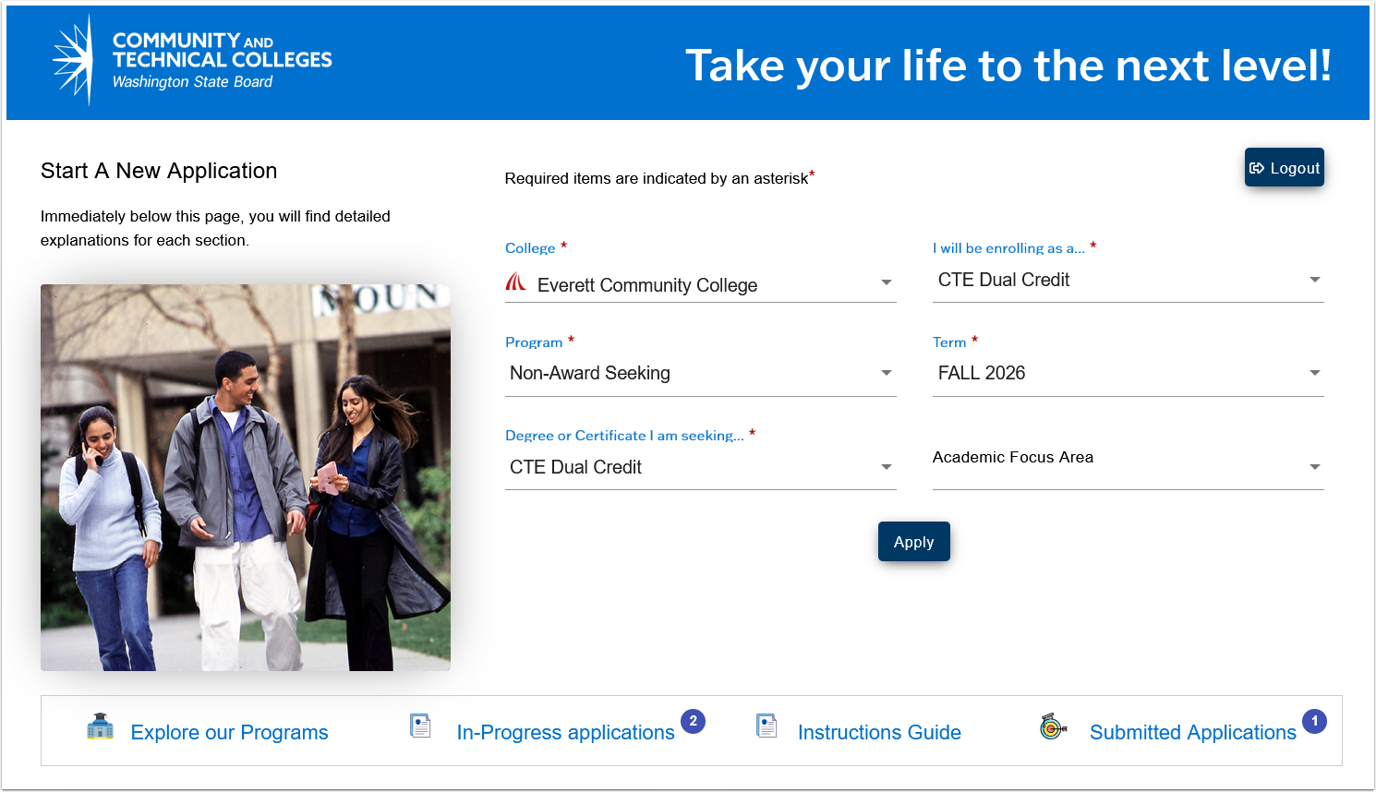
Example oaap screenshot

Slide 14
Submitting an application
A QRG has been created to walkthrough the CTE Dual Credit application process.
Link: https://ctclinkreferencecenter.ctclink.us/m/79544/l/2079451-oaap-career-and-technical-education-cte-dual-credit-admissions-application-without-a-fee

Slide 15
OAAP Upload Documents
Some colleges allow students to upload documents as part of the OAAP application.
CTE Dual Credit will use the same admissions template as Running Start students. If your college currently accepts documents for Running Start and CiHS students, this will also be available for CTE Dual Credit students.
Know your college’s process and provide CTE Dual Credit students with clear instructions on what to upload - or whether they should skip this section of the application.
Notes:
This slide was updated following the September 16 Webinar.

Slide 16
OAAP Application fees
Colleges determine whether to charge students an application fee in OAAP.
Application fees can be configured by admit type. Colleges that charge other applicants can choose not to charge CTE Dual Credit students.
If your college does not currently charge application fees in OAAP but plans to, additional setup will be required with SBCTC and your Student Financials staff.
Application fee waiver codes can be generated in OAAP. Colleges should establish a process for providing waiver codes to students before they apply so the code can be entered during the payment process.

Slide 17
Prepare for student questions
Students may need assistance while completing their application. It is important to understand where OAAP directs students for help.
College Email and Phone: Each college configures one email address and phone number in OAAP for all applicant types. This contact information appears in the light green toolbar near the top of the application as students move through each section.
ctcLink Help: Some error messages may direct students to the ctcLink Help website. Review your college’s information and make sure staff who may receive inquiries know how to direct students for additional assistance.

Slide 18
Reviewing CTE Dual Credit Applications
CTE Dual Credit applications should be validated with CTE Dual Credit program staff to confirm the student selected the appropriate admit term based on application timing and the college’s local admissions processing timelines.
To identify submitted applications, run the Admissions Query and filter by the CTE Dual Credit admit type or NASCTE plan code.
QRG Resource: 9.2 Running Admissions Query.

Slide 19
Reviewing CTE Dual Credit Applications (Continued)
Some applications may partially match an existing person in ctcLink and require staff review to determine whether it is the same person. This process is called OAAP Suspense Management.
Suspense Management must be completed before an EMPLID can be assigned to the application. Students will not see an ID on their submitted application in OAAP until approximately one hour after staff complete this process.
Suspended applications should be reviewed and processed regularly.
To identify suspended applications, run the Applications in Suspense (QCS_RA_APPLICATION_STAGING) query.

Slide 20
Oaap application status
Students and staff can view the application status in OAAP:
  Submitted: Received successfully in ctcLink but not yet matriculated.
  Active in Program: Received successfully and matriculated, creating an active Student Program/Plan stack.
  Pending: Received in ctcLink but suspended due to a partial match. Staff must complete OAAP Suspense Management.
  Cancelled: Received in ctcLink but later withdrawn by college staff.
Status Updates: OAAP statuses are updated hourly based on changes made in ctcLink, such as matriculating or withdrawing an application or completing Suspense Management.
Notes:
This slide was added to the presentation following the September 16th Webinar

Slide 21
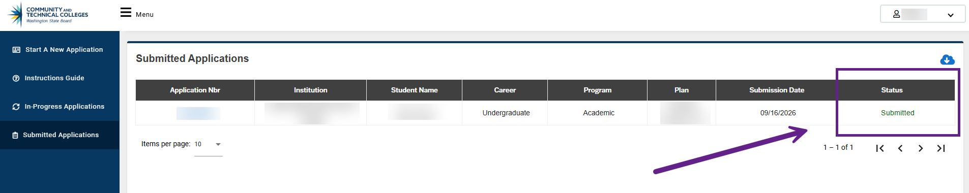
OAAP Application Status Example Screenshot
The screenshot below shows how a Submitted application status appears to a student in OAAP.
Notes:
This slide was added to the presentation following the September 16th Webinar

Slide 22
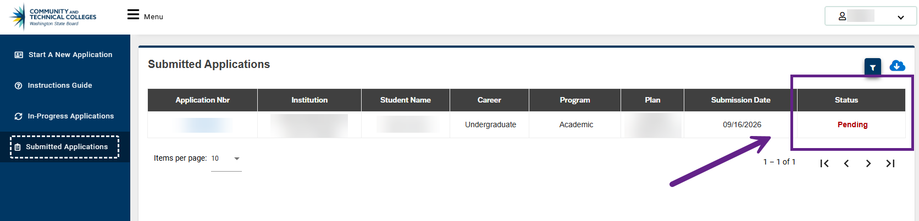
OAAP Application Status Example Screenshot
The screenshot below shows how a Pending application status appears to a student in OAAP.
Notes:
This slide was added to the presentation following the September 16th Webinar

Slide 23
Completing the Admissions process
Applications must be matriculated to create the Student Program/Plan Stack.
Once staff matriculate the applicant, the admissions process is complete. The matriculation date should be on or before the start date of the student’s admit term.
Colleges can send an admissions letter welcoming students and providing information about next steps.
Determine whether your college has an existing admissions letter appropriate for CTE Dual Credit students or if a new letter should be requested for this population.

Slide 24
CTE DC Business process
Enrollment

Slide 25
Before students enroll
Before giving students the go-ahead to self-enroll in ctcLink, confirm the following:
Student is term activated for the correct term.
Student has an enrollment appointment, if required by your college.
If the class has prerequisites, the student has the appropriate prerequisite requirement or value needed to enroll.
For OEE classes, the student knows which start date to use. In HCX, the earliest available start date is automatically populated, but students can select another valid date within the allowed range.
Student has completed Activate Your Account (AYA) in ctcLink.

Slide 26
Restricting Enrollment in CTE DC Classes
Colleges can use one or a combination of the following options to restrict enrollment in CTE Dual Credit classes:
Hide the class from public class search
  When setting up the class, do not select Schedule to Print in Maintain Schedule of Classes.
  Students searching by subject and catalog number will not see the class in their results.
  Colleges can provide the specific class number, which students can use to find the class directly.
Require a class permission code
  Provide the permission code to students in advance so they can enter it during enrollment.

Slide 27
Restricting Enrollment in CTE DC Classes (Continued)
Colleges can use prerequisites to restrict enrollment in CTE Dual Credit classes.
  For example, a class can require students to be assigned to a specific Student Group or Academic Plan, such as CTE Dual Credit, before they can enroll.
    Be sure to account for students in multiple dual credit programs who may not have a Student Program/Plan stack for the NASCTE plan.
  The student must meet the prerequisite before attempting to enroll. Otherwise, they will receive a prerequisite error and will not be able to complete enrollment.

Slide 28
Student enrollment experience
Know whether your college typically directs students to the ctcLink Student Homepage or HCX for tasks such as enrolling in classes, paying fees, and viewing academic records.
The enrollment process is similar in ctcLink and HCX, but the student experience looks different, and HCX may include an additional step depending on how classes are configured.

Slide 29
HCX vs. ctcLink enrollment
In HCX, classes hidden from search can only be enrolled in through the Shopping Cart. Students must first add the class to their cart, then navigate to the Shopping Cart to complete enrollment.
HCX also offers a public class search that does not require students to log in to view classes. However, students must log in before they can enroll.
In the ctcLink Student Homepage, students can enroll directly in a class without first adding it to the Shopping Cart, unless the class requires a corequisite.

Slide 30
Resolving enrollment issues
Students may receive an error message when attempting to enroll. The Self-Service Enrollment Messages QRG explains various error messages to help staff determine troubleshooting next steps.

Slide 31
CTE DC Business process
Class Setup

Slide 32
CTE DC Class Setup: OEE Session Type
CTE Dual Credit classes must be set up as Open Entry/Open Exit (OEE).
OEE classes allow students to begin at different times within the same term.
Each student is assigned an individual Start Date at enrollment. As a result, students in the same class may have different deadlines based on the rules assigned to the class.
For OEE classes, the census date is the last day of the quarter, as defined on your college’s Term/Session Table.

Slide 33
CTE DC Class Setup: OEE Rules & Dates
OEE classes are typically scheduled using the term start and end dates, and students may enroll throughout the term.
The system uses the student’s Start Date, the OEE dynamic date rules, and the college’s academic calendar setup to calculate:
  Drop dates
  Cancel and withdrawal dates
  Census dates
  Other key academic deadlines
Ensure all CTE Dual Credit class sections are assigned the appropriate OEE rule to prevent unintended outcomes, including the system assigning incorrect “W” grades.
See Appendix A of the CTE DC Business Process Document for an example OEE rule that allows staff to drop a student at any time during the term without backdating or assigning a withdrawal grade.

Slide 34
CTE DC Class Setup: High School Location Codes
SBCTC staff have created a High School LOCATION Code Workbook based on the official list of high schools published on OSPI’s website. Each LOCATION code corresponds to an OSPI School Code.
Colleges must assign the appropriate location code to each CTE DC class section to identify the high school or skills center where the course is offered.
SBCTC will maintain the list of global OSPI high school codes on the CiHS page of the SBCTC website, under the section titled “Resources.”

Slide 35
CTE DC class setup: High School Location Codes (Continued)
College Actions
  Identify your CTE Dual Credit high school partners in the workbook.
  Configure only the LOCATION codes for schools your college partners with.
  Submit a CS Support ticket to add locations to the Campus Table.
  Assign the appropriate LOCATION code to every CTE Dual Credit section to identify where the course is offered.
QRG: Adding Locations to the Campus Table

Slide 36
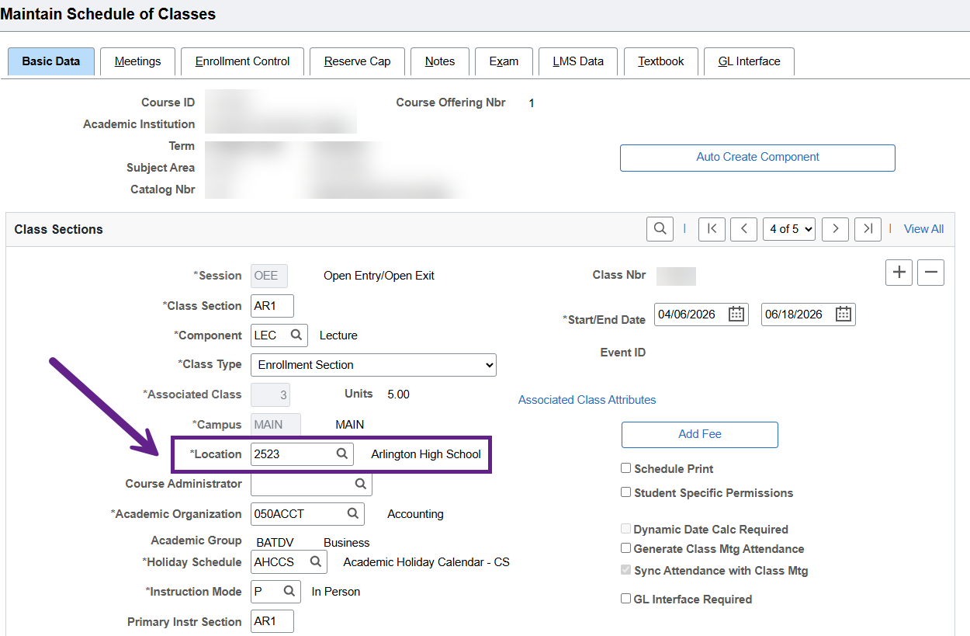
Example class location screenshot

Slide 37
CTE DC Class Setup: Additional Class Coding
CTE DC classes must be coded with the following Course Attributes:
SCTE Course Attribute – Identifies the class as CTE Dual Credit
SFND Course Attribute, Value 5 – Identifies the class as a fund course
SNFG Course Attribute – Prevents FTES from generating
SNCF Course Attribute – Used when class instructors are not college faculty
Class Location – Use the appropriate OSPI high school location code from the High School LOCATION Code Workbook
  Colleges must submit a ticket to SBCTC first if the code is not available
For additional coding requirements, refer to the SBCTC Student & Course Coding Manual.

Slide 38
CTE DC Class Setup: Class Fees
Class fees are used to assess specific charges tied to individual class sections in ctcLink. These fees are applied in addition to, or in place of, standard tuition depending on course configuration. Colleges are responsible for ensuring that all class fees are configured consistently with SBCTC policy, local business processes, and audit expectations.
  Class fees should be reviewed and validated prior to term activation and enrollment activity to ensure accurate tuition calculation and student billing.
    Query = QCS_SF_CLASS_FEES_BY_TERM (Class/Crse/List Fees by Term)
When fees are associated with OEE classes, colleges must establish a clear process for handling refunds, if applicable.

Slide 39
CTE DC Class Setup: Instructor information
High school instructors not employed by the college can be added to ctcLink as a Person of Interest (POI).
POI setup requires steps in both HCM and Campus Solutions. Coordinate with your HR office in advance.
POIs can be assigned to classes as instructors and, if appropriate, authorized to enter grades.
External Instructors can be added during the current term without affecting enrolled students. Add them before the QARS Cleanup Deadline for accurate quarterly reporting.

Slide 40
Grading information
Grades are due at the end of the quarter. For year-long courses where final grades are not available until spring, submit grades with spring quarter reporting.
If high school instructors will enter grades, coordinate with your HCM team and LSAs to provide the appropriate security, training, and grading expectations. Consider when your college opens grade rosters and communicate this to the instructor.
High school instructors entering grades must be set up as External Instructors on the Instructor/Advisor Table:
  Grade Roster Access: Approved
  Assign Type: Unassigned - prevents FWL calculations from processing

Slide 41
Grading information (Continued)
Until a standard statewide grading/transcription policy is established, follow local articulation agreements.
Protect student records: If a student does not meet the required grade under the articulation agreement, the college should remove the course from the student’s record.
Spring deadline: All academic-year grades must be posted before the spring Data Warehouse Transcripts & Completions snapshot to support accurate course success reporting by SBCTC.

Slide 42
CTE DC OAAP Go-live Information
Timelines and Considerations

Slide 43
OAAP Go-Live Options
SBCTC will coordinate with the OAAP vendor to enable the new CTE Dual Credit admit type for your college.
Colleges can choose from two go-live cohorts:
  Pilot Expansion Cohort 1: October 19
  Pilot Expansion Cohort 2: November 16

Slide 44
OAAP Go-Live considerations
On your go-live date, you will need to:
  Set up OAAP Terms
  Remove the CTE Dual Credit plan from the OAAP Academic Plan Configuration page
Keep in mind:
  Once enabled, the CTE Dual Credit Admit Type will remain visible in OAAP and cannot be hidden through configuration.
  If terms have not been set up for the admit type, students will not be able to proceed past the Term field in the application.
  If your college does not currently charge OAAP application fees but wants to charge CTE Dual Credit students, choose Cohort 2.
  Colleges can join Cohort 1 without an application fee and enable fees later by working with SBCTC on an individual basis following Cohort 2.

Slide 45
OAAP Go-Live Cohort Sign-Up
Consult with your Registrar before opting in to a cohort.
Choose the go-live date that best positions your college to:
  Process new CTE Dual Credit applications
  Support high school and student questions
  Troubleshoot issues as they arise
Due Date: Friday, September 25
Sign Up: Link

Slide 46
ctcLink Go-Live Checklist

Slide 47
ctcLink go-live checklist
We’ve created a CTE Dual Credit Go-Live Checklist to help your college prepare for go-live and track required ctcLink setup tasks. Please consult the CTE Dual Credit Business Process document for full details.
Go-Live Checklist: Link

Slide 48
ctcLink Campus solutions support

Slide 49
Your CS Support team is here to help!
Use the ctcLink Reference Center for guidance on functionality.
  New to the ctcLink Reference Center? Consult the How to Search the ctcLink Reference Center QRG.
Use the PCD environment to test security and setup before go-live. Remember the environment is refreshed the first Monday of every month. (See next slide)
  Note: OAAP does not have a test environment connected to PCD.
Refer to the CTE Dual Credit – ctcLink Training Resources document, which provides recommended Canvas trainings for the CTE DC Business Process.
For additional assistance, follow your college’s local process to submit a ctcLink Support ticket to SBCTC (Campus Solutions).
  Reference CTE Dual Credit Expansion in your request so we can quickly identify and route your ticket.
Notes:
This slide was updated following the September 16th Webinar.

Slide 50
PCD Environment Information
PCD is the dedicated environment for college testing and query development.
PCD is typically refreshed the first Monday of each month. Refreshes overwrite changes that have not also been made in Production. See SBCTC Environment/Pillar Updates for the current schedule.
PCD uses Okta Multi-Factor Authentication (MFA).
Your PCD security access should match Production. Security changes should be made in both environments; otherwise, changes will not carry to PCD until the next refresh.
New PCD users must complete Activate Your Account (AYA) for PCD. Production account activation does not carry over to PCD.
QRG: Testing in PCD and Production - includes first-time account activation steps.
Notes:
This slide was added to the presentation following the September 16th Webinar.

Slide 51
CS Support Listserv Information
If you are a ctcLink end-user and not already hearing about learning opportunities firsthand, join one or more support lists today.
ctcLink Customer Support teams (including CS Core) send notifications of learning opportunities (including trainings, work sessions, user acceptance testing, issues, trips/tricks, and more), as well as global and cross-pillar system communications to the applicable ctcLink Support eLists (aka listservs) on a regular basis.
We encourage you to sign-up for the ctcLinkCSSupport listserv today!
Notes:
This slide was added to the presentation following the September 16th Webinar.

Slide 52
Thank you!
Any questions?

