Slide 1
CTE Dual Credit
ctcLink Pilot Expansion
Community of Practice
System Information Webinar
September 2, 2026
Notes:
SBCTC – Bill
Please add questions in chat as we proceed with the presentation.
Expectations of participating colleges
Goal to retire SERS, with all colleges operating in ctcLink for CTE DC – due to security concerns and maintenance of SERS
The expanded pilot requires participating colleges to fully adopt the established business processes – inclusive of OAAP, Academic Plan, OEE, and Attributes for student and course coding. Implementation with all partner districts.
Local flexibility for certain aspects of the project, in configuration, that will be discussed as part of the onboarding process.
Sincere appreciation to our college pilots (EvCC and SVC), data service, and campus solutions teams for their dedication and contributions to this important project.
As we move forward, please contact me with questions about the expanded pilot. Our goal is to minimize the impacts to our pilot sites by managing communications through SBCTC.

Slide 2
Presentation overview
Strategic Context
Expectations of New Colleges
System Provided Supports
System Resources
Key Benefits
College Staffing & Capacity
Community of Practice Focus Areas (today)
Questions
Notes:
SBCTC - Bill

Slide 3
COP Participants
FY26 Cohort
Bates
Bellingham
Big Bend
Clark
Edmonds
Olympic
Peninsula
Pierce District
Seattle District
Shoreline
Tacoma
Whatcom
Notes:
SBCTC - Bill

Slide 4
Strategic context
Alignment across all dual credit options
  CTE DC, RS, CiHS
Designated OAAP for CTE Dual Credit
  Student direct navigation of admission and enrollment
Create a single dual credit ecosystem to support students and K12 partners.
Transcribes CTE DC as college credit, not ACPL
Replacement of SERS
  Goal: all CTE DC in ctcLink by fall 2027
Notes:
SBCTC

Slide 5
expectations for new colleges
Colleges must:
  Commit staff time across multiple units
  Follow shared business processes
  Access ctcLink resource center and follow guidance documents
  Participate in system coordination
  Accept evolving processes
  Fully utilize ctcLink for all CTE DC enrollment processes
Notes:
SBCTC - Bill

Slide 6
What supports will be provided
Community of Practice
  September 16 – Campus Solutions focus
  October –CS demo of OAAP and Enrollment
  October to December – Open office hours
Business process documentation
Training materials
Shared resources
Report development
Solar Winds ticketing system
Notes:
SBCTC

Slide 7
System resources
SBCTC CTE Dual Credit ctcLink Pilot Webpage
  Business Process Document
  System Webinar PPT & Recording
  CTE Dual Credit ctcLink Pilot College Resources
  Project and Readiness Document
SBCTC Policy Manual
  Chapter 4 Instructional Program & Course Development
ctcLink Reference Center
ctcLink Service Desk/Ticketing System
Notes:
SBCTC – Bill/Kimberly

Slide 8
Key benefits
Student Benefits
  Single system experience
  Transcripts are available sooner
  Better alignment across programs
  Improved transferability of dual credit courses
  Credit doesn't appear as Academic Credit for Prior Learning
College Benefits
  Real-time student tracking
  Improved reporting capabilities
  Streamlined training for K12 partners
  Faster transcription
  Reduction in manual processing
Notes:
SBCTC – Bill/Kimberly

Slide 9
Key benefits
System Benefits
  Standardization of processes
  Foundation for future policy alignment (grading, articulation)
  Retirement of legacy systems (e.g., SERS)
K12 Benefits
  Student reports, rosters of enrollment
  Common system across dual credit programs
  Counselors and Career Specialists – common systems/training
Notes:
SBCTC – Bill/Kimberly

Slide 10
College Staffing & Capacity
College Staffing:
  Admissions
  Registration
  Financial Aid
  IT/ctcLink
  Instruction
  Course building
  Dual credit program team
  Human Resources (POI)
  Business Office (Fees)
Requires:
  Manual review + automated processes
  Continuous troubleshooting
  Staff time allocated to support workload
Notes:
SBCTC - Bill

Slide 11
COP Areas of focus today
High School Communication and Coordination
  Sharing of college developed resources
  Coordination of Training
Course Build & Academic Calendar
  Admission and Registration
Data, Reporting, & Tracking
  Confirming accuracy of student information
Instructor Setup & Human Resources
  Use of Person of Interest (POI)
Notes:
SBCTC - Bill

Slide 12
High school coordination
Heavy reliance on K-12 partners to assist in communication with instructors, students, and families
Key issues:
  Calendar misalignment
  Need for Instructor communication and training
  Grade submission methods
  Multiple college options, inconsistent regional practices
Pilot approach:
  Communication strategies
  POI vs. college entry approach (teacher access, grading)
Notes:
EVCC - Anna
Heavy reliance on K-12 partners - increased need for communication to instructors, and to students/families via instructors/cte directors
SVC:
Start w/ communicating why this change from schools before discussing everything that will change. Ali's pitch: "We want to build more articulations so that students can receive more dual credit without it affecting your FTE. However, because the process is so manual, we don't have the staff capacity to build more articulations and be able to transcribe students. Therefore, if schools want more dual credit for their students, they must do this new system. This new system will also improve transferability of courses greatly because they will appear on the transcript as if the student had taken them at the community college. This will make them more valuable!" We also like to pitch that "it is valuable for students to interact w/ college systems w/ supportive adults before exiting high school so they get practice with this."
SVC is starting to offer a teacher training this year w/ clock hours available so teachers can feel more confident in doing these processes w/o SVC representative
This will be a heavy lift from high schools if they haven't done the OAAP before. We had some resistance and were told that teachers liked the old way "SERS" because it was fast and easy-->high schools don't understand how much work it was on the community colleges.

Slide 13
Course Build & Academic Calendar
Build in ctcLink as Open Entry Open Exit (OEE)
Classes require a set of course attributes and high school location coding
  See example on next slide
  OSPI High School Code List
  SBCTC High School Code List
Areas to Consider:
  Course build impact (staffing and timeline)
  Calendar alignment – campus and multiple dual credit programs, deadlines
  Teachers on Classes - Person of Interest
  Student Group Coding (student group management)
  Census date (OEE)
Notes:
EvCC - Heather
HS location codes requires college to build coding for state tracking and registration tracking
CTE attributes on the class build which impact coding and reporting
Course transcription implication – grades by ctcLink or manual grading
I think we should add a bullet just above the Student Group Coding bullet that says “Course Attribute Coding (course coding management) - Carmen

Slide 14
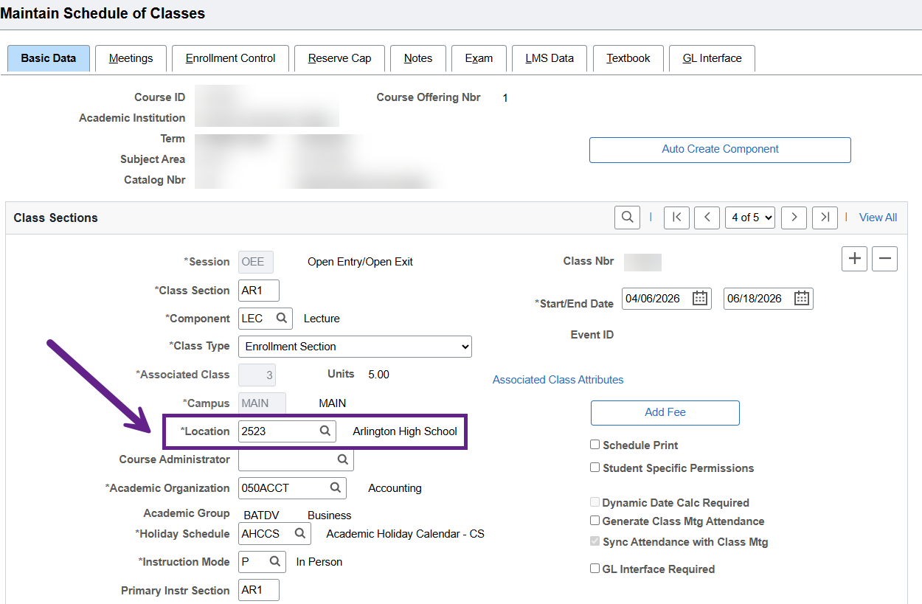
HS Location code
Notes:
EvCC - Heather
HS location codes requires college to build coding for state tracking and registration tracking
CTE attributes on the class build which impact coding and reporting
Course transcription implication – grades by ctcLink or manual grading
I think we should add a bullet just above the Student Group Coding bullet that says “Course Attribute Coding (course coding management) - Carmen

Slide 15
Data, reporting, & tracking
Reporting queries exist and are still evolving
Colleges must:
  Run queries
  Validate data
Challenges:
  Identifying students by high school before registration
  Tracking multi-program applications (students may be in more than one program type but are only applying to one program)
  Tracking multi-program enrollment
Notes:
EVCC – Heather
SVC:
For application, this year we are suggesting that teachers create an assignment where students either write: I am not applying for dual credit or type in their application number. This creates a way for teachers to track this. When students submit application, the final page they are taken to has an application number. This can create confusion occassionally if they think this is their ctcLink#.
We also saw student applications occassionally go to "pending." I think this was happening mostly when students had applied to more than one CTC. "Pending" is a different bucket than the other applications. To pull them out of "pending" I would need to note this and send their app number to enrollment and then they would be admitted. This required that students know their application number.
When enrollment processes application, they apply as CTE or CiHS meaning that if students are in both programs, they aren't showing on the application list unless you do some magic in excel with cross filtering.
Didn't have POI function so we spent a lot of time sending teachers enrollment reports because they couldn't login to see themselves. Many teachers thought that students had finished enrollment process and they hadn't-->we had over 170 classes left in shopping carts in spring because students added class to shopping cart but didn't "check out"

Slide 16
Instructor setup & hr
Set up HS teachers in ctcLink using “Person of Interest” (POI) functionality
Requires HR and potential IT support
Does not require ID verification or I-9
Considerations:
  System accuracy
  Staff workload
  Instructor name identified vs. "Staff or TBD"
  Program consistency (CiHS and CTE DC)
Notes:
EVCC - Anna
Pros are direct access to rosters/entering grades (don't need to send individual rosters)
SVC:
SVC is still working on this. Our hangup is that HR wants us to collect SSN to create POI but we cannot collect SSN b/c we aren't hiring these teachers unlike CiHS. How did EvCC work around the SSN problem?
Classes are built differently in order to be assigned to a class (staff/TBD if no POI, students don't see instructor name as secondary check for enrolling), collaboration with IT and HR for access

Slide 17
Lessons learned SVC
Engaging high school partners
  Option for high school partners to "book" an SVC representative to come to classrooms
    When high schools took advantage of this, it worked well!
  Also created video and PowerPoint tools for teachers to utilize if they didn’t want a representative. These were emailed multiple times to teachers.
Establishing internal timelines
  We aligned our internal deadlines with CiHS deadlines
Internal decisions
  Course structure-->OEE
  Winter/spring registration: Most classes built for spring and a small number in the fall which allowed us to do a "pilot of the pilot" and resolve some issues for spring
  Student self-registration: We had a lot of issues with this: course builds prevented some students from enrolling, holds on student accounts, need to term activate students, some students just missing a shopping cart for no reason. We had students email asking to be manually enrolled as a workaround.
Notes:
Students who already have a ctclink# from being transcribed from SERS will likely need to be term activated because there isn't a way for the registrar to catch them and term activate them. When we manually transcribe them, they are only term activated for the quarter that they are receiving credit.

Slide 18
Thank you for your participation
Questions?
SBCTC Contact Information
William Belden, wbelden@sbctc.edu
Notes:
SBCTC - Bill

