Slide 1




Applying to SVC
Using the OAAP
For students applying to
CTE Dual Credit or College in the High School
Notes:
Hello! This presentation is for high school students taking high school dual credit programs such as CTE Dual Credit and/or College in the High School who will be applying to Skagit Valley College.
Applying to Skagit Valley College will allow you to receive college credit for your dual credit classes. In this presentation, we will walk you through how to apply to SVC using the Online Admissions Application Portal, also called OAAP

Slide 2
What is Dual Credit?
Dual Credit: Classes that earn high school and college credit at the same time, for the same work!
SVC has three different dual credit programs:
College in the High School – Academic courses offered at the high school, taught by SVC-certified high school teachers. No cost to student.
CTE Dual Credit – Career and Technical Education (CTE) courses offered at the high school, taught by SVC-certified high school teachers. No cost to student.
Running Start – Academic and CTE courses offered at SVC, taught by SVC faculty. Student pays fees, books, transportation, etc. Fee waivers available!
Notes:
Skagit Valley College offers three kinds of dual credit programs
This presentation is specifically for students College in the High School and/or CTE Dual Credit class
Dual Credit classes are Classes that earn high school and college credit at the sametime, for the same work!
2

Slide 3

Meet the Dual Credit Team
Jessica Paredes Strong
Dual Credit Recruiter & Advisor
Brandy Lanning
Dual Credit Program Specialist III
Ali Holmes
CTE Dual Credit Coordinator
Kelly Dyer
Director, Dual Credit Programs

Slide 4
What are we doing today?
Checking to see if you have already applied to SVC.
Applying to SVC if you haven't already submitted an application.
Why are we doing this?
You must apply to SVC to become a student.
You must be an SVC student to enroll in your dual credit class and receive your college credit!
Notes:
In our presentation today we have two goals.
Number 1 is to check to see if you have already applied to Skagit Valley College
Number 2 is to apply to Skagit Valley College if you haven't already submitted an application.
Why are we doing this?
You must apply to SVC to become a student and
You must be an SVC student to enroll in your dual creditclass and receive your college credit!
4

Slide 5
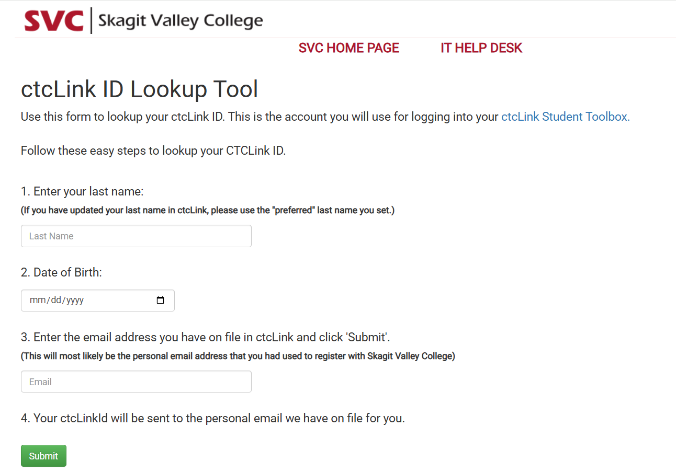
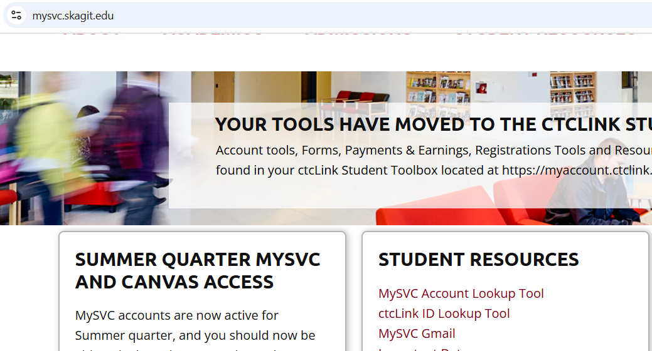
Have you already applied to Skagit Valley College?
3
mysvc.skagit.edu
If you aren’t sure if you have applied to SVC or not…
Go to mysvc.skagit.edu
Click ctcLink ID Lookup Tool
Fill out the form and click submit
1
If you learn you DO have a ctcLink# with SVC, then you
DO NOT need to apply again!
2
Notes:
The first thing we will do is check to see if you have already applied to Skagit Valley College.
In your browser please type mysvc.skagit.edu
Then you will navigate to a tool under the "Student Resources" called the CtcLink ID LookUp Tool
You will click this an be taken to a page that looks like this.
Please enter your last name, your date of birth, and the email you think you have on file and click submit.
If you learn you DO have a ctcLink# with SVC, then you
DO NOT need to apply again and will be done with this presentation.
5

Slide 6
What if….
I did not receive an email with a ctcLink ID#
  Check your spam folder
  Still nothing? Submit an application to SVC.
I did receive an email from SVC with a ctcLink ID#
  This means you have already applied to SVC.
  You do not need to complete the SVC application again (you’re finished for today). Save that ID#!
Notes:
If you submitted that form and didn’t receive an email w/ your ctclinkID#, the first thing you should do is check your spam folder to see if you received an email in that folder
If you still did not receive an email from Skagit Valley College, you will need to submit an application to get your ctclinkID.
You will follow the rest of the presentation to learn how to submit an application.
If you did receive an email from Skagit Valley College with a 9-digit ctclinkID#, that means you have already applied to Skagit Valley College and you do need to complete the application.
6

Slide 7

SVC Application
Notes:
For the next part of the video, we will walk you through the SVC application. If you follow instructions closely, this application should take about 15 minutes to complete.

Slide 8
Application Deadlines
HS Semester 1 and Yearlong Classes: October 30, 2026
HS Semester 2 Classes:
March 5, 2027
Students must apply by the deadline to get a ctcLink ID#!

Slide 9
Logging into the OAAP
Have You…
Taken CTE or College in the High School class(es) from another WA community college?
Participated in Running Start at another WA community college?
Applied to another WA community college for any program?
2a
If "no" to all questions
Click "Create A New Account" and apply to SVC.
2b
Login as “Existing User Login” and apply to SVC. ​You may need to recover your username or reset your password to login. ​
If "yes" to any questions
Notes:
When logging into the OAAP, you will first need to determine if you are “creating a new account” or “logging in as an existing user.” I will show you a screenshot of what this looks like on the next slide.
If you have taken a CTE or CiHS class at another community college, participated in running start at another community college, or applied toan other WA state community college for any program, you will select “existing user login.”
If none of these conditions apply to you, you will select, “Create a New Account.”
9

Slide 10
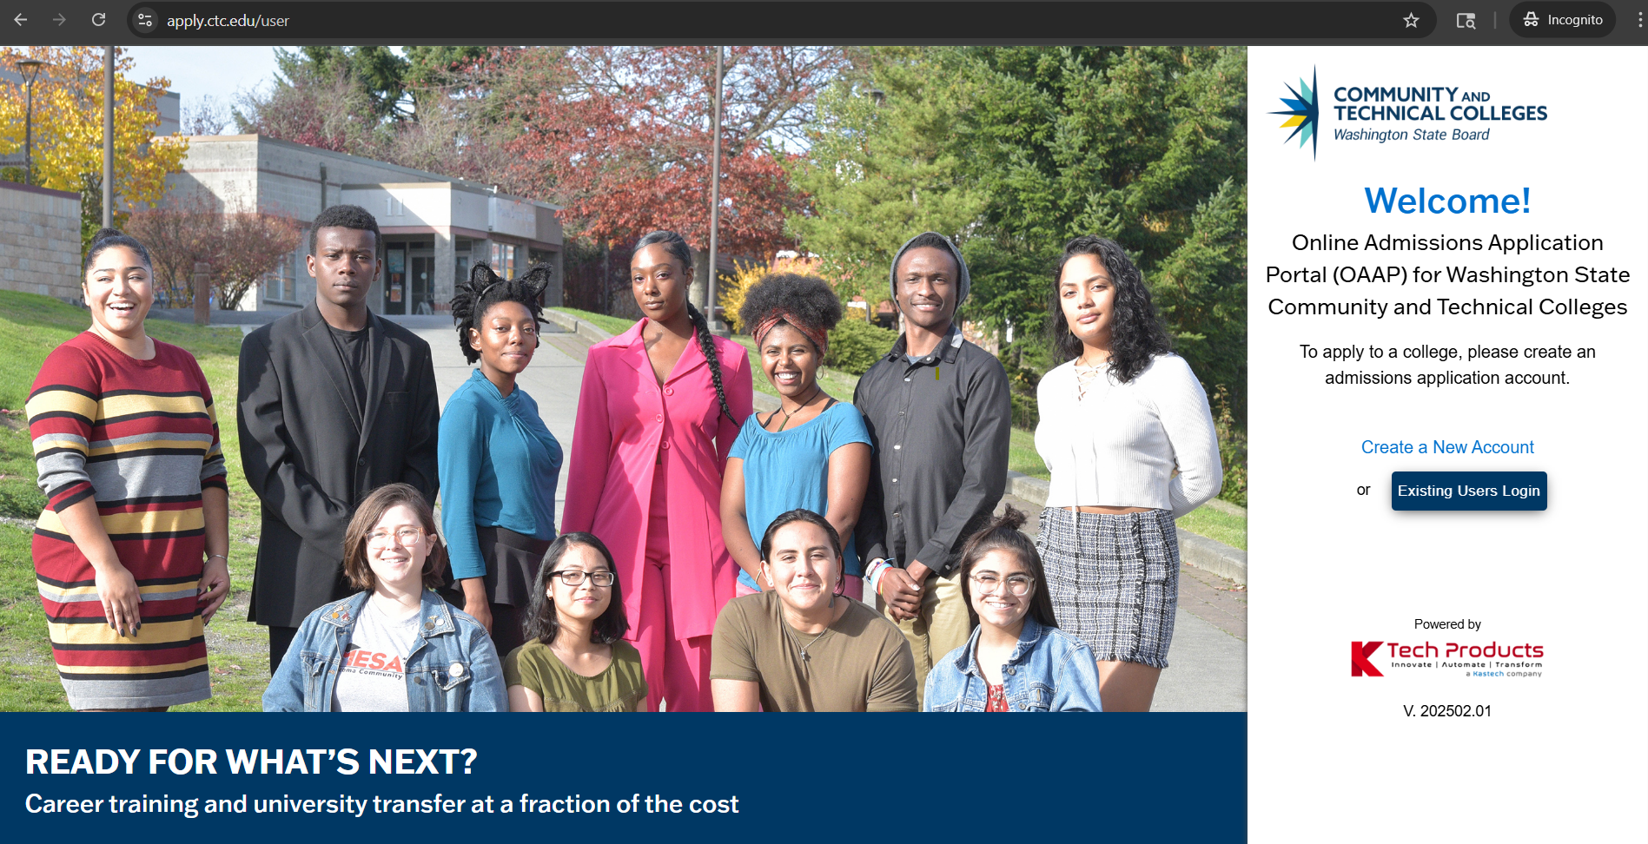
Logging into the OAAP
1
apply.ctc.edu/user
2a
2b
Notes:
To apply to the OAAP, you will enter apply.ctc.edu/user into your browser
Then you will have the option to “create a new account” or login as “existing users login”
If you aren’t sure which to click, go back and view the previous slide
10

Slide 11
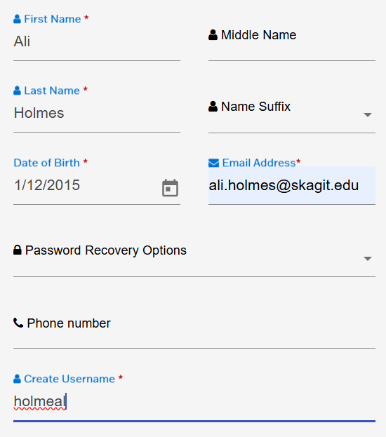
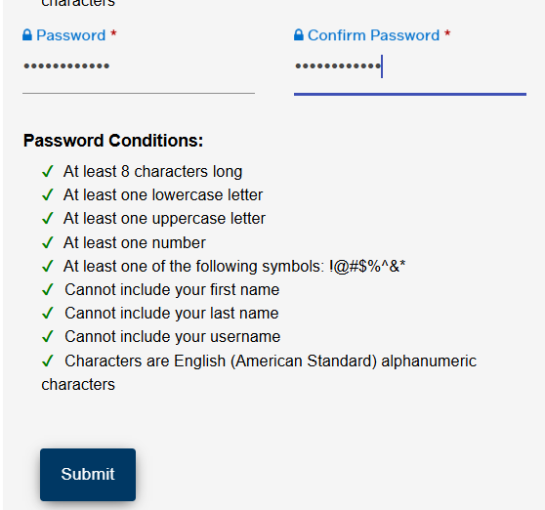
Password and email set up
Use a personal email address.
Notes:
To create an account, you will need to enter your first and last name, date of birth, email, create a username, and create a password.
If you are someone that uses a nickname or an alternative first name to your given name, please enter your given name on this part of the application.
There will be a section later in the application where you can indicate you preferred name.
Please use your personal email address rather than your school email address.
It is always a good idea to also select a password recovery question where it says password recovery options.
Once you’ve created a unique username and password that meets all the conditions, green check marks will appear and you will hit be able to click Submit.
If you are having trouble creating a unique username, try using one of your social media handles as your username
11

Slide 12
What if….
I received an error “This email/account already exists”
  Use the reset password button so you can login
  If you cannot reset your password, please email enrollment@skagit.edu or call English: 360.416.7700 or
  Spanish: 360.416.7740
I can’t access the email where the password reset was sent
  Use your phone to send you the two-factor verification code instead of your email
Notes:
If you receive an error that says “this email or account already exists” use the reset password button to login
If you cannot reset your password, please email enrollment @skagit.edu or use of the following phone numbers to call us.
If you cannot access the email where the password reset was sent, use your phone to send you the two factor verification code instead of your email.
12

Slide 13
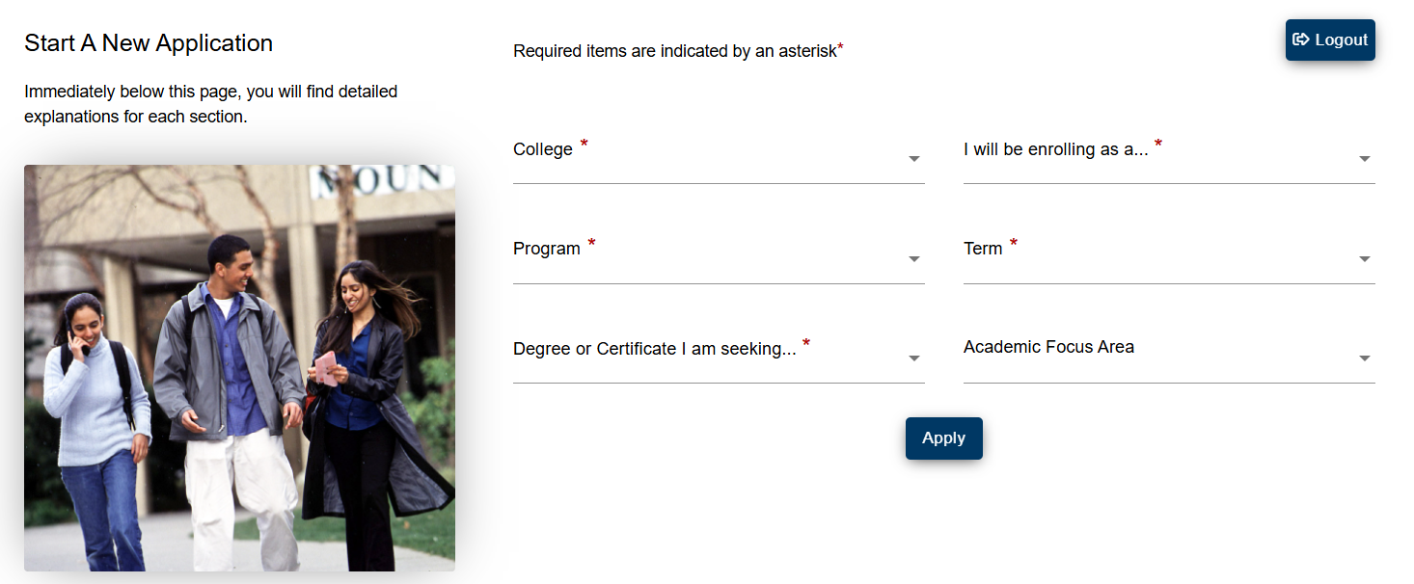
Start Your Application to SVC
Notes:
The next page you will automatically be taken to looks like this.
Please note that throughout the application, any field that has a red asterisk means you must select an answer to move on to the next part of the application.

Slide 14
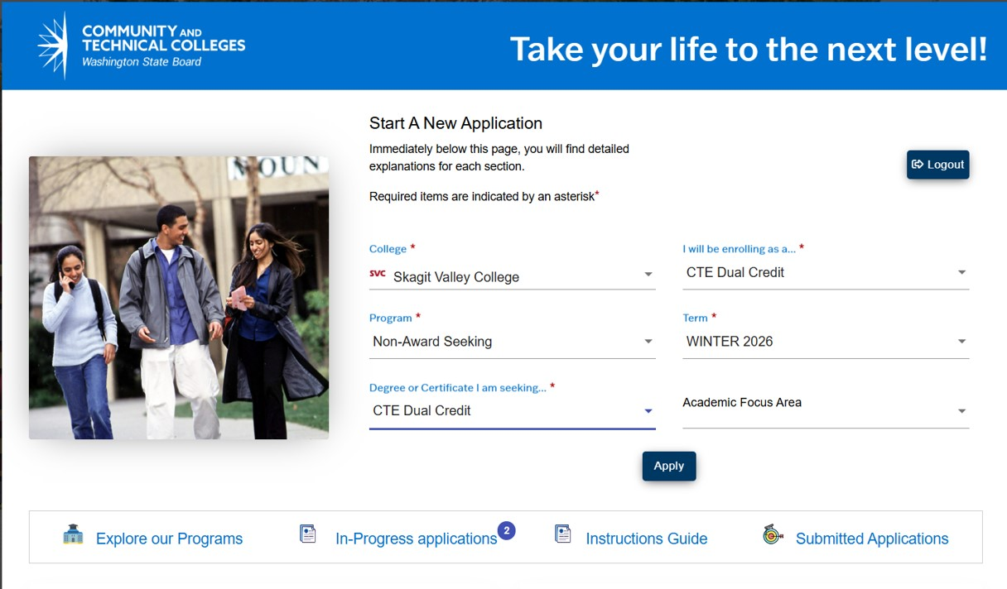
Apply to SVC as a CTE Dual Credit Student
Ask teacher
Notes:
In this next section, I am going to first explain how to apply to Skagit Valley College as a CTE Dual Credit student
I will then explain how to apply to Skagit Valley College as a College in the High School Student
If you are enrolled in both program at the same time, you can apply as either a CTE Dual Credit or College in the High School student.
In the college field, select Skagit Valley college.
In the “I will be enrolling as field select ‘CTE Dual Credit’.”
In the program field select “non-award seeking.”
For the term: Semester 1 and yearlong courses apply for Winter quarter. Semester 2 courses apply for Spring quarter.
For degree or certificate I am seeking, select, “CTE Dual Credit.” Then hit apply.
14

Slide 15
Apply to SVC as a College in the High School Student
College in the High School
Ask teacher
College in the High School
Notes:
I will now explain how to apply to Skagit Valley College as a College in the High School student.
In the college field, select Skagit Valley college.
In the “I will be enrolling as field select ‘College in the High School’.
In the program field select “non-award seeking.”
For the term: Semester 1 and yearlong courses apply for Winter quarter. Semester 2 courses apply for Spring quarter. If you are unsure, you can always ask your teacher.
For degree or certificate I am seeking, select, “College in the High School.”
You can leave the “Academic Focus Area” blank.
Then hit apply.
15

Slide 16
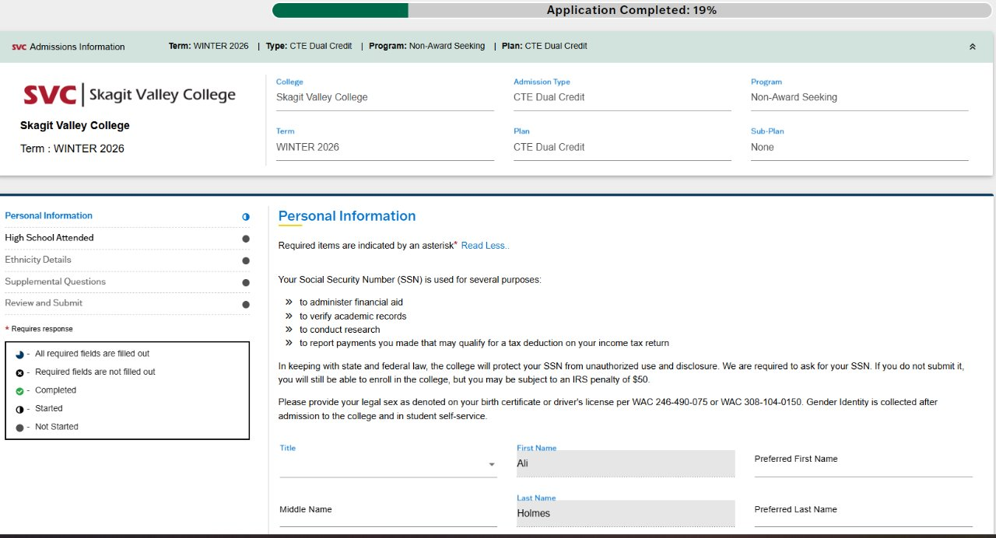
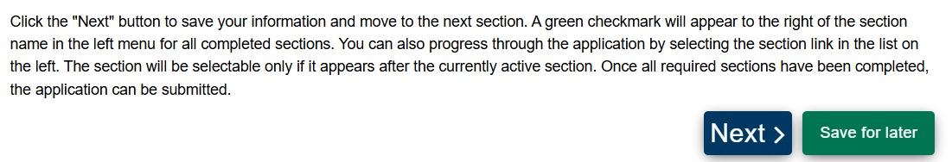
Application window
Notes:
Once you hit apply, you will automatically be taken to a page that looks like this
This is the start of your application
At the very top there is a green bar that indicates what percentage of the application you've completed.
On the left you can see that there are 5 sections of this application: personal information, high school attended, ethnicity details, supplemental questions, and review and submit.
Fields such as your name and birthday will be prepopulated
You can enter your nickname or alternative first name in the “preferred first name” section
You must enter a phone number and an address
If you know your social security number, please enter it here, it really helps with our record keeping. Please note that if you do not know your number or don’t have a number, you can still apply to the college.
If you attend college after high school, you can update your information in order to explore your financial aid options.
When you scroll to the bottom of the page you will have the option to click Next or Save for Later
16

Slide 17
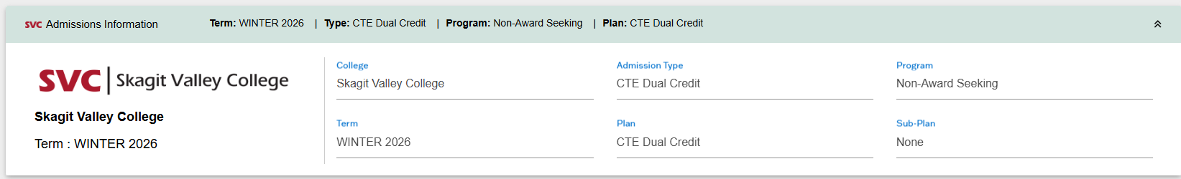
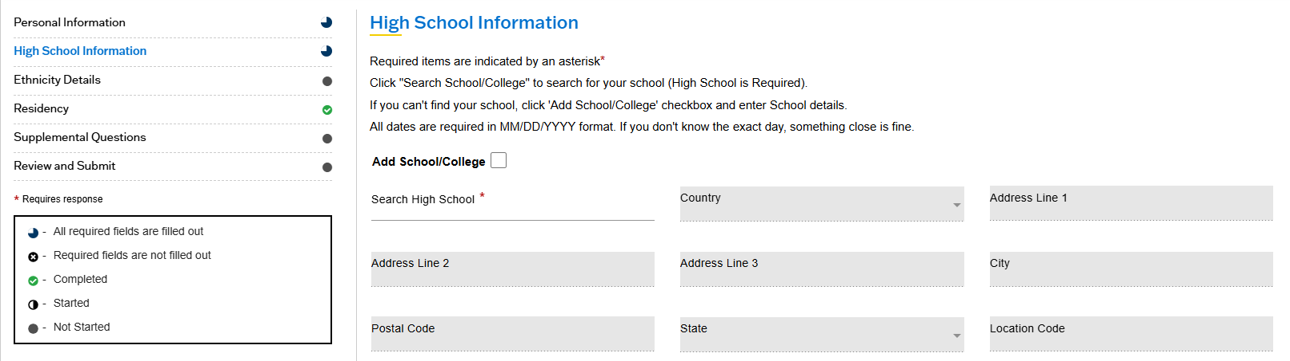
Application window continued
Notes:
The next section is “high school information.” Start by searching for your high school by clicking into the “search high school” field.
17

Slide 18
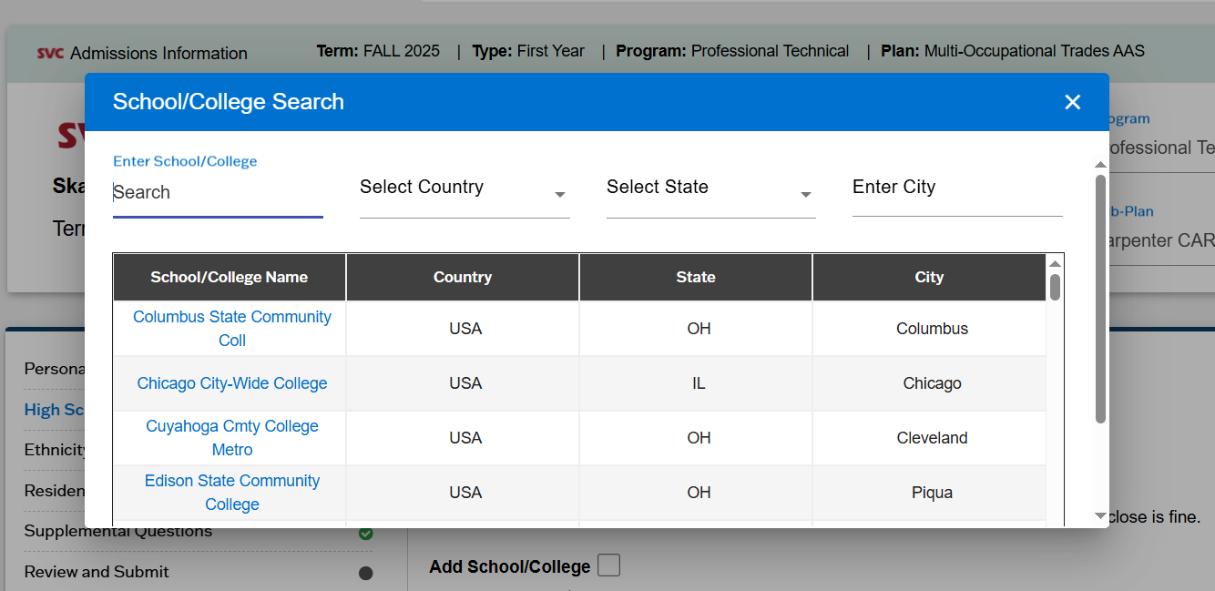
Application window cont
Notes:
When you do this, a new window will open allowing you to search by the name of your high school.
Type your school into the search field.
18

Slide 19
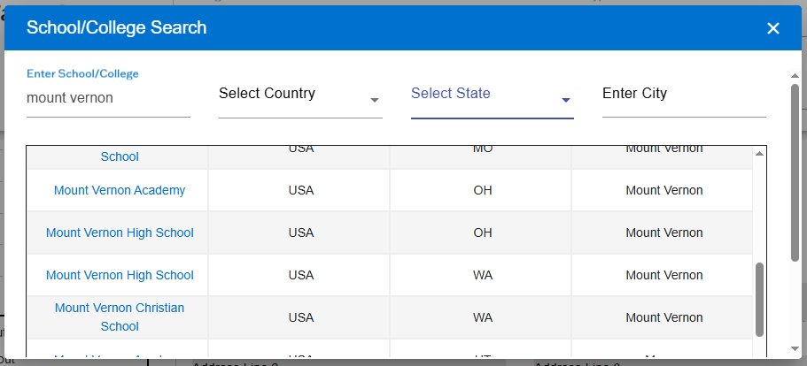
Application Window (HS selection)
Notes:
I'm using Mount Vernon High School as my example. Be sure double check you are adding the correct high school. In my example, there are several Mount Vernon's but only one Mount Vernon High School in Washington.
19
19
19
19

Slide 20
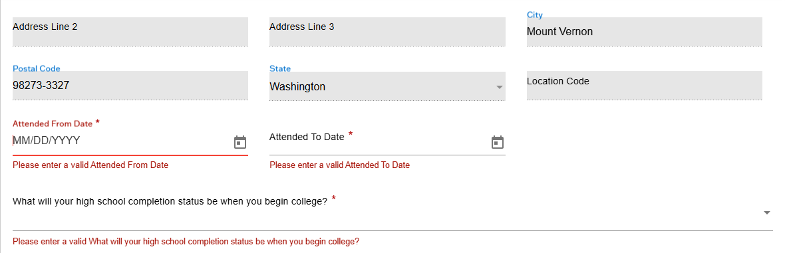
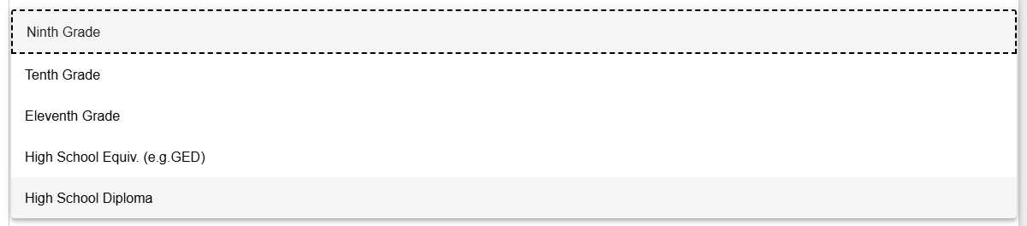
Entering Class information
If you aren’t sure what date you started high school or will graduate, put “9/1/year started” and “6/15/year of graduation”
Grade (‘26-’27) | Year Started | Year of Graduation
9th | 2026 | 2030
10th | 2025 | 2029
11th | 2024 | 2028
12th | 2023 | 2027
Choose your current grade.
If you are in 12th grade, choose “High School Diploma.”
Notes:
Slide=for video only
Once you've selected your high school, the address will pre-populate for you.
Then you will need to enter the dates you attended from and the dates you attended to. If you aren’t sure what date you started high school or will graduate, put “9/1/year started” and “6/15/year of graduation”
The next question you will answer is “what will your high school completion status be when you begin college?”
Here you will select your current grade unless you are in 12th grade. If you are in 12th grade select, “high school diploma.”
20

Slide 21
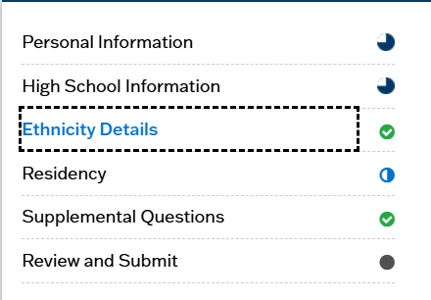
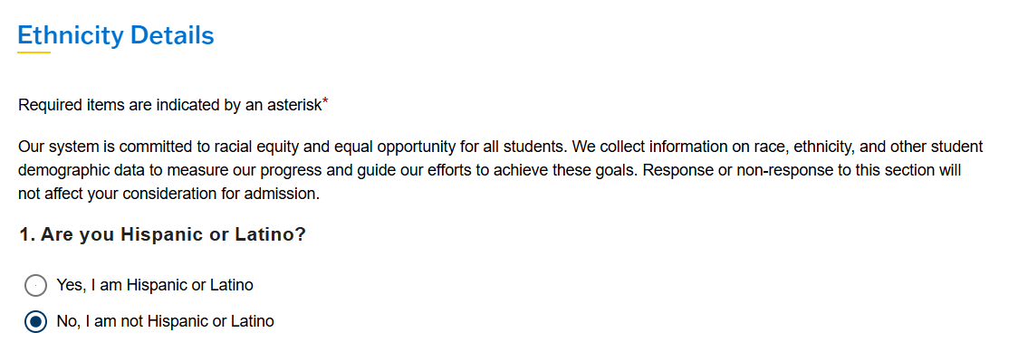
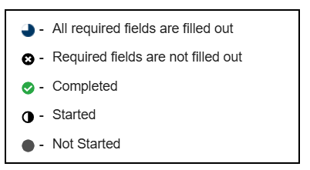
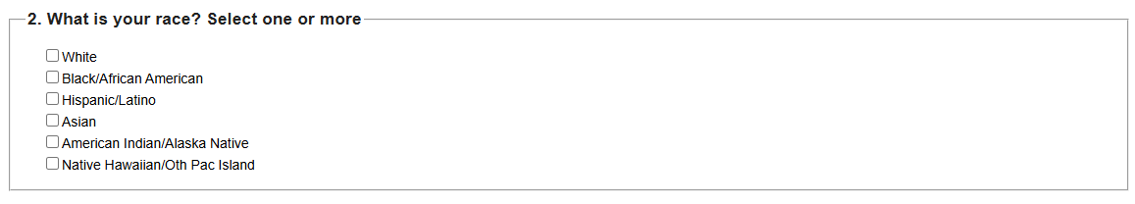
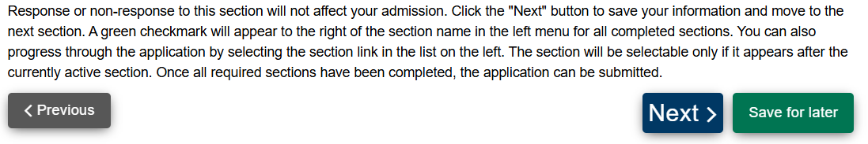
Demographics Details
Notes:
The next section is Ethnicity details. You will need to answer 2 questions about your ethnicity and your race.
Please note you can select more than one race .
21

Slide 22
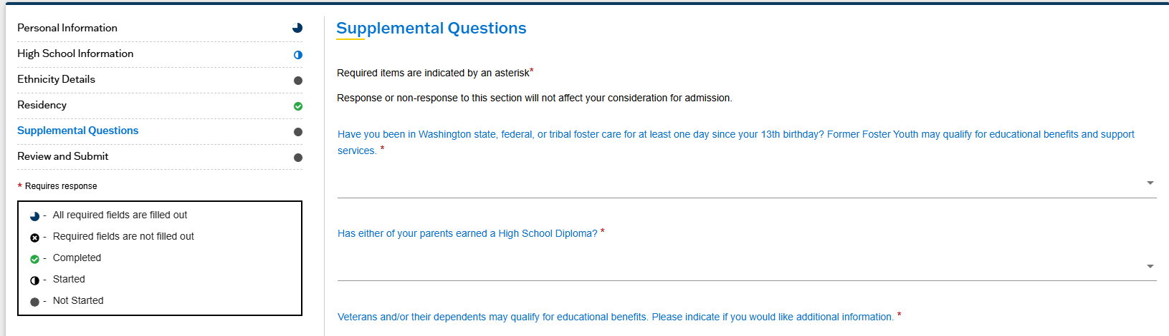
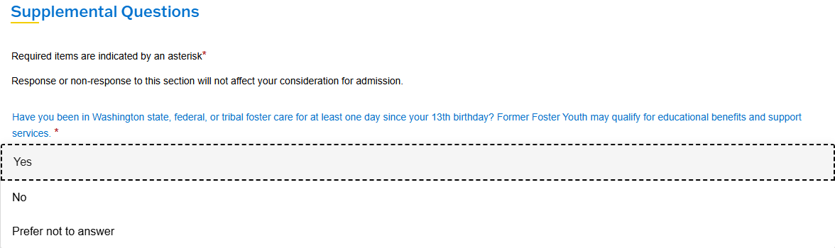
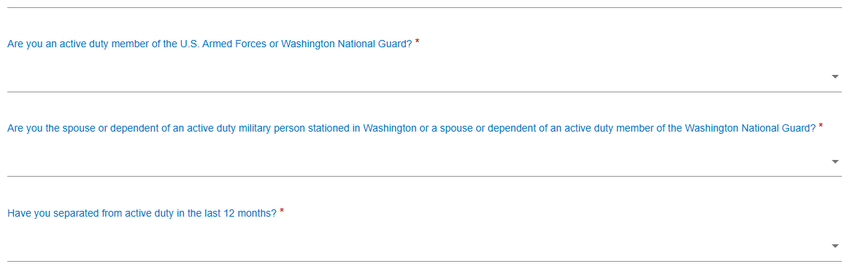
Additional Demographics
If you aren't sure of the answer to some of these questions, you can always choose "prefer not to answer."
Notes:
The next section is Supplemental questions. There are 6 supplemental questions.
All questions in the supplemental questions section can be answered with yes, No, or prefer not to answer.
22

Slide 23
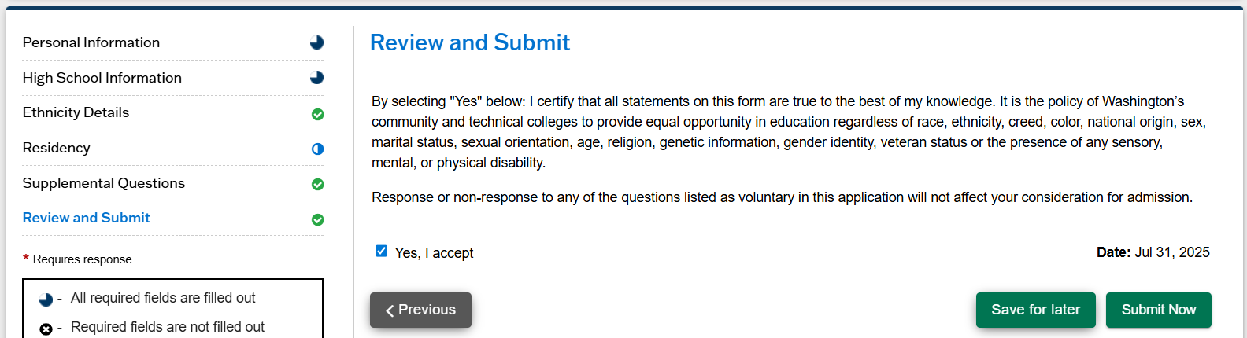
Application Submittal
Notes:
The last section is Review and Submit. When you are ready, you will click the box next to Yes I Accept and then you will hit Submit Now.
Once you've hit Submit, Now you have submitted your application to Skagit Valley College.
23

Slide 24
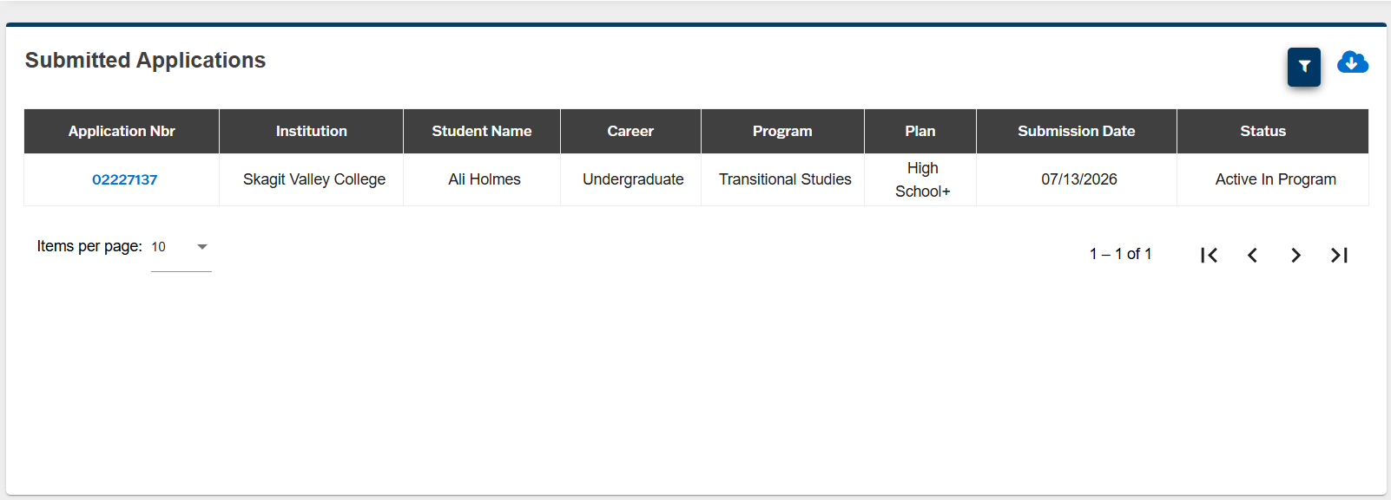
How do I know if I successfully submitted my application?
Submitted
This is your application number. Save this for reference.
Notes:
After you hit "submit" you will automatically be taken to this page that includes you application number.
The status will say "submitted" until your application is processed.
Please save your application number in case we need to look it up when admitting you to the college.
24
24
24
24

Slide 25
Congrats! You applied!
You will receive a confirmation email when your application is successfully submitted. Please save the application number in the confirmation email.
After we process your application (takes about
3-5 business days), you will get another email called a “Welcome Letter.” This email will have your 9-digit ctcLink ID# (college ID#)!
25
25
Notes:
Congratulations, you have now finished applying to Skagit Valley College.
You will receive a confirmation email when your application is successfully submitted.
After we process your application, you will get another email called a “Welcome Letter.” This email will have your 9-digit ctcLink ID# (college ID#)!
You will need to save this ID in order to do the next steps to get dual credit

Slide 26
What happens if….
I don’t submit my application before the deadline?
You will not have an SVC ctcLink account and will not be able to enroll in your course to get college credit.
I don’t enroll in my course?
You must enroll in your course in ctcLink. If you do not enroll, you will not get credit at SVC.
Welcome to SVC – we’re glad you’re here!
26
26
Notes:
Finally, we have found that students often have two common questions:
What happens if I don’t submit my application before the deadline?
If you don’t submit your application before the deadline, you will not have an SVC ctcLink account will not be able to enroll in your course to get dual credit
What happens if I don’t enroll in my course?
If you don’t enroll in your course, you will not get college credit at SVC.

Slide 27
Next Steps…
Activate your ctcLink account.
  Instructions are emailed in your “Welcome Letter”
  View PDF Instructions
Enroll in your dual credit course(s) in ctcLink.
  Stay tuned for enrollment deadlines and instructions
27
23
Notes:
The last two steps are activating your account and enrolling in your dual credit course
We will have other videos explaining these two steps in detail
For now, you have done everything you needed to do and submitted your application
Your teacher will notify you when your class is ready to do the next steps

Slide 28
Thank You! Any Questions?
Email: dualcredit@skagit.edu
Website: www.skagit.edu/dual-credit
Phone: 360.416.7814 (Jessica Paredes Strong)
Dual Credit Office: Lewis Hall, Mount Vernon Campus
Get 1-on-1 help with your application:
  Every Monday from 3:30 to 5:30PM
  in Lewis Hall, Mount Vernon Campus
  Every Tuesday from 11AM to 1PM
  in Oak Hall, Whidbey Island Campus
28
28
Notes:
Thank you for watching! If you have any questions, please reach out to us by phone, email, or by visiting us in person.

