Slide 1




Enrolling in Dual Credit using ctcLink
Enrolling in Dual Credit Courses Using ctcLink
For students enrolling in
CTE Dual Credit or College in the High School
Notes:
Hello! This presentation is for our high school based dual credit students including students who are enrolled in CTE Dual Credit or College in the High School courses at Skagit Valley College.
Enrolling in your Skagit Valley College course will allow you to receive dual credit. We will guide you through how to enroll in your class in ctcLink, the WA state community college system.
Please note that this video will not walk you through how to activate your account. There is a separate video on how to activate your account. Please make sure you have previously activated your account before watching this video.

Slide 2
What is Dual Credit?
Dual Credit: Classes that earn high school and college credit at the same time, for the same work!
SVC has three different dual credit programs:
College in the High School – Academic courses offered at the high school, taught by SVC-certified high school teachers. No cost to student.
CTE Dual Credit – Career and Technical Education (CTE) courses offered at the high school, taught by SVC-certified high school teachers. No cost to student.
Running Start – Academic and CTE courses offered at SVC, taught by SVC faculty. Student pays fees, books, transportation, etc. Fee waivers available!
Notes:
Dual credit is classes that earn high school and college credit at the same time for the same work. For this presentation, we will specifically be discussing how to enroll in dual credit classes for the following two programs: college in the high school and CTE dual credit.
2

Slide 3

Meet the Dual Credit Team
Jessica Paredes Strong
Dual Credit Recruiter & Advisor
Brandy Lanning
Dual Credit Program Specialist III
Ali Holmes
CTE Dual Credit Coordinator
Kelly Dyer
Director, Dual Credit Programs

Slide 4
What are we doing today?
Activating your ctcLink account, if you have not already done this. (ctcLink is the WA state community college system)
Enrolling in your dual credit course(s) through your ctcLink account.
Why are we doing this?
To learn how to enroll in your dual credit course in ctcLink
You must enroll in your course in ctcLink so you can receive your college credit!
Notes:
4

Slide 5
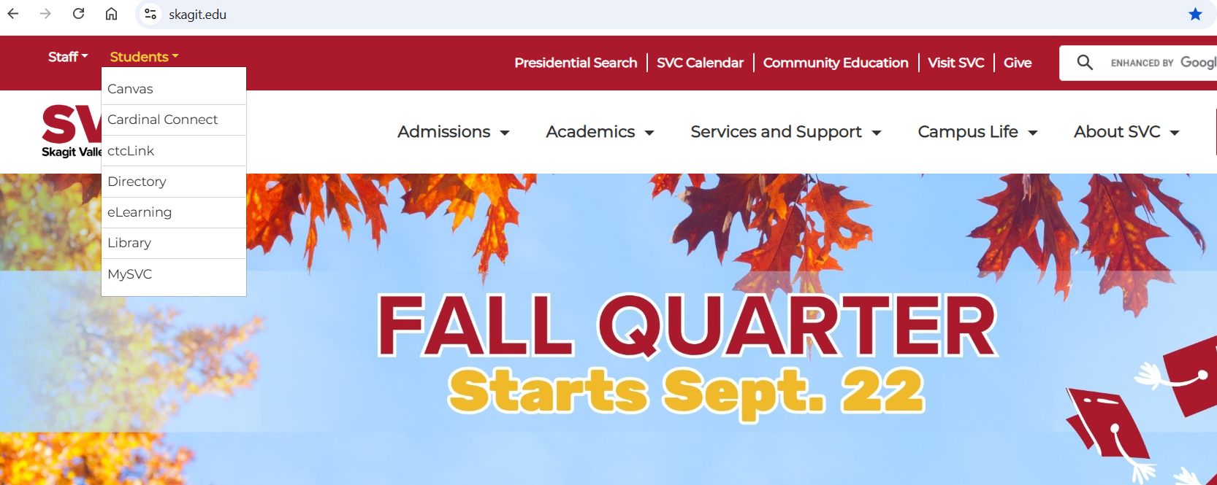
Enter skagit.edu into your browser
Notes:
Let’s go back to skagit.edu
In the top left corner, select “Students,” then select “ctcLink” in the drop-down menu.
5

Slide 6
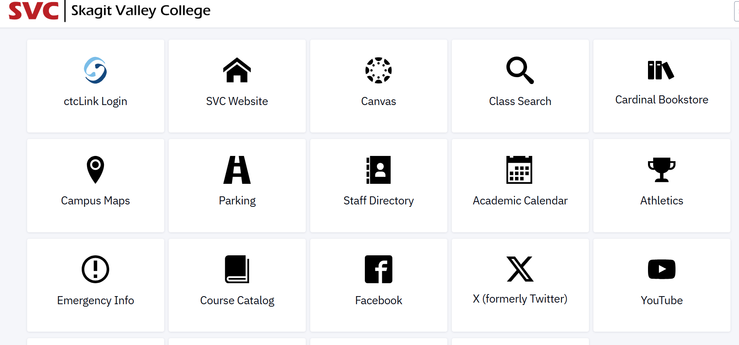
Click the 'ctcLink Login' tile
Notes:
Select the ctcLink Login tile in the top left corner
6

Slide 7

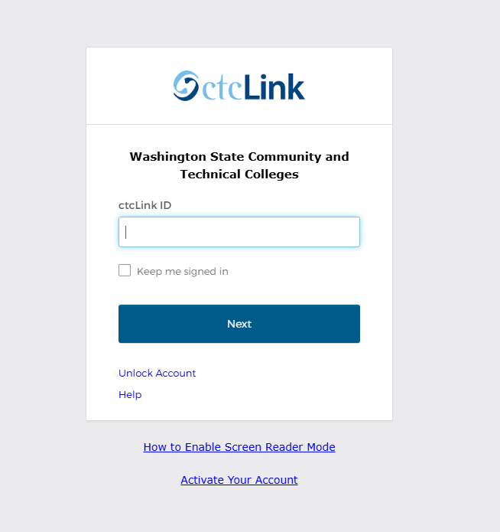
ctcLink login
Notes:
Select "Activate your account"
7

Slide 8
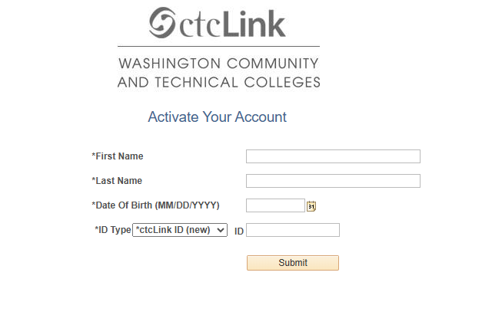
Activation scteen
Notes:
Enter your contact information.
Enter your ctcLink ID# - this was sent to the email you used for your SVC application, in your Welcome Letter.
Didn't get a Welcome Letter? Check your spam/junk folder.
Still don't see a welcome letter? Try looking up your ID: https://www.mysvc.skagit.edu/tools/forms/ctclinkidlookup.aspx
Last option is to contact enrollment@skagit.edu for support getting your ID#.
8

Slide 9
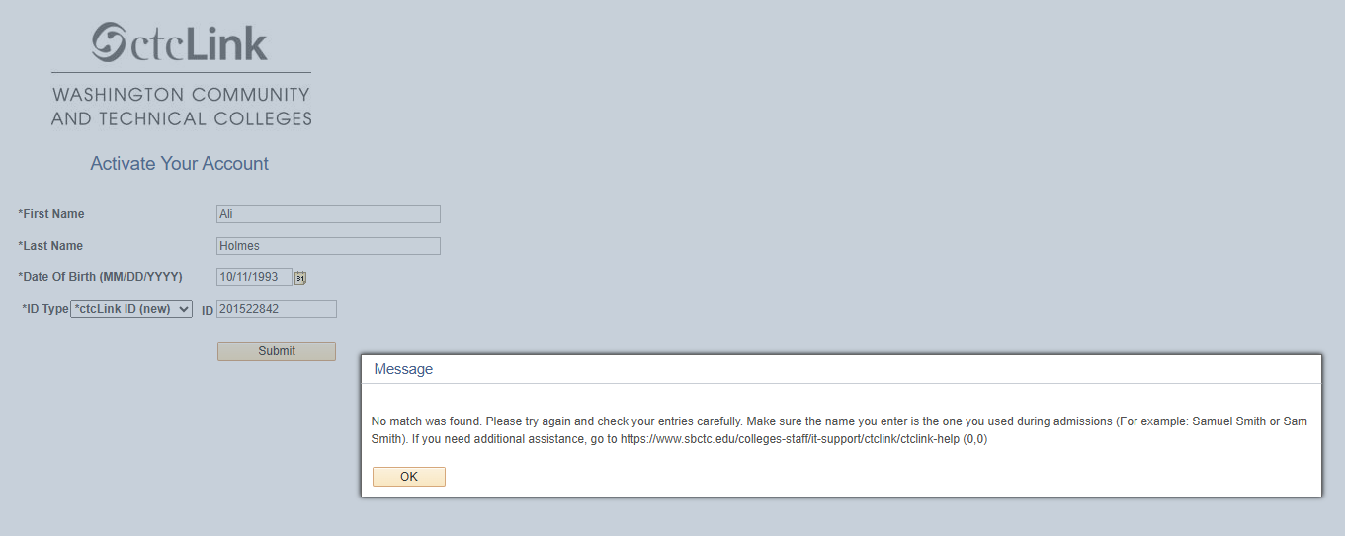
Getting an Error Message?
Double check:
You entered the correct birthday
You entered the correct ctcLinkID#
You used your full name instead of your nickname
Still not working?
Email enrollment@skagit.edu to have us look up your application and get your ctcLink#.

Slide 10


Course
Enrollment

Slide 11
Enrollment Deadlines
HS Semester 1 and Yearlong Classes: January 7, 2027
HS Semester 2 Classes:
April 8, 2027
Students must enroll in their courses by the deadline to get their SVC dual credit!

Slide 12
Enter skagit.edu into your browser
Notes:
The first thing you will need to do is put “Skagit.edu” into your browser.
You will then hover over students and then click on ctcLink in the menu that pops up.
12

Slide 13
Click the 'ctcLink Login' tile
Notes:
Next you will select the ctcLink login tile.
13

Slide 14
ctcLink established login screen
Notes:
Next you will enter your ctcLink ID # and then hit next
14

Slide 15
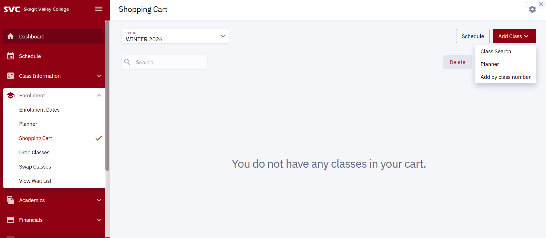
Enrollment screen
On the left, expand "Enrollment" menu
Click on “Shopping Cart”
Select the correct term
Click on "Add Class," then click "Add by class number"
1
3
2
4
Notes:
This slide will teach you how to enroll in your dual credit class using your class number.
Class numbers are emailed to your teachers and they are posted on our website. Please contact dualcredit@skagit.edu for support with class numbers.
Please note that if you are enrolled in more than one dual credit class, you will need to enter more than one 5-digit number in order to receive dual credit.
Semester 1 and yearlong courses enroll in Winter quarter. Semester 2 courses enroll in Spring quarter.
The first think you will need to do is on the left you will click “enrollment”
The second thing you will need to do to enroll is click “shopping cart”
The third thing you will need to is verify that you have the correct term selected. As a reminder, Semester 1 and yearlong courses will select in Winter quarter. Semester 2 courses will select in Spring quarter.
Lastly, you will click on “add class” and on the menu and on the menu you will select “add by class number.”
15

Slide 16
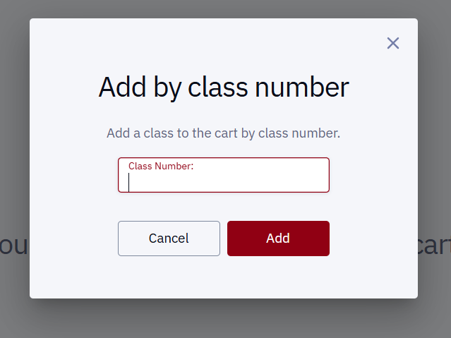
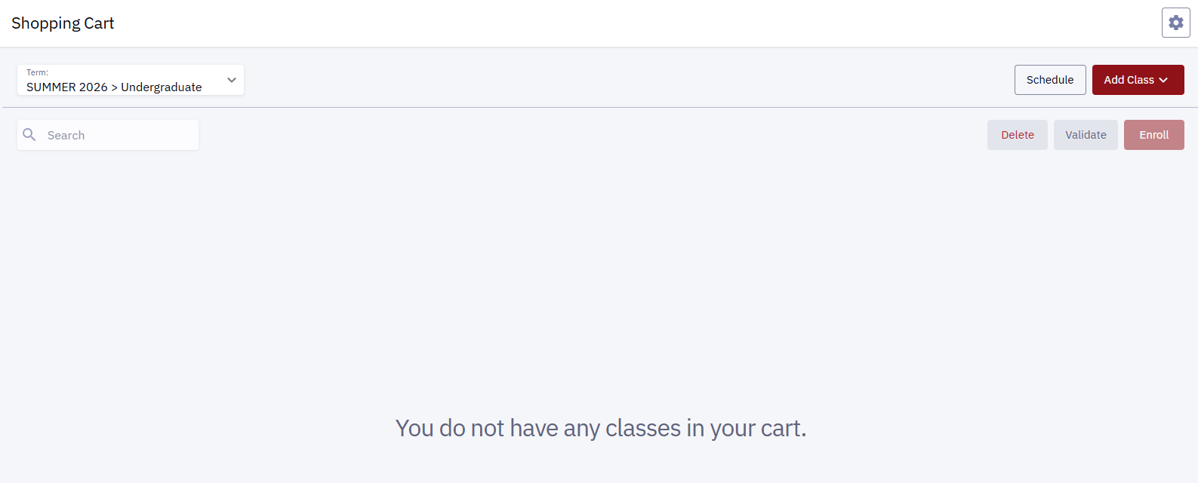
Input Class Number
You can find your class number 3 different ways:
Ask your high school instructor for the class number
Look up your class number on our website: skagit.edu/dual-credit
Email the Dual Credit team for your class number at dualcredit@skagit.edu
Notes:
Finally, you will be asked to put in your class number. You can find your class number in three different ways: it will be emailed to your instructor so you can ask them, you can look it up on our website, or you can email the dual credit team at dualcredit@skagit.edu and ask us as well.
16

Slide 17
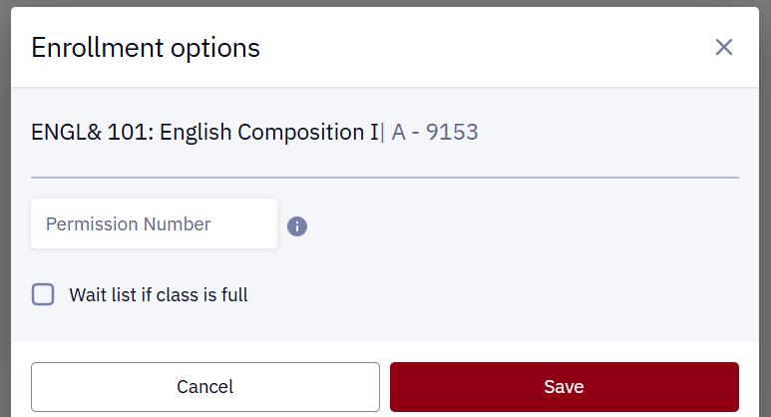
Review Search Results
Your search results will appear. If this is the correct course, click “Save.”
You do not need a permission number.
Notes:
The next screen you will be taken to looks like this. Unless you are in a 199 class, you do not need a permission code to enroll and you will click “save.”
If you are in a 199 class, your teacher will provide you that permission code.
17

Slide 18
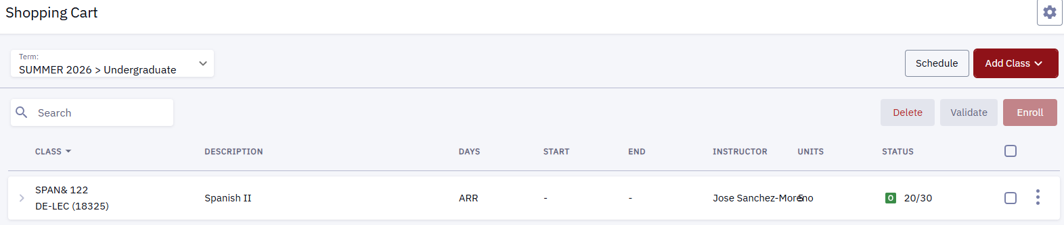
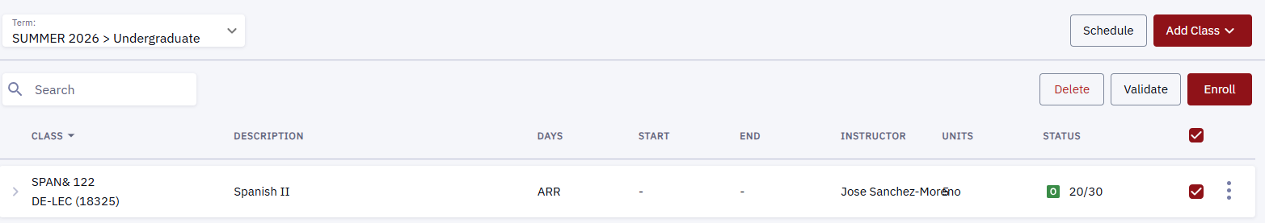
Complete Enrollment
Click the checkbox next to the course
Click “Enroll”
2
1
Notes:
The last thing you will nee to do is click the checkbox that is next to the class.
Then you will need to click “enroll.”

Slide 19
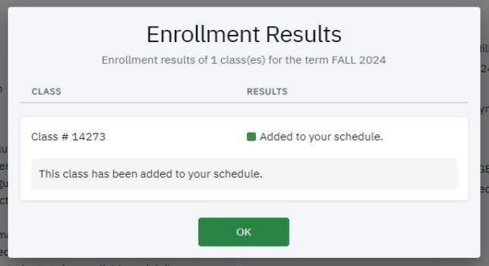
✅Success
If you successfully enrolled, the message below pops up.
Then click “OK”
Notes:
Once you have successfully enrolled, you will see the following message pop up.
You can then click okay.
19

Slide 20
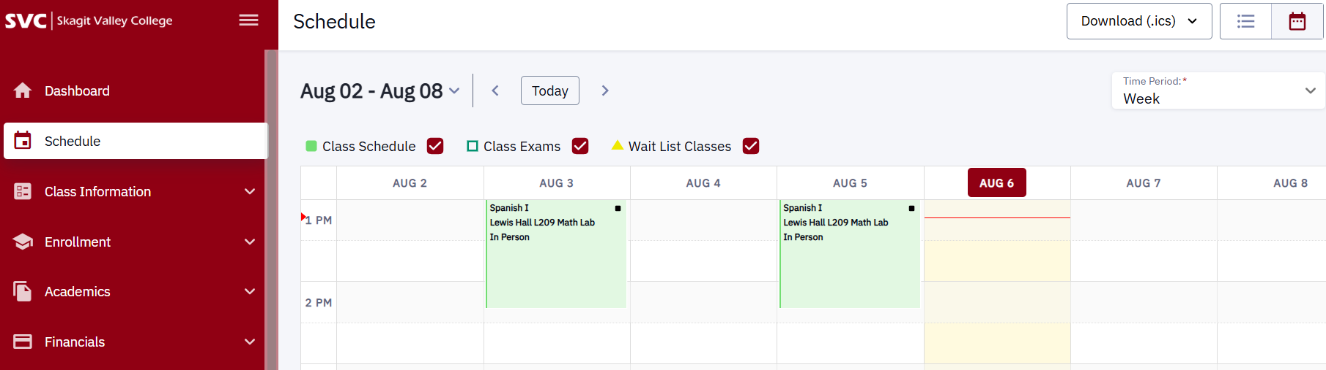
✅Success
Another way to confirm you are enrolled is by clicking on “Schedule” in the menu. This will show all the classes you are currently enrolled in.
Notes:
Another way to check that you are enrolled in your class is to go to the left-hand menu and click on “schedule”
If you can see the class appearing in your calendar, you know that you have enrolled.
20

Slide 21
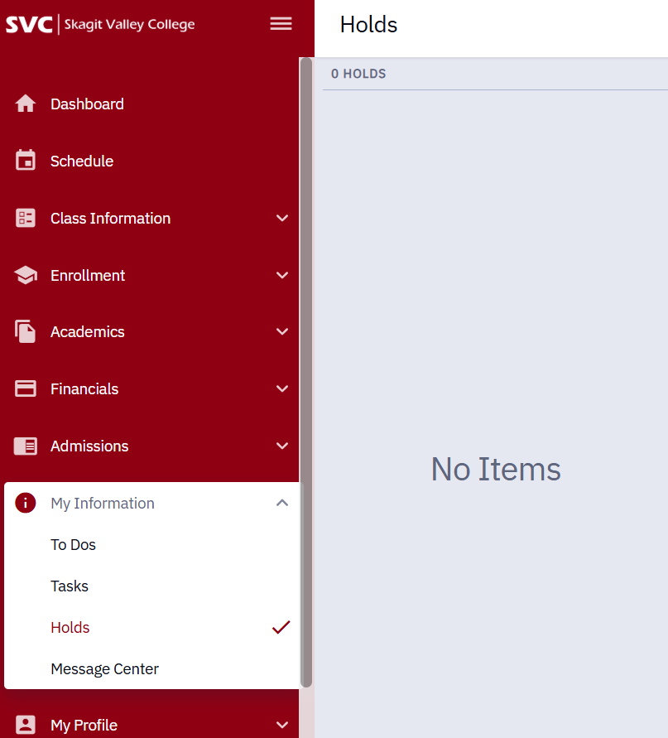
What happens if I have a hold?
​
​
Navigate to holds to see what kind of hold you have to determine what to do next by clicking “my information” and then “holds.”
21
21
Notes:
Occasionally, dual credit students cannot enroll in their classes because of a hold on their account.
The first thing you need to do is check to see what kind of hold you have on your account
Navigate to holds by clicking “my information” and then “holds.”

Slide 22
What happens if I can’t enroll because…
I have an SFA hold?​
​If you are 18 years or older, you will have an annual Student Financial Responsibility Agreement (SFA) hold.
Students must acknowledge their financial responsibilities to the college. Students must accept the SFA agreement in ctcLink before enrolling in classes.​
​
CTE Dual Credit and College in the High School classes are free!
You will not be charged any money by SVC for these classes.
22
22
Notes:
A common hold that some dual credit students run into is the SFA hold.
This hold is placed on any student who is 18 or older at the time they enroll in their dual credit class.
You will need to resolve this hold before you can enroll in your class.
Directions on how to resolve this hold will be emailed to your teacher or you can contact dualcredit@skagit.edu and we will be happy to provide you those directions as well
Students who are 18 years or older must accept their financial responsibilities to the college before enrolling in their dual credit class.
Please note that while students who are 18 years or older must accept this hold, any student who is enrolled in CTE Dual Credit or College in the high school will not be charged tuition as both programs are free to all students.

Slide 23
What happens if I can’t enroll because…
I have a Running Start hold?
Email your completed, signed RSEVF (Running Start Enrollment Verification Form) to dualcredit@skagit.edu.
We will process your form and remove your hold. Then, you will be able to enroll in your dual credit class.
23
23
Notes:
Another common hold that students run into that prevents them from enrolling is the running start hold.
In order to remove this hold, you will need to email your signed RSEVF to dualcredit@skagit.edu
Once we have processed your form and removed the hold, you will be able to enroll in your dual credit class.

Slide 24
What if…I Still Can’t Enroll?!
Send the following email to dualcredit@skagit.edu to request to be manually enrolled. You will need to enter all the information in brackets [ ] before sending the email.
Subject: Dual Credit Enrollment Help
Email Message:
Hello, I am unable to enroll in my dual credit class. Please enroll me in my [CTE Dual Credit or College in the High School] course at [HIGH SCHOOL] for [5-Digit COURSE NUMBER(S)].
My ctcLink ID# is [XXXXXXXXX].
Thank you,
[NAME]
24
24
Notes:
We have one final option for students who are still not able to enroll.
Through this new system that we are using, we have found that occasionally students have run into other technical issues that prevent them from enrolling.
Therefore, we have a way of manually enrolling students.
If you are one of these students, please follow these directions and we will manually enroll you in your CTE or college in the high school class or classes.
Please note that you will send an email to dualcredit@skagit.edu requesting to be manually enrolled.
Below is a sample email that you can use to send to us.
You must tell us all of the information in the brackets before sending the email.
“Subject: Dual Credit Enrollment Help
Email Message:
Hello, I am unable to enroll in my dual credit class. Please enroll me in my [CTE Dual Credit or College in the High School] course at [tell us your HIGH SCHOOL] for [5-Digit COURSE NUMBER or course numbers(S)].
My ctcLink ID# is [XXXXXXXXX]. Provide your ctclink ID
Thank you,
[NAME] “
If we don’t receive all of the information in the brackets, we will be unable to enroll you so please write this email thoroughly and then we will be happy to assist you.

Slide 25
Congrats! You enrolled!
You are now enrolled in your dual credit course!
If you are taking more than one CTE Dual Credit and/or College in the High School course,
be sure to enroll in each of your classes!
25
25
Notes:
Congratulations! You are now enrolled in your dual credit course!
If you are taking more than one CTE Dual Credit and/or College in the High School course,
be sure to enroll in each of your classes!

Slide 26
What happens if….
I don’t think I’ll pass the course?
Talk to your teacher ASAP to see if there is a possibility of raising your grade.
CTE Dual Credit Course:
If your grade is a B or better (A, A-, B+, B), then that grade will go on both your high school and college transcript and be part of your permanent record.
If you have a below a "B", then SVC will automatically drop you from the class. You will not get credit on your college transcript.
26
26
Notes:
Finally, we have one common question that many students like to ask, what happens if I don’t think I’ll pass the course?
The first thing you need to do is Talk to your teacher ASAP to see if there is a possibility of raising your grade.
The second thing you need do if there isn’t a possibility of raising your grade is determine which program you are in.
If you are in CTE Dual Credit, If your grade is a B or better (A, A-, B+, B), then that grade will go on both your high school and college transcript and be part of your permanent record.
If you have a below a "B", then SVC will automatically drop you from the class. You will not get credit on your college transcript.

Slide 27
What happens if….
I don’t think I’ll pass the course?
Talk to your teacher ASAP to see if there is a possibility of raising your grade.
College in the High School Course:
The grade you earn will go on your permanent college transcript and impact your college GPA.
If you have a D or an F in the course, we recommend you consider dropping the course so that it doesn’t go on your college transcript. Students must initiate the drop process themselves.
If you want to drop a class, you must do it before the withdrawal deadline or the class with show up as a “W” on your transcript
27
27
Notes:
If you are in College in the High School, grading works slightly differently
If you are on College in the High School, The grade you earn will go on your permanent college transcript and impact your college GPA.
If you have a D or an F in the course, we recommend you consider dropping the course so that it doesn’t go on your college transcript. Students must initiate the drop process themselves.
If you want to drop a class, you must do it before the withdrawal deadline or the class will show up as a “W” on your transcript

Slide 28
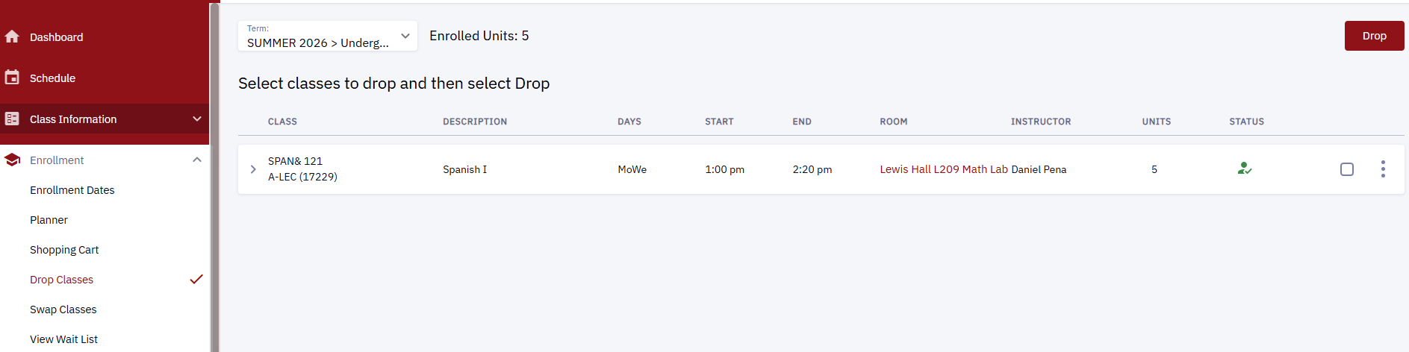
How to Drop a Class
On the left, expand "Enrollment" menu
Click “Drop classes”
Click the checkbox next to the course
Click “Drop”
Notes:
If you are student who needs to drop a class, you will login to ctcLink and click on the “enrollment” tab in the menu. Instead of going to shopping cart you will click “drop classes”
Similarly to how you enrolled in your class, you will click on the checkbox next to your class and then you click “drop” to complete dropping the class.
Once you have dropped a class, it will no longer appear on your college transcript.
28

Slide 29
Thank You! Any Questions?
Email: dualcredit@skagit.edu
Website: www.skagit.edu/dual-credit
Phone: 360.416.7617 (Brandy Lanning)
Dual Credit Office: Lewis Hall, Mount Vernon Campus
29
29
Notes:
Thank you for enrolling in your dual credit class. If you have any questions, we are hear to help, please reach out to us by phone or email.

