Slide 1
CTE Dual credit Washington Dual Credit Program Deep Dive workshop series
Kimberly Ingram, Program Administrator (SBCTC)
Tim McClain, Dual Credit Program Supervisor (OSPI)
William Belden, Workforce Policy Associate (SBCTC)

Slide 2
agenda
2:00 p.m. – 3:00 p.m. SERS Focus
SERS Overview & Resources
3:00 p.m. – 5:00 p.m. CTE Dual Credit Focus
CTE Dual Credit
Accountability
Students
Why is CTE Dual Credit Important – What we Know
Research Findings
Challenges & Opportunities
Statewide Partnerships
Our Shared Path Forward
Questions
Notes:
Our ctcs offer a variety of placement options to asses student readiness. Optimal placement helps ensure students are able to engage in the classroom with their faculty and fellow students, learn the required material, and enjoy the most meaningful learning experience possible.

Slide 3
Sers overview
Statewide Enrollment and Reporting System
The Statewide Enrollment and Reporting System (SERS) is used by CTE Dual Credit consortium members, teachers, college staff, registrars, and students to view and manage information related to participants and CTE Dual Credit courses

Slide 4
Sers User Accounts
District User
Registrar
Staff
Students
Teacher

Slide 5
Sers-District User
Search for Students
View & Edit Student Profile
View Student Registration History
Reset Student Password
Search for Articulations

Slide 6
Sers-registrar
Search for Articulations
Viewing Student Profiles and Registration History
Editing a Student's SID (ctcLink ID/EMPLID)
Admitting Students to Your College (for SERS)
Registering Students
Transcribing Student Records
Saving Post-Transcription Student Information Changes
Changing Course Item Numbers

Slide 7
Sers-staff
Manage User (Non-students) and Student Accounts
Send Bulk Email to Users and Students
Impersonate
Manage Teacher Records
Manage High School Class Records
Manage High School Class Offerings
Manage College Course Records
Manage Articulations
Performing Consortium Maintenance
Manage Fees and Registration
View Registration History

Slide 8
bulk student email
Filters:
Missing Fees
Missing Mail-Ins (paperwork)
All Current and Future Registrations
Year Transcribed
School District
High School
Grade Levels
Note: If there are multiple students with the same email address, the message will only be sent once

Slide 9
Bulk user email
Filters:
Staff Type
High School
School District
Ungraded Class Records
Unrecorded Variable Credits
Note: If there are multiple students with the same email address, the message will only be sent once

Slide 10
Sers-student
Manage Account
Recover User Name
Resetting Password
Editing Profile
Register for Classes
Viewing History
Status

Slide 11
Sers-teacher
Manage Account/Profile
Find Class
Assign Grades or Update Student Status
Assign Variable Credits
Search for a Student
View a Student's Profile
Reset a Student Password
Search for Articulations

Slide 12
Sers reporting-district users
Student Counts By High School
Partner High School List
Class Registrations
Credit Progress
Registration Summary
Teachers With Ungraded Students
HS Registration by Class & Teacher
Classes With Students
Unduplicated Transcribed Counts

Slide 13
Sers reporting-Registrar
Students To Admit
Students To Register
Students To Transcribe

Slide 14
Sers reporting-staff
Student Counts By High School
Student Counts By College
Course Registrations
Active Classes With No Students
Articulations With No Registrations
Classes With No Offerings
Basic Student Data
Enrollment Report
Mail-In Not Received
Fees Not Paid
Mailing List for Current Registered Students

Slide 15
Sers challenges
Ability for students to verify their system passwords
Student account verification using cell phone numbers
Automated validation for data entry fields
Administrative functions for college staff
Searchable course titles
Dates for articulation agreement updates
Expanded access to data
Cross-system compatibility with CEDARS and ctcLink
Notes:
Student account verification using cell phone numbers: Because students cannot retrieve or reset their SERS login information themselves, they sometimes apply creative workarounds to access the system (e.g., changing a digit in a birthdate) when they forget their usernames and passwords, resulting in multiple SERS records for the same student. As a result, college staff must spend time reconciling duplicate SERS and college records to award credit and ensure accurate program- and state-level reporting.
Automated validation for data entry fields: Web platforms sometimes have data validation features that catch errors at the point of data entry. Stakeholders believed that error messages for key fields such as when a user enters a comma instead of a period or misspells .com or .net in an email address could improve data quality.
Administrative functions for college staff: Currently, postsecondary staff lack the authority to merge or delete SERS records and must ask SBCTC to make the changes necessary. Allowing college staff to update student records, following guidelines set by SBCTC, could save staff time.
Searchable course titles: Creating searchable fields for the titles of articulated high school and college courses would help students, families, and staff members find courses for registration and other administrative processes.
Notifications or date-of-update fields for articulations in SERS: Stakeholders observed that articulation agreements are created and updated by dual credit coordinators on an ad-hoc basis, creating uncertainty regarding whether the agreements recorded in SERS are current. A field in SERS tracking the date that an agreement was created (or uploaded) and revised and/or email or text alerts to SERS users regarding changes could inform users of updates.
Expanded access to CTE Dual Credit data for secondary staff, including:
CTE Dual Credit attainment data disaggregated by student characteristics to identify equity gaps and
lists of articulated classes by college to help secondary staff identify relevant articulation agreement models and students interested in less common fields find dual credit opportunities.
Clearly identified multicourse articulation agreements: In some instances, a single college course is articulated with two high school courses. Because SERS does not clearly indicate when courses are part of a sequence, students and families may not realize that completion of both courses is needed to earn college credits and meet program requirements. Stakeholders also noted that SERS does not allow them to connect courses in two-course articulation agreements when students cannot take both courses in the same year.
Cross-system compatibility and communication: SERS functions independently of OSPI’s CEDARS and the postsecondary ctcLink system. Because these systems are separate and access to SERS is limited, registrars and dual credit coordinators must manually enter some student information and grades, requiring additional staff time, increasing the likelihood of data entry errors.

Slide 16
resources
Manuals
District User
Registrar
Staff
Student
Teacher
Contact Information
sers@sbctc.edu

Slide 17
CTE Dual credit Washington Dual Credit Program Deep Dive workshop series
Kimberly Ingram, Program Administrator (SBCTC)
Tim McClain, Dual Credit Program Supervisor (OSPI)
William Belden, Workforce Policy Associate (SBCTC)
Notes:
Bill – overview and introduction, importance of topic, engagement in polls, second component – poll of educational representation in the zoom – postsecondary, k-12, state agency, consortium/both

Slide 18
Introductions
Name, Institution, Role, Pronouns, Land Acknowledgement
Poll 1
Secondary
Postsecondary
Both/Consortium
State Agency
Other
Poll 2: We have strong relationships with our partner schools/colleges. (Yes, with all; Yes; with most; Neutral/It depends; No, with most; Not at all)
Notes:
As is customary at OSPI and many of our partner agencies, I would like to begin with a land acknowledgement, recognizing the Indigenous people who have stewarded our respective lands since time immemorial and who still inhabit the area today. Here in Olympia, we owe a great debt and our deepest gratitude to the Steh-Chass band of Indigenous people of the Squaxin Island Tribe.
At this time, I invite anyone who wishes to do so to acknowledge the caretakers of the ancestral lands on which you reside and work. As you do so, I encourage you to reflect upon what this acknowledgement means to you and how it might influence your ways of thinking and behaving as we engage in our day-to-day work.
Likewise, I would like to acknowledge the pain and trauma resulting from 400 years of racism in the United States. We stand with our communities of color and all communities that have been, and continue to be, marginalized in our society and in our education system. It is critical that we acknowledge and change the systems that perpetuate racism and all of the -isms in our society. Education is only one of those systems. Until we are no longer able to predict a student’s outcome in public education system based on their race, we have not accomplished our goal of racial equity in education. If you wish to share a reflection, please use the chat box to impart your thoughts, feelings, and resources.

Slide 19
Why CTE Dual Credit?
WSIF/ESSA Accountability Measure
Perkins Program of Study Requirement and Accountability Measure (5S2)
Perkins State Plan Priority
CTE Program Standards
Guided Pathways/Graduation Pathways
RCW 28B.50.531
CLNA and Responsiveness to Workforce Needs
Notes:
Tim
1. Dual Credit/Advanced Course Taking Opportunities – 1 of 9 metrics, 1 of 3 non-academic metrics
2. 5S2: Program Quality – Attained Postsecondary Credits Defined as: The percentage of CTE concentrators graduating from high school having attained postsecondary credits in the relevant career and technical education program or program of study earned through a dual or concurrent enrollment or another credit transfer agreement.
3. 42 References to Dual Credit in WA State Perkins Plan
4. Preparatory Courses – A technically intensive and rigorous CTE course or sequence of courses in which students demonstrate mastery of occupational specific skills including the application of EALRs and GLEs as required to meet industry defined standards needed for a specific career; leads to a certificate or credential necessary for employment or offers dual credit; and leads to workforce entry, approved apprenticeships, or postsecondary education in a related field.
5. Reasearch demonstrates the sooner a student starts their journey, the more likely they are to graduate on time; program mapping and pathway advising
Career/Technical Field = CTE Sequence: Complete 2.0 or more CTE credits in the same CTE program area that either include a dual credit course, or lead to an industry recognized credential OR Complete a Core Plus program (Manufacturing, Construction and Maritime available)
6. Community and technical colleges shall create agreements with high schools and skill centers to offer dual high school and college credit for secondary career and technical courses...If a community or technical college has created an agreement with a high school or skill center to offer college credit for a secondary career and technical course, all community and technical colleges shall accept the course for an equal amount of college credit."
7. Washington Roundtable Goal: by the year 2030, 70 percent of Washington students will earn a postsecondary credential by age 26. This requires doubling postsecondary credential attainment.

Slide 20
What we know about CTE Dual credit – The pros
At 130,000+, participation 40% higher than RS + CiHS combined
71% of all HS students take CTE D/C; 97% pass rate
Only dual credit program with consistent growth over last 5 years
Only DC program without participation gap by income
Only DC program without participation gap by race/ethnicity (except AI/AN)
Asian & African-American students have 6% higher completion rates than average
Only DC program without a participation gap by ability
Notes:
Tim

Slide 21
What we know about CTE Dual credit – the Cons
Only DC program in which female participation is lower (-4%)
5% participation gap in migrant students
16% participation gap among low-income American Indian/Alaskan Native students (13% overall)
5% completion gap by ability & migrant status; 9% by students experiencing homelessness
Avg. participant GPA is lower than non-participants (2.66 vs. 2.75); significantly lower than other DC participants (3.01 CiHS, 3.08 RS)
Transcription rates are low.
"Any Dual Credit EXCEPT CTE"
Notes:
Tim

Slide 22
CTE dual credit Pulse Check (Polls)
In general, I feel there is strong alignment between secondary and postsecondary commitment or approach to CTE Dual Credit.
As a postsecondary participant, I feel our secondary partners understand our programs and want to articulate classes that fit our program requirements.
As a school/district level participant, I feel our postsecondary partners are eager to articulate classes for CTE Dual Credit.
Notes:
Kim Wheeler – Poll Anywhere or Zoom Polls – three questions/polls - options (Always, Usually, Neutral/Sometimes, Rarely, Never)
Tim

Slide 23
Research Project overview
Seattle Colleges awarded funding from Perkins Special Projects Grant
2020-2022
Focus on improving CTE Dual Credit programs in Washington State
CTE Dual Credit Research
Dual Credit Steering Committee
Webinar Series
Community of Practice
CTE Dual Credit Guidebook
Guidebook Webinar Series Presentations
Contracted with RTI International
Washington CTE Dual Credit Project Final Report, June 2022
Notes:
Kimberly
CTE Dual Credit Research (Best Practices, State Models, Focus Groups, etc.)

Slide 24
Research findings
Identified Challenges
Enrollment processes/timelines
Courses that may be offered for CTE Dual Credit
Criteria for awarding college credit
College transcription process
Program/staffing costs
Instructor qualifications
SERS
ctcLink
Notes:
Kimberly
Recommendations
Multiple dual credit programs can increase student choices and opportunities but can also create confusion, particularly for students and families but also for teachers, counselors, and other school staff. Dual credit program staff interviewed for this report reported that stakeholders might benefit from messaging or resources clearly explaining the following program differences:
·Enrollment processes and timelines: Running Start and College in the High School students enroll at partnering colleges following the same timeline and processes as regular college students. CTE Dual Credit students need only enroll with the partnering college if they choose to be awarded college credit upon successful course completion—which, depending on the course articulation, may be after students have graduated high school.
·Courses that may be offered for CTE Dual Credit: Running Start students choose courses from the institution’s regular course offerings. College in the High School can include CTE coursework, but in practice most courses offered through this program are in non-CTE subjects. However, some stakeholders expressed uncertainty regarding whether a college may articulate a high school CTE course (e.g., photography or business) that the college offers as a transfer course.
·Criteria for the awarding of college credit: Running Start and College in the High School students are awarded college credit in the same manner as regularly matriculated students (upon receipt of a passing course grade). Depending on the articulation agreement, CTE Dual Credit students may be required to earn a higher grade than a regularly matriculated student to be awarded college credit.
·Credit transcription process: Running Start and College in the High School students receive transcripted college credit upon completion of each successfully completed course. The CTE Dual Credit articulation agreement determines whether college credit is automatically transcribed at the end of the term or academic year upon earning a minimum course grade (direct transcription), or whether a student must request that the college transcribe credits the student has earned.
·Program costs: Most secondary and postsecondary stakeholders noted that College in the High School courses can include students who will and will not earn college credit, regardless of the grades they earn, based on their (or their family’s) ability to pay the program’s tuition and fees. The same inequities were not noted for CTE Dual Credit or Running Start. A single funding model for Running Start, College in the High School, and CTE Dual Credit should ensure equitable access for low-income students while balancing financial costs to districts and postsecondary partners.
·Instructor qualifications: State policy requires community and technical colleges to recognize the credentials of secondary CTE instructors teaching a CTE Dual Credit course in their area of certification. CTE Dual Credit and College in the High School instructors must meet the same qualifications as on-campus faculty in their discipline, a bar that stakeholders believed many high school CTE teachers would not be able to meet.

Slide 25
Recommended strategies
Funding and Staffing Support
Create a centralized hub for CTE Dual Credit resources
Support ongoing collaboration between CTE Dual Credit program staff
Increase funding for CTE Dual Credit support
Train new and additional postsecondary staff on CTE Dual Credit and ctcLink
Notes:
Bill

Slide 26
Recommended strategies
Equity and Access
Address barriers to student participation in CTE Dual Credit
Support equity through CTE Dual Credit data reporting and dual credit management systems
Strengthen CTE Dual Credit advising
Align Dual Credit Programs
Notes:
Bill

Slide 27
Recommended Strategies
Articulation Process
Address misconceptions and clarify state policy
Encourage postsecondary faculty support for CTE Dual Credit
Create a model process for articulation agreement development (statewide agreements)
Expand the number of CTE Common Courses
Promote CTE equivalencies to maximize impact
Notes:
Bill
Themes and Common Needs Across our System
Data on credit utilization
To support articulation process, program administration, and student engagement
Collaboration between partners
To support state agencies, colleges, districts, and schools
Articulation guidance
To create consistent practices
To common understanding of which courses are eligible
Streamlined processes and options
To support students, their families, and reduce confusion

Slide 28
CTE equivalencies - OSPI
CTE course equivalencies are classes that allow students the opportunity to learn the standards of core subject areas through CTE classes.
Local Course Equivalencies – Equivalency frameworks are developed locally and approved as being equivalent at the school district level. School board policy and procedures determine the process for approving local course equivalencies.
Statewide Course Equivalencies – Statewide equivalency frameworks are developed at the state level with a team of industry and educational partners. Districts may modify performance assessments and leadership alignment in the statewide approved framework. They may add standards to the framework but may not delete them.
Notes:
Lisa- What is a CTE equivalency? What it is not…

Slide 29
EQUIVALENCY DEVELOPMENT AND APPROVAL PROCESS
Identify Need
OSPI or District Identified
Course Equivalency Application
Draft Frameworks
Technical Working Groups
CTE/Academic Educators
Refine and Evaluation
Internal OSPI editing
Finalize
Public Comment
OSPI Review and Editing by OSPI Staff
Notify State Board of Education
Superintendent Review and Approval
Industry/Community Groups, as applicable
Approval Process
Public Announcement and Posting of ADA
Utilize State Data
Additional work group
Notes:
Lisa- Process, process and rigor

Slide 30
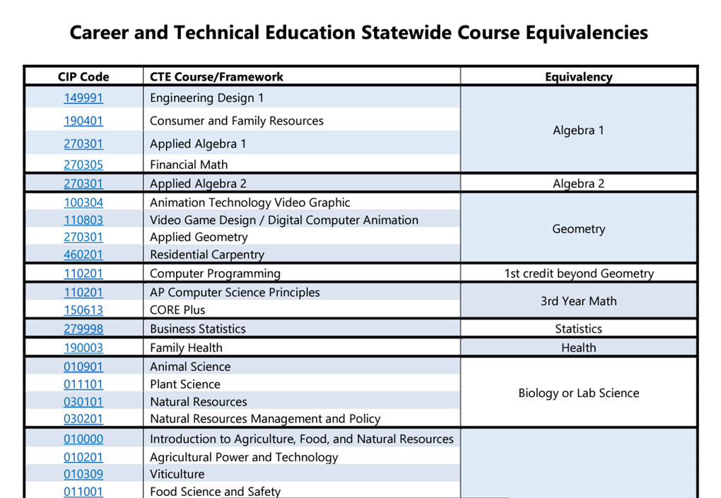
Examples of Equivalencies
There are more than 50 equivalencies approved between SBE and OSPI.
Full list as of May 2022
For More Info: Lisa.Fish@k12.wa.us
CTE Resources & Essentials
Added in 2021:
CIP 470616: Core Plus Maritime
CIP 011201: Soil Chemistry
CIP 030198: Climate Science Engineering and Technology
CIP 110201: Advanced Placement (AP) Computer Science Principles
CIP 130101: Careers in Education/Teacher Academy
CIP 270301: Applied Geometry
Notes:
Lisa- Equivalencies and the part they play with conjunction with CTE pathways, Dual credit, IRCs

Slide 31
Challenges & Opportunities
Areas for Immediate Consideration
Utilize functionality of ctcLink for registration and records
Standard approach to transcription
Align practices with NACEP
Inconsistency of practices across partners
Structured FAQ/guidance for CTE Dual Credit
Consistency of articulation/transferability within CTC system
Consistency of course equivalencies/eligibility
Data access/resource repository/regular communication
Need clarity of policies similar to CiHS and RS
Turn-over and vacancies in key positions
Instructor certification practices
Notes:
Tim
Themes and Common Needs Across our System
Data on credit utilization
To support articulation process, program administration, and student engagement
Collaboration between partners
To support state agencies, colleges, districts, and schools
Articulation guidance
To create consistent practices
To common understanding of which courses are eligible
Streamlined processes and options
To support students, their families, and reduce confusion

Slide 32
Poll
If you had to select ONE thing to be prioritized in the next year, what would it be?
Standardized Articulation Forms
State-Level Rule Changes for Consistency (Grading, Transcription, Curriculum Alignment, etc.)
Clarity on Courses Eligible for CTE Dual Credit
Improvements to SERS
Notes:
Tim

Slide 33
Our shared path forward
Convene an implementation committee from advisory committee membership and state partners
Shared leadership by SBCTC and OSPI
Create a charter and workplan to guide prioritization of efforts
Representative membership from CTE Dual Credit advisory committee and related agencies
Prioritize the issues – short, medium, long-term issues
Review FY22 legislation for dual credit possibilities
Exploring national model (NACEP)
Existing partnerships and relationships: OSPI, SBCTC, WSAC, ERDC, Core Plus, WA STEM, WCHSCR/ICRC, Career Connect Washington
Notes:
Bill

Slide 34
Questions & Contact Information
Contacts
William Belden, Policy Associate
wbelden@sbctc.edu
Kimberly Ingram, Program Administrator
kingram@sbctc.edu
Tim McClain, Dual Credit Program Supervisor
tim.mcclain@k12.wa.us
Notes:
All

Slide 35
Resources - SBCTC
Career and Technical Education (CTE) Dual Credit
SERS
CTE Dual Credit Consortia Contact Information
CTE Dual Credit Research Report
WA CTE Dual Credit Guidebook
CTE Dual Credit Resources
Programs/Course Articulations
Pathways and Program of Study (POS) Mapping
Data Collection/Reporting
Credit Transcription and Transfer
Recruitment and Advising
Tech Prep Email List - to join the CTE Dual Credit conversation

Slide 36
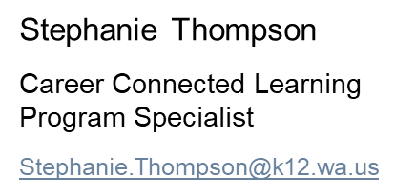
Resources - OSPI
Kickstarting College and Career Readiness by Eliminating Financial Barriers to Dual Credit
$12.96M/Year for CTE Dual Credit + IRCs
OSPI Bulletins
Bulletin B049-22: Running Start Updates (1.2 AAFTE/RSEVF/SQEAF)
Bulletin B055-22: Grant Award Reporting and Processes
Bulletin B072-22: Dual Credit Test Fee Program (AP/CI/IB + Low-Income Verification)
Guidance
Academic Acceleration Guidance
Legislative Reports
Summer Running Start Legislative Report (Coming Soon)
ERDC Legislative Report: Update on Dual Credit Programs
Updated FAQs
Running Start FAQ
College in the High School FAQ
Exam-Based Dual Credit Programs FAQ
New Staff

