Slide 1
ADA TITLE II WORK GROUP STATUS UPDATE FOR WACTC-TECH
“Accessibility: Essential for some, useful for all.”
~ W3C Web Accessibility Initiative
January 23, 2025
Monica Olsson, SBCTC Policy Associate Accessible IT Coordinator Carrie Powell, SBCTC PMO Team Project Manager
Notes:
Monica

Slide 2
Status: Completed (1 of 2)
October 11, 2024: ADA Title II Work Group formed for system-wide coordinated response to DOJ ADA Title II Web Accessibility ruling.
October 22, 2024: Distributed Issue Brief (attached) on DOJ Accessibility Compliance Deadlines.
November 1, 2024: Presented DOJ Ruling and Accessible IT (AIT) Coordinator Tracker Survey to Information Technology Commission. (ITC)
November 6, 2024: Attended Department of Enterprise Services (DES) sourcing kickoff to learn about RFP for statewide contract for document and PDF remediation. (Ongoing)

Slide 3
Status: Completed (2 of 2)
Nov 22 - Dec 3, 2024: Held conversations with educational technology stakeholders, including eLearning staff at Highline College and the SBCTC Educational Technology Advisory Group (ETAG) regarding the Ally Accessibility tool for Canvas.
December 31, 2024: All colleges responded to AIT Coordinator Tracker.
January 9, 2025: Invitations sent for AIT Coordinator Kickoff session on Friday, January 31, 2025.

Slide 4
Status: In Progress
Revitalize Mailman list for AIT Coordinators (AT-COORD listserv)
Collect and share system-wide baseline accessibility data
Survey: College Digital Accessibility Readiness Survey went out to all colleges on Thursday, Jan 9. Deadline Friday, Jan 24. Results will be shared with AIT Coordinators at Kickoff session Jan 31. Memo attached.
Prototype all-college dashboard for Ally Accessibility tool in Canvas.
Web Accessibility Tool Survey for college Web Administrators.
SBCTC Accessibility Task Force

Slide 5
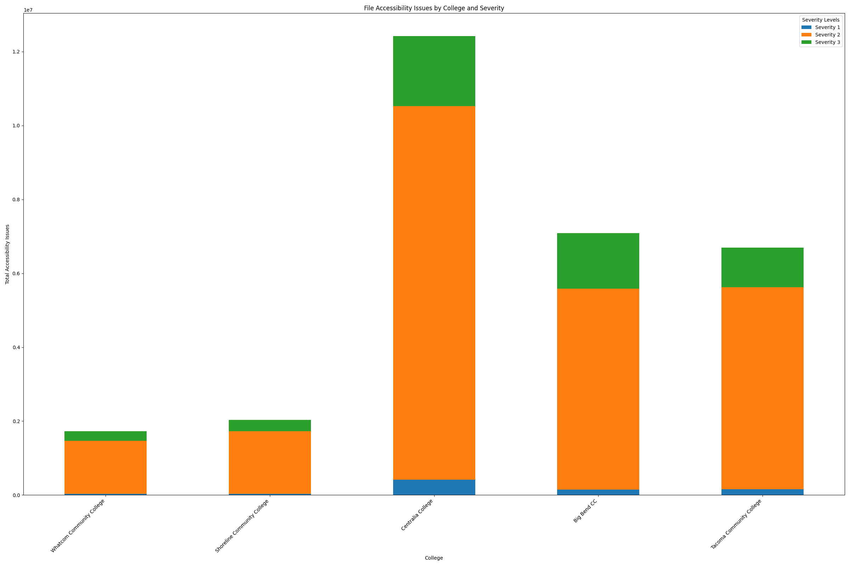
Sample ally

Slide 6
Status: UP NEXT
January 31, 2025: System-wide Accessible IT Coordinator Kickoff meeting.
February 6, 2025: Present Canvas Ally Accessibility dashboard prototype to eLearning Council (eLC) for discussion and feedback.
February 14, 2025: Q&A session with Rob Carr from WebAIM and guest attorney Judith Risch.

Slide 7
Gaps
Staff capacity, skillset, and funds for audit of third-party web and mobile applications.
Example: Over 200 unique applications across the system are used by faculty and students integrated into Canvas (LTI) with unknown levels of accessibility compliance.
Many colleges allow faculty control to add or edit LTI configurations in courses.

Slide 8
ADA TITLE II WORK GROUP
THANK YOU!
Questions?
Work Group Members: Monica Olsson molsson@sbctc.edu Andy Duckworth aduckworth@sbctc.edu Carrie Powell cpowell@sbctc.edu Kevin Bouwman kbouwman@sbctc.edu

